Slide 1
Using Assisted Registration in Communicare v14.8
Communicare Presentation
NOTE: All screen shots from Communicare indicate PCEHR. Any reference to the PCEHR or the My Health Record within this presentation are used interchangeably.
v1.2
31 March 2016

Slide 2
Assisted Registration
What is Assisted Registration?
Assisted registration was developed so that health service patients could create a My Health Record with support from those whose health and wellbeing guidance they trust the most.
By providing assisted registration you can help your patients sign up for a My Health Record before they leave the health service, so health professionals will be able to immediately begin uploading health information to their My Health Record.

Slide 3
Assisted Registration
What is Assisted Registration? [cont.]
Assisted Registration is one of five ways that health service patients can register for a My Health Record.
The five avenues include:
Online – by visiting www.myhealthrecord.gov.au
Over the phone – by calling 1800 723 471
In person – by visiting a Department of Human Services centre offering Medicare services
In writing – by completing an application form, available from a service centre offering Medicare services or from www.myhealthrecord.gov.au
Assisted Registration - by completing an Assisted Registration form with the aid of an authorised employee of a healthcare organisation

Slide 4
Assisted Registration
What is Assisted Registration? [cont.]
Assisted Registration offers patients a quick, personalised and well-informed registration experience.
This includes:
Quick – registration in just a few minutes, as a known customer or with photo ID and a Medicare Card
Personalised – face-to-face with people you trust so you can ask questions
Well-informed - accurate information from trained staff

Slide 5
Assisted Registration
Who can apply through Assisted Registration?
You can offer assisted registration to patients aged 14 or over
You can offer assisted registration to someone with parental responsibility for a minor, whose name also appears on their Medicare card
A child under 14 years of age who has their own Medicare card*
* This functionality is not currently available through Communicare

Slide 6
Assisted Registration
Who cannot apply through Assisted Registration?
You cannot offer assisted registration to any adult who does not have capacity
You cannot offer assisted registration to someone acting on behalf of an adult in their care

Slide 7
Using Assisted Registration in Communicare v14.8
Administration staff processes

Slide 8
Assisted Registration in Communicare
The Communicare assisted registration function can be accessed by any staff member who has system access rights to My Health Record Assisted Registration module
ONLY staff who have been authorised and under taken assisted registration training are legally authorised to register health service patients using Communicare assisted registration functionality.

Slide 9
Assisted Registration in Communicare
Select ‘Patient Biographics’

Slide 10
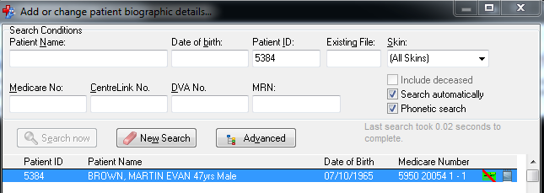
Assisted Registration in Communicare
Enter ‘Patient Name’ or ‘Patient ID’ to search for patient
Double click on ‘Patient Name’

Slide 11
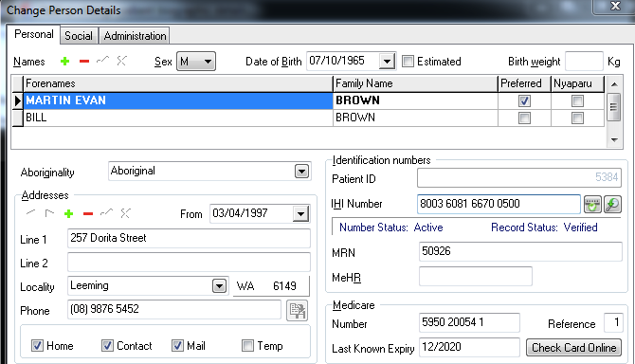
Assisted Registration in Communicare
Check patient ‘Medicare Number’ details are correct
Select ‘Check Card Online’
*If the Medicare Card is not valid you cannot proceed with Assisted registration

Slide 12
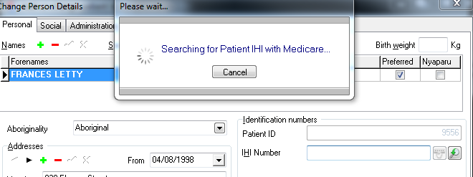
Assisted Registration in Communicare
A search with Medicare for the IHI number will occur. If a match is successful, an ‘IHI Number’ will be populated.

Slide 13
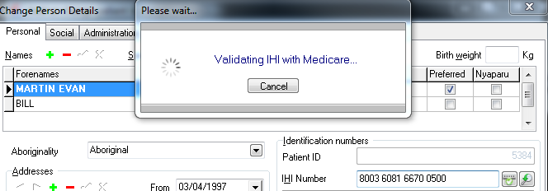
Troubleshooting Assisted Registration in Communicare
If the IHI number is shaded purple select ‘Verify IHI’
If the details in Communicare match the Medicare IHI information, the number will be validated and will no longer be shaded purple

Slide 14
Assisted Registration in Communicare
If a patient has a valid IHI and wishes to sign up for a My Health Record select ‘My Health Record Registration’
NOTE:
If the IHI was not verified and remains purple the patient will need to contact Medicare and check or update their details.
Once this has been done the Communicare details should also be updated to match Medicare and the IHI validation process undertaken again.

Slide 15
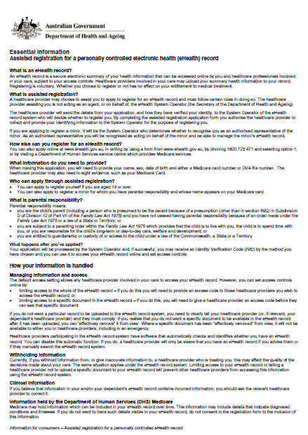
Assisted Registration
Patient should be Informed
With the use of the ‘Essential Information’ sheet, you should explain what the My Health Record is including benefits and legal requirements.
Each patient should be offered a copy
of the ‘Essential’ Information’ sheet to
read and keep should they wish.

Slide 16
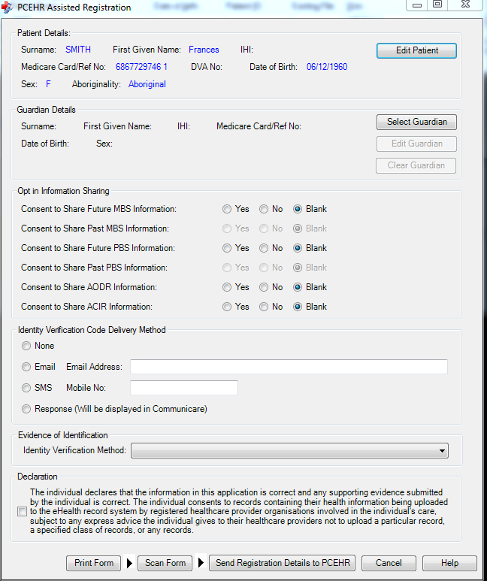
Assisted Registration in Communicare
The Assisted Registration screen will prepopulate with the patient details
Confirm the details are correct before proceeding

Slide 17
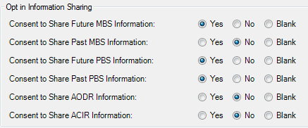
Assisted Registration in Communicare
Complete all boxes with patients answers to each question

Slide 18
Assisted Registration in Communicare
Identify how the patient would like to receive their IVC.
NOTE:
If ‘None’ is selected a My Health Record will still be generated and a patient may elect at a later date to request an IVC

Slide 19
Assisted Registration in Communicare
Select from the drop down menu which form of identification was used to identify the patient.

Slide 20
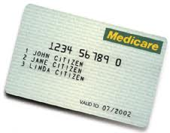
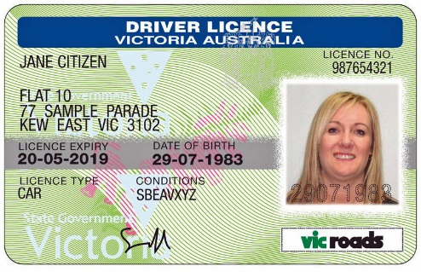
Assisted Registration
Identity Verified
The information required to have a patients identity verified include either:
via a known customer model; or
100 point ID check [e.g. Medicare
card and one piece of photo ID].

Slide 21
Assisted Registration in Communicare
Tick the ‘Declaration’ if the health service patient consents to the generation of a My Health Record to continue
Select ‘Print Form’ and have health service patient check all information is correct and then ensure they sign the completed form*
*New legislation does not require the patient sign the form, however, it is recommended the process of signing the form and retaining consent continues. You should abide by your health service Assisted Registration Policy.

Slide 22
Assisted Registration in Communicare
17. The form should be stored as per health service Assisted Registration Policy
18. Select ‘Send Registration Details to My Health Record’

Slide 23
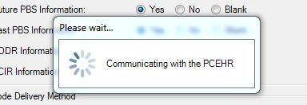
Assisted Registration in Communicare
The assisted registration will check and confirm the form is fully completed and will generate a My Health Record
If an IVC was requested it will be generated at this time also

Slide 24
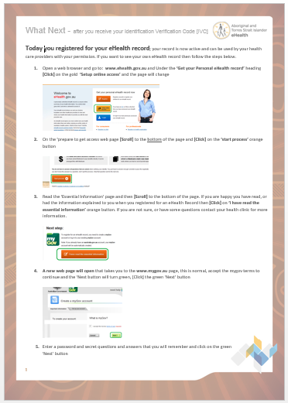
Assisted Registration
Registration
Next Steps
The staff member can provide the
patient with an Information pamphlet
‘What Next’ –after you receive your
Identification Verification Code [IVC]’
to assist in setting up online access
to their record.

Slide 25
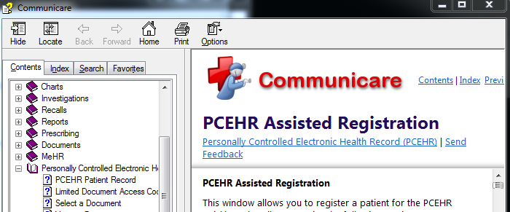
Assisted Registration in Communicare
If you require help simply select ‘Help’ to link you to the Communicare online help menu

Slide 26
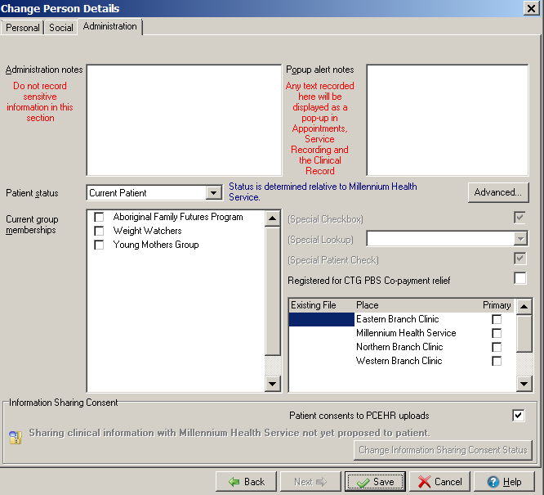
Assisted Registration in Communicare
Patient Consent for My Health Record Uploads
On the ‘Biographics’ page on the ‘Administration’ tab, there is a tick box ‘Patient consents to My Health Record uploads’.
If the patient gives their consent tick the box.
If a patient does not give their consent, ensure you leave the box unticked.
NOTE: This does not have to be ticked each time a patient comes in. It is done when a patient signs up for a record or prior to the first SHS being sent.

Slide 27
Presentation Close
Questions

