Slide 1
1606_Version 2.0
PowerPoint Presentation – For the Trainer
Orientation and Induction to CQI Learning Program
Module 1
Instructions for trainers
The learning module was developed by the ThinkThrough team led by Dr Sanchia Shibasaki and Dr Beverly Sibthorpe, with contributions from Dr Jacki Mein, Ms Kerry Copley, Ms Carolyn Renehan, Professor Ross Bailie, and Mr Alistair Harvey.
Notes:
Notes for the person delivering the Modules
This PowerPoint presentation is designed to support the person delivering the learning program to the learner(s). The presentations identify and describe the key points for each topic area. The presentations also support the trainer by incorporating information on adult learning principles, learning activities, and so on.

Slide 2
The following presentation consists of two parts. Please ensure you read the content on the slide and in the notes section.
Part 1: Instructions for those delivering the modules – slides 2 to 12
Part 2: Presentation for learning participants – slides 13 onwards
Instructions for the trainer are written in the notes section
When delivering the module, we recommend you print the presentation in notes pages format.
It is highly recommended that those delivering the Orientation and Induction Modules are familiar with the Professional Development Course Outline for CQI and the Learning Manuals.

Slide 3
The learning manuals and PowerPoint presentations are designed to be tailored or customised to your workplace. As such, you may replace videos, images, words and so on. You may add examples that are reflective of your organisation, situation, and process.

Slide 4
When tailoring the modules, it is recommended that you ensure the quality of content and the intended outcome of the tool is maintained and where relevant consistent with the National CQI Framework for Aboriginal and Torres Strait Islander Primary Health Care.

Slide 5
Learning Programs for CQI
The Orientation and Induction Learning Program:
Is one of six learning programs in the Professional Development Course Outline for CQI (refer to the Professional Development Course Outline)
Maps to nine CQI competencies, includes a set of learning outcomes, and provides information such as key references to support the development of learning tools
Learning programs are designed to build on each other.

Slide 6
Orientation and Induction Learning Program
Provides foundational knowledge and skills to prepare learners for work in CQI in primary health care and as such, the content focusses on broad CQI topics
Consists of three modules.
Whether all three modules are delivered in one day or delivered separately is left to the discretion of the workplace.

Slide 7
Orientation and Induction Learning Program
It is recommended that this learning program is delivered at your workplace as part of the overall orientation and induction to the workplace. The program may be delivered to a group or on a one-to-one basis.

Slide 8
Criteria for delivering the modules
Those involved in the delivery of learning programs should ideally have:
A thorough working knowledge of the relevant learning programs and able to interpret and apply the learning programs to different contexts and audiences
Thorough knowledge and skills in adult learning principles
The ability to ‘unpack’ learning outcomes – read notes below.
Notes:
Criteria for the Development and Delivery of Learning Programs
Those involved in the development and delivery of learning programs should ideally have:
A thorough working knowledge of the relevant learning programs and be able to interpret and apply the learning programs to different contexts and audiences
Thorough knowledge and skills in adult learning principles
The ability to ‘unpack’ learning outcomes:
a) to reflect basic building blocks of topics and concepts. For example, the unpacking of what is a performance indicator should cover the basic building blocks such as what is measurement, what is an indicator, and so on
b) to reflect requirements of the AQF levels. For example, the learning module content for a learning outcome at AQF Level 1 should reflect the requirements of this level and so on
c) to reflect the different levels of learning such as knowledge, comprehension, application, analysis, synthesis, and evaluation. At the foundational level (knowledge) learning participants should be able to recall or recognise information, ideas, and principles. As such, learning outcome terms such as describe, define, list and so on are used (e.g. Describe a PDSA cycle). As participants progress through learning levels, the learning outcome terms should reflect this progression for example, give examples of implementing a PDSA cycle (comprehension) or facilitate the uptake of PDSA cycles in primary health care services (application) and so on.

Slide 9
Criteria for delivering the modules
Consultation with individuals with relevant expertise in the learning program content and with representatives from the adult learning sector and industry sector to identify training and learning needs and knowledge gaps
Capacity and capability to customise learning content and delivery to meet the work environment and learning styles of the target audience (i.e. contextualise). In all cases of customising content, the integrity of the outcome of the learning program must be maintained.
Notes:
Criteria for the Development and Delivery of Learning Programs
Those involved in the development and delivery of learning programs should ideally have:
Consultation with individuals with relevant expertise in the learning program content and with representatives from the adult learning sector and industry sector to identify training and learning needs and knowledge gaps
Capacity and capability to customise learning content and delivery to meet the work environment and learning styles of the target audience (i.e. contextualise). In all cases of customising content, the integrity of the outcome of the learning program must be maintained. The authors of the learning manuals and PowerPoint presentations acknowledge there is significant variation and diversity between Aboriginal and Torres Strait Islander peoples, communities and community controlled primary health care services. This variation and diversity has implications on the type of terms used and the differing interpretations of terms. For the purposes of this learning module, several terms are used to be consistent with terms used in the Vocational Education and Training sector and to be adaptable to individual and group contexts. For example, the term ‘client’ is used in lieu of ‘patient’ to describe individuals who may be interested in using the service; individuals that live in the service catchment area and/or patients. The term ‘learning’ is used where possible to describe training. As mentioned above, your organisation may customise learning content and delivery to meet the work environment and learning styles of the target audience (i.e. contextualise). In all cases of customising content, the integrity of the outcome of the learning program must be maintained.

Slide 10
Criteria for delivering the modules
Adopt a reflective and narrative based approach to CQI; e.g. opportunities to describe experiences in applying CQI and to discuss what works, what didn’t work, and contribute personal opinions
Assess and monitor the quality of learning and training using processes such as a CQI training group that includes experts with relevant knowledge of the learning topic; adult learning; and the industry sector.
Notes:
Criteria for the Development and Delivery of Learning Programs
Those involved in the development and delivery of learning programs should ideally:
Adopt a reflective and narrative based approach to CQI; e.g. opportunities to describe experiences in applying CQI and to discuss what works, what didn’t work, and contribute personal opinions
Assess and monitor the quality of learning and training using processes such as a CQI training group that includes experts with relevant knowledge of the learning topic; adult learning; and the industry sector.

Slide 11
In preparation for the delivery of this module
Identify language, literacy, and numeracy needs for learners and adjust learning approach and tools as needed
Familiarise yourself with the learning manual, PowerPoint presentation and notes, and any associated materials
Tailor group discussions and tasks to the learners’ workplace and role
Review the timing of sessions and base the length and number of sessions on the requirements of the learner’s workplace and the learner
Check the organisation setting – available space, layout, access to computers, internet, YouTube
Review the PowerPoint presentation and associated resources such as YouTube links (check if links are still current)
Decide what tasks you want learners to complete (based on their knowledge, skills and relevance to their job and tasks)
Find relevant information learners may need (e.g., blank forms, policies, instruction manuals)
Discuss any changes to the learning and training resources with the registered owner.

Slide 12
On the day …
Confirm front desk / reception are aware of the training and the location – organise appropriate signage if required
Check room layout
Assess OH&S
Check room temperature – adjust ventilation and/or air conditioning
Check water, cups, refreshments
Open PowerPoint presentation
Write name and contact details on the whiteboard
Organise forms – record of attendance, evaluation forms
If required, complete OH&S hazard identification and risk assessment form
Check availability of markers, butchers paper, stationary (pens, notepaper, sticky notes)
Check access to computer, internet, YouTube.

Slide 13
End of Notes

Slide 14
Orientation and Induction to CQI Learning Program
Module 1
The learning module was developed by the ThinkThrough team led by Dr Sanchia Shibasaki and Dr Beverly Sibthorpe, with contributions from Dr Jacki Mein, Ms Kerry Copley, Ms Carolyn Renehan, Professor Ross Bailie, and Mr Alistair Harvey.
Notes:
Acknowledgements – refer to the section in the learning manual titled ‘Acknowledgements’.

Slide 15
Welcome
Welcome to the learning journey for CQI
Acknowledgement of Country and Traditional Owners
Introduction of trainer.
Notes:
Welcome
Introduce yourself – refer to the whiteboard or PowerPoint presentation where you have written your name and contact details
Acknowledgement of Country, Traditional Owners and Elders
If applicable – provide information about your service or organisation.

Slide 16
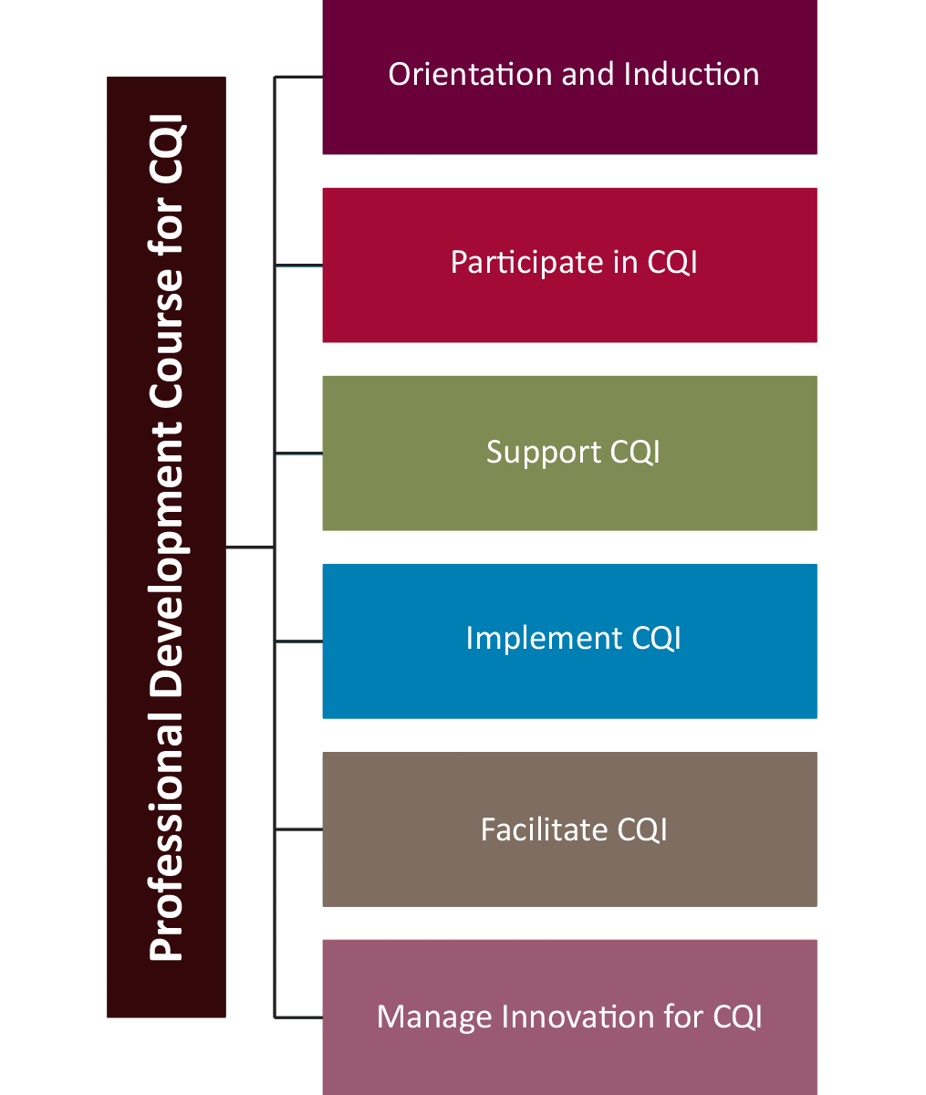
About the CQI Learning Programs
Based on a Professional Development Course Outline for CQI that aligns to the Australian Qualifications Framework (AQF)
Six learning programs – build on each other.
Notes:
Ask participants the following questions and encourage a group discussion – there are no right or wrong answers
What is the purpose of orientation and induction?
What is involved in an orientation and induction?
What do participants expect from this orientation and induction?
The key messages to highlight to participants are the following:
The Orientation and Induction to CQI is a professional development learning program for all staff, board members and others working in Aboriginal and Torres Strait Islander primary health care services.
The Orientation and Induction learning program provides the foundational knowledge and skills to prepare you for work in continuous quality improvement in primary health care and as such, the content focusses on broad CQI topics.
The Orientation and Induction learning program was developed based on a professional development course outline for CQI that aligns to the Australian Qualifications Framework. A benefit aligning this program to the AQF is it allows those who complete the program to be considered for recognised prior learning.
The Orientation and Induction to CQI Learning Program is one of six learning programs in the professional development of CQI package.
The learning programs build on each other so as you progress through the Professional Development Course Outline for CQI, each learning programs will provide further exploration and detailed discussions of concepts and topics.

Slide 17
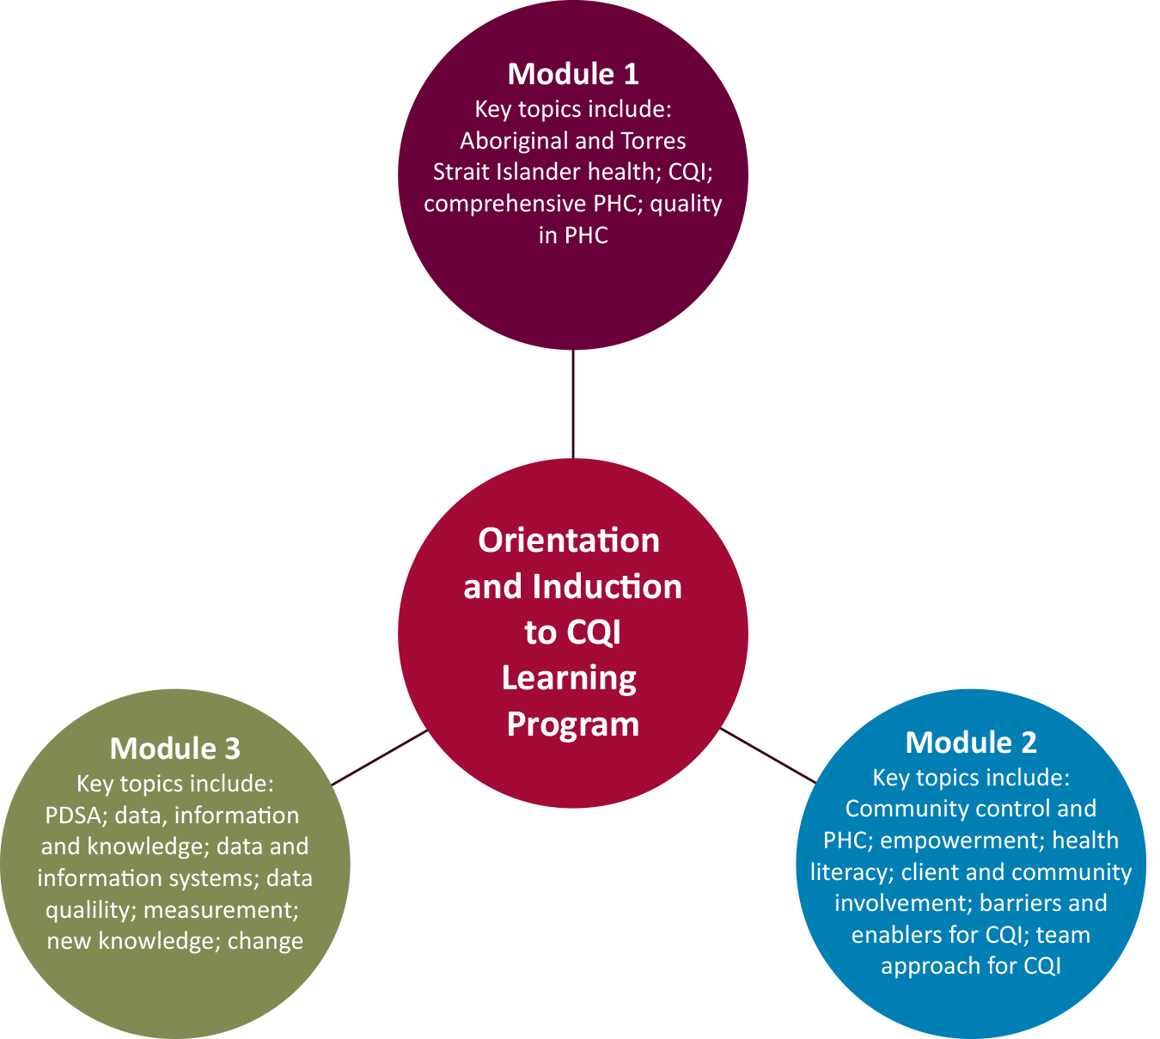
About Orientation and Induction to CQI
Is a professional development learning program for all staff, Board members and others working in Aboriginal and Torres Strait Islander primary health care services
Made up of three modules.
Notes:
Provide information about the Orientation and Induction to CQI Learning Program:
The program is a professional development learning program
The program is for all staff, Board members and others working in Aboriginal and Torres Strait Islander primary health care services
Made up of 3 modules (refer to the diagram and highlight that this training session covers Module 1).

Slide 18
Orientation and Induction to CQI Modules
Provide foundational knowledge and skills to prepare you for work in continuous quality improvement (CQI) in primary health care.
Notes:
Provide information about the Orientation and Induction to CQI Learning Program:
It is recommended the Orientation and Induction to CQI Learning Program is delivered as part of the organisation’s orientation and induction process as it provides foundational knowledge and skills to prepare you for work in continuous quality improvement (CQI) in primary health care.

Slide 19
Icebreaker
Notes:
If applicable – insert an icebreaker here or ask participants to introduce themselves to each other and then to the group.
The purpose of this icebreaker is for participants to introduce themselves to the group and to each other.

Slide 20
Learning outcomes
Define CQI
Describe the history of CQI and its uptake in primary health care
Describe the common characteristics of CQI
Define comprehensive primary health care
Identify the National Aboriginal and Torres Strait Islander Health Plan 2013–2023 and Implementation Plan
Identify the National CQI Framework for Aboriginal and Torres Strait Islander Primary Health Care 2015–2025
Identify the role and drivers of quality in primary health care
Notes:
Highlight – support for language, literacy, and numeracy: advise participants if they require support or assistance with language, reading, writing and/or using numbers, to let you know so that you can identify ways to support their learning needs.
Learning outcomes – On completion of Module 1, participants should be able to (read through learning outcomes – continued to next slide)

Slide 21
Learning outcomes
Identify the principal internal and external mechanisms of quality management in primary health care
Define clinical governance
Describe the key attributes of clinical governance
Identify what is meant by a population health approach in primary health care
Identify the main social and cultural determinants of health for Aboriginal and Torres Strait Islander people.
Notes:
Continue to read through learning outcomes.
Repeat support for language, literacy, and numeracy: advise participants if they require support or assistance with language, reading, writing and/or using numbers, to let you know so that you can identify ways to support their learning and training needs.
Ask group if anyone has any learning needs
Ask candidates about their knowledge of the topics or subjects
Ask if participants have any questions, queries or concerns?

Slide 22
Session Outline
Learning program tools
Learning manual
PowerPoint presentation
Other handouts
Include group and individual tasks, individual self-reflection, videos.
Notes:
Provide information to participants about the session outline:
Learning program tools and other handouts (if relevant),
Description of learning activities: individual and group tasks, times for self reflection, videos and so on
If you have an agenda – refer to the agenda
Describe how long the session will go for and break times.

Slide 23
What do we know about Aboriginal and Torres Strait Islander health?
Source: YouTube video - https://youtu.be/miU9Tr-V80k
Notes:
Begin with a discussion or task to capture and hook the participants attention. Your hook might be a set of questions or you might start with a Youtube video (as shown in this slide), icebreaker or some other activity that is relevant and appropriate for your group
Example of questions:
Why do we want to work in Aboriginal and Torres Strait Islander primary health care?
How do we know if what we are doing is working?
The purpose of this short video is to provide some information about what we know (from the National Aboriginal and Torres Strait Islander health survey) about Aboriginal and Torres Strait Islander health and to set the scene for CQI.
The YouTube video is embedded into the slide – press on the play button. If the video fails to load, enter the following URL into your web browser: https://youtu.be/miU9Tr-V80k
Link the next section to the video. Highlight messages relevant to this learning module such as:
The survey findings demonstrates that Aboriginal and Torres Strait Islander people require good access to quality primary health care services
The survey findings provides valuable information for policy makers, service providers and others about what they need to do to improve health outcomes.
So as highlighted in the video, ongoing access to quality health services is one important contributor to improving the health and wellbeing of Aboriginal and Torres Strait Islander people (AIHW 2011). Addressing such differences in health outcomes requires widespread action at multiple levels (this means at the national, state and territory, and local levels) of government and organisational and community action.
Highlight this section focusses on the broader topic of why CQI is important to Aboriginal and Torres Strait Islander health. In terms of delving down and discussing levels of responsibility for CQI for example at the national level the role and responsibility for CQI is this and at the state and territory level the role and responsibility for CQI is that – this information is expected to be covered in the other learning programs such as participate in CQI, support CQI and so on. However, if participants are interested in this level of details – make reference to the National CQI Framework for Aboriginal and Torres Strait Islander primary health care.

Slide 24
Aboriginal and Torres Strait Islander health
Notes:
Why CQI for Aboriginal and Torres Strait Islander health? The YouTube video provides us with some information about why CQI is important for Aboriginal and Torres Strait Islander health. But let us first recognise, acknowledge and understand the following:
Definition of Aboriginal health
Diversity of Aboriginal and Torres Strait Islander people
Health and wellbeing outcomes
Social determinants of health
Cultural determinants of health.
Refer to the learning manual for notes on the above topics

Slide 25
Learning Activity
Notes:
Please note – at the time of developing this resource the National CQI Framework for Aboriginal and Torres Strait Islander Primary Health Care 2015-2025 was in the process of being finalised and formally released. It is important trainers review this information and update.
Do a search on your web browser for the National CQI Framework for Aboriginal and Torres Strait Islander Primary Health Care 2015-2025
What is the overarching vision of the National CQI Framework for Aboriginal and Torres Strait Islander Primary Health Care 2015-2025?
Answer: Aboriginal and Torres Strait Islander people receive the highest attainable standard of primary health care wherever and whenever they seek care.
What are the essential building blocks for embedding CQI in primary health care?
Answer: There are fifteen building blocks considered essential for embedding CQI in everyday practice at the local level. These are the Framework core components. In total, they comprise the essentials but not necessarily the totality of what is needed to build an integrated system for high quality primary health care for Aboriginal and Torres Strait Islander people.
For those are interested in who and what are the roles and responsibilities at each level for embedding CQI in Aboriginal and Torres Strait Islander primary health care – add a question in here and ask participants to refer to the section in the Framework that addresses this topic.

Slide 26
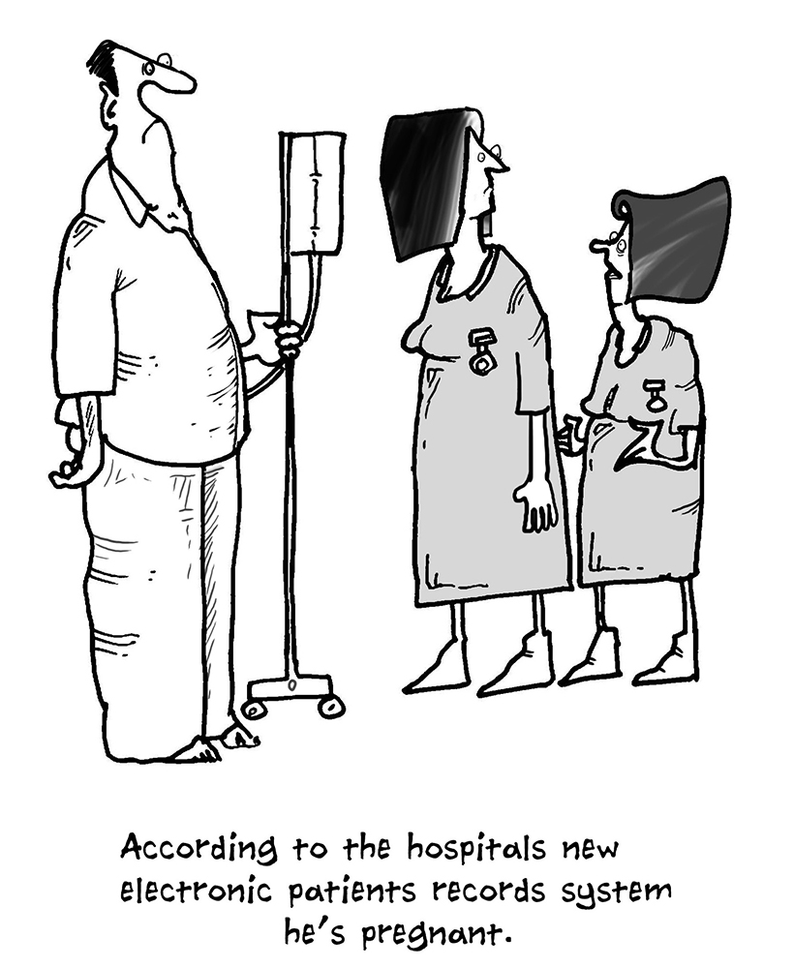
What is CQI?
Source: Cartoonstock https://www.cartoonstock.com/directory/h/hospital.asp (hospital cartoon 9 of 3267)
Notes:
Begin with a discussion or task to capture and hook the participants attention. Your hook might be a set of questions, a cartoon (as shown in this slide), a Youtube video, icebreaker or some other activity that is relevant and appropriate for your group.
Read the blurb at the bottom of the cartoon
Example of questions:
Ask participants if they’ve experienced a situation where there was a mix up with their patient information?
How did they react?
What was the outcome of this event?
Link the slide to CQI – the purpose of CQI is to address problems like the cartoon.

Slide 27
What is CQI?
Short for Continuous Quality Improvement.
Continuous, forward looking, process of ongoing learning and sharing.
Ask the following questions
Can we do better?
How are we doing?
How can we do better?
Notes:
Refer to the slide
CQI is …..
Highlight to participants that CQI also requires a ‘no-blame’ or blame free approach - No blame is where individuals are able to identify and report problems without fear of reprimand or punishment.

Slide 28
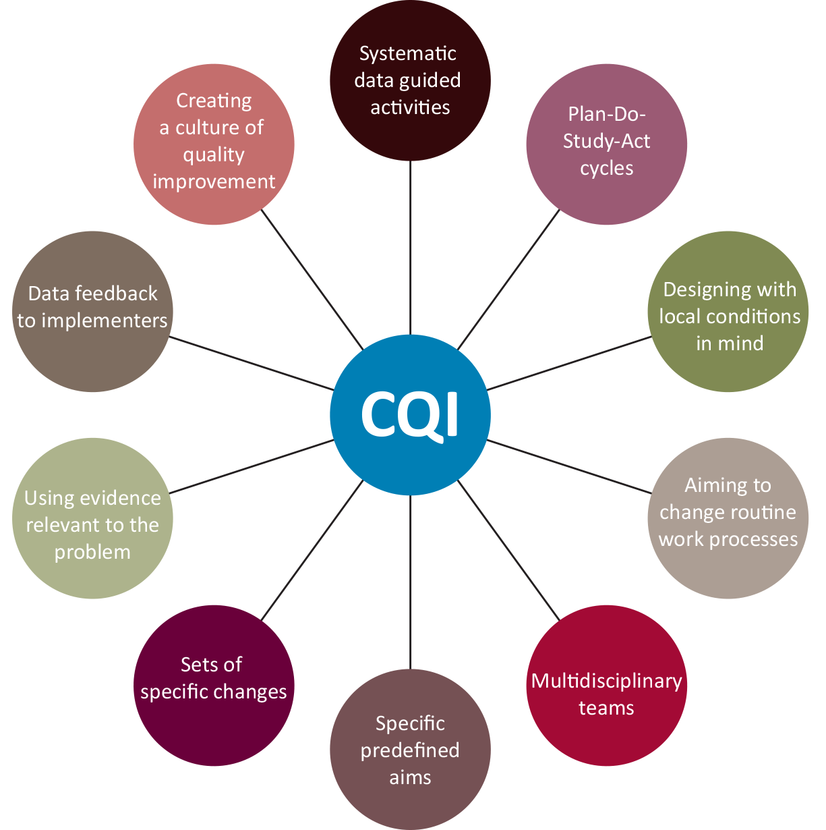
Common characteristics of CQI
Notes:
Here are some common characteristics of CQI.
Describe each characteristic and where relevant provide an example (Rubenstein et al, 2013)
Systematic data guided activities – Uses systematic data-guided activities (e.g. aims and measures) to achieve improvement
Plan–Do–Study–Act cycles – Involves an iterative (more than one cycle) development and testing process such as PDSA Designing with local conditions in mind – Uses available previously established evidence relevant to the target QI problem or goal (e.g. evidence-based care models or behavioural change strategies)
Aiming to change routine work processes – Aims to change how routine or daily care work processes are organised, structured or designed
Multidisciplinary teams – Designed and/or carried out by multidisciplinary teams that include members from the target organisations/communities
Specific predefined aims – Seeks to achieve specific pre-identified aims, targets or outcomes
Sets of specific changes –The initiative seeks to implement a set of specific changes in order to embed improvements in routine or daily care work processes
Using evidence relevant to the problem – Uses available previously established evidence relevant to the target QI problem or goal (e.g. evidence-based care models or behavioural change strategies)
Data feedback to implementers – Involves feedback of data (e.g. quantifiable performance measures/benchmarks) to initiative designers and/or implementers
Creating a culture of quality improvement – Seeks to create a culture or mindset of quality improvement
Encourage participants to also provide examples.

Slide 29
German Coast Guard
Source: https://www.youtube.com/yR0lWICH3rY
Notes:
The YouTube video is embedded into the slide – click on the play button. If the video fails to load, enter the following URL into your web browser: https://youtu.be/yR0lWICH3rY

Slide 30
German Coast Guard
Imagine you are the coast guard. As a team you’ve watched the replay. Answer the following questions:
How did we do?
Could we have done better?
How could we have done better?
Discuss what does ‘no blame’ mean.
Notes:
Ask participants to answer the questions as it relates to the video
Invite participants to share their responses
When you have completed step 1, ask participants to reflect on an activity in the workplace and to apply the questions to the activity
Invite participants to share their responses
When you have completed this task – CONGRATULATE the individual or group – Well done!!! You’ve started a CQI cycle
3. Discuss what does ‘no blame’ mean. No blame is where individuals are able to identify and report problems without fear of reprimand or punishment.

Slide 31
What is comprehensive primary health care?
Primary health care is socially appropriate, universally accessible, scientifically sound first level care provided by health services and systems with a suitably trained workforce comprised of multi-disciplinary teams supported by integrated referral systems in a way that: gives priority to those most in need and addresses health inequalities; maximises community and individual self-reliance, participation and control; and involves collaboration and partnership with other sectors to promote public health. Comprehensive primary health care includes health promotion, illness prevention, treatment and care of the sick, community development, and advocacy and rehabilitation.
(PHCRIS 2016)
Notes:
Aboriginal and Torres Strait Islander people need good access to both Aboriginal and Torres Strait Islander-specific and mainstream primary health care that is comprehensive.
So what is comprehensive primary health care and primary health care? – invite a participant/s to read aloud the definition
Emphasise comprehensive primary health care approach in Aboriginal Community Controlled Health Services (ACCHSs) is broader in scope than the above definition – i.e. in addition to primary clinical care and preventive and health promotion activity, ACCHSs usually include education and development in relation to workforce training, and governance and community capacity building (Wakerman, Humphreys et al. 2008).

Slide 32
Population health
Population health is defined as “the health of a population as measured by health status indicators and as influenced by social, economic and physical environments, personal health practices, individual capacity and coping skills, human biology, early childhood development, and health services”.
(Dunn & Hayes 1999)
Notes:
Primary health care takes a population health approach.
So what is population health? Population health is defined as “the health of a population as measured by health status indicators and as influenced by social, economic and physical environments, personal health practices, individual capacity and coping skills, human biology, early childhood development, and health services” (Dunn & Hayes 1999).

Slide 33
Population health
Population health focuses on understanding health and disease in community, and on improving health and well-being through priority health approaches addressing the disparities in health status between social groups.
(AIHW 2016)
Notes:
Primary health care takes a population health approach.
Population health is focused on understanding health and disease in community, and on improving health and well-being through priority health approaches addressing the disparities in health status between social groups (AIHW 2016). It considers the social and cultural determinants of health and wellbeing including history, culture, housing, education, employment and safety including racism.

Slide 34
Population health and CQI
Population focus
Individual focus
Source: http://www.safetyandquality.gov.au/wp-content/uploads/2015/07/Infographic-Health-literacy-in-Australia.jpg
Notes:
So how is this relevant to CQI?
A population health approach in CQI focuses on groups of clients and community members, rather than individuals, in terms of their needs, access, care and outcomes.
Highlight the slide shows populations at a national level. Populations or groups of people can also be as follows – next slide.

Slide 35
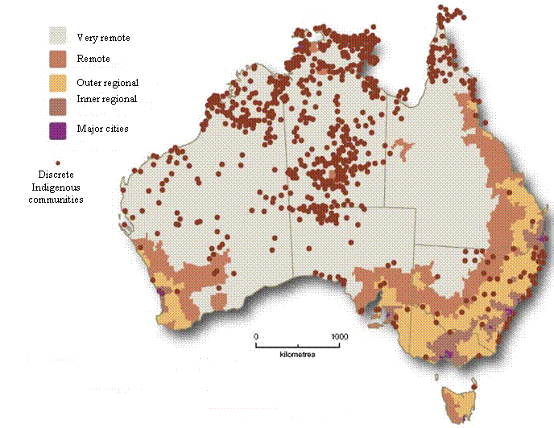
Population health and CQI
Source: http://www.aph.gov.au/~/media/wopapub/senate/committee/indig_ctte/reports/2008/report1/c02_1_gif.ashx
Notes:
State or territory level – population of people born in Queensland living in New South Wales
Regional level – population of people that live in the Pilbara aged 12 to 17 years
Local level – population of older people that access the local primary health care service.
The map on this slide shows the discrete indigenous populations or communities in Australia. As you can see – you can zoom in to focus on states and territories and regions.
Check in with your participants:
Be alert to changes in individual and/or group attention, body language and emotion
Respond to changes in emotions or group dynamics such as loss of attention, group chatter and so on by introducing a short break or asking for feedback about the topic – are participants familiar with these topics would they like you to move on? Are the topics difficult to understand – do they require further explanation or discussion?

Slide 36
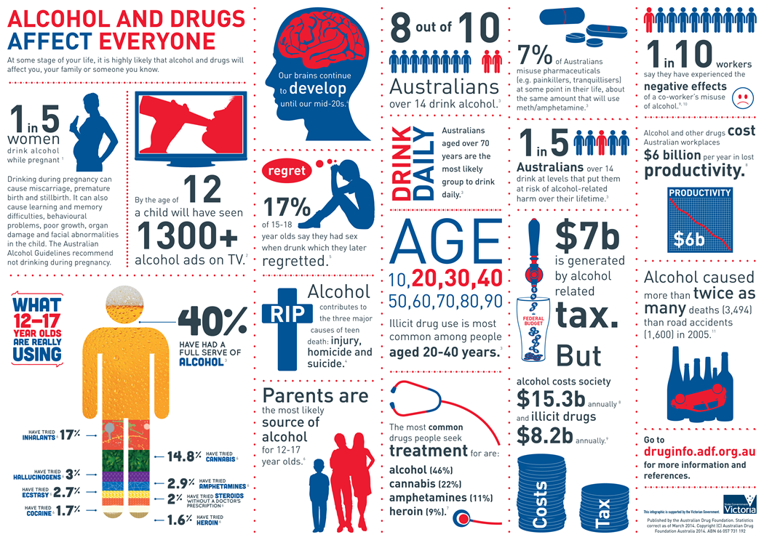
Learning activity
Source: http://www.druginfo.adf.org.au/attachments/article/1489/15A934_AU_DrugFoundation.pdf
Notes:
Ask participants to look at the infographic: Alcohol and Drugs Affect Everyone
Take this opportunity to explain to participants that an infographic is a visual representation of information or data, e.g. as a chart or diagram. Explain what this infographic is about and that if focusses on populations
Ask participants (in pairs or small groups) to answer the questions:
Illicit drug use is most common in what population age group?
Answer: 20 to 40 years (show participants where to find the answer on the infographic)
2. What proportion of Australians misuse pharmaceuticals?
Answer: 7% of Australians (show participants where to find the answer on the infographic)
3. What group is most likely the source of alcohol for 12 – 17 year olds?
Answer: Parents are the most likely source of alcohol for 12 – 17 year olds (show participants where to find the answer on the infographic)
4. How could CQI in primary health care address this issue?
Answer: go back to the questions - How did we do? Could we have done better? How could we have done better? You could start asking these questions about screening for alcohol and other drugs.

Slide 37
Before we move forward let’s look back
Source: Price, M. 2014. The Story of Improvement and the Role of Culture and Standards. TMI Enterprises. http://www.slideshare.net/MarkLeeson/mike-price-the-story-of-improvement-and-the-role-of-culture-and-standards
Notes:
Most of today’s quality improvement methods were developed in industry and adapted for use in other sectors, such as health.
The roots of quality improvement approaches can be traced back to the thinking about production quality control that emerged in the early 1920s. Pioneers for quality improvement include (Refer to the slide): Walter A. Shewhart, W. Edwards Deming, Joseph M. Juran, Armand Feigenbaum, and Kaoru Ishikawa (Chassin & O’Kane 2010, The Health Foundation 2013).

Slide 38
CQI is now a global approach for improving health care quality
Started moving away from looking and assessing past health care activities – known as quality assurance
Began using proactive and forward looking methods like CQI
Why? - Based on the idea that improving the service as a whole (that is the service system) and steps in providing care (that is care processes) in a continuous ongoing manner can lead to better outcomes.
Notes:
Quality improvement was first introduced into health care in the 1980s
Healthcare organisations started moving away from looking and assessing past health care activities such as care processes and outcomes. This type of assessment is known as quality assurance.
Healthcare organisations began using proactive and forward looking methods like CQI based on the idea that improving the service as a whole (that is the service systems) and steps in providing care (that is care processes) in a continuous ongoing manner can lead to better outcomes.
CQI has now evolved as a global approach for improving health care quality (Colton 2000, Johnson and Sollecito 2013, The Lowitja Institute 2015).

Slide 39
Drivers and mechanisms of quality in PHC
Quality Umbrella
CQI
Accreditation
nKPI
Notes:
CQI Programs are a part of a broader family of activities and initiatives that operate under an umbrella known as ‘quality’. Quality activities and initiatives, such as quality planning, quality control, quality assurance, and quality improvement, aim to improve the overall delivery of health care. In Aboriginal and Torres Strait Islander primary health care, quality activities include CQI, accreditation, and national reporting against key performance indicators (i.e. performance reporting) – (Refer to the umbrella).
CQI differs from both accreditation and performance reporting in that it is internally assessed as opposed to externally assessed (The Lowitja Institute 2015).

Slide 40
Mechanisms to embed quality activities into PHC services
Internal
Compliance with relevant legislation such as Commonwealth, state and territory Acts and laws
Professional registration and accreditation
Organisational policy and procedures
Accreditation
Clinical governance
CQI
Key performance indicator reporting.
Notes:
The internal mechanisms to embed quality activities into PHC includes – refer to slide.

Slide 41
Mechanisms to embed quality activities into PHC services
External
Key policy drivers
Government payments to GPs and pharmacists as incentives for particular quality improvements (e.g. the Practice Incentives Payment [PIP] for GPs, and
Quality standards.
Notes:
The external mechanisms to embed quality activities into PHC includes – refer to slide.

Slide 42
Aboriginal and Torres Strait Islander Health
Source: https://www.youtube.com/watch?v=bc6gj8gPfpk
Notes:
The YouTube video is embedded into the slide – click on the play button. If the video fails to load, enter the following URL into your web browser: https://youtu.be/bc6gj8gPfpk
Drivers are the factors or components of a system that influence the achievement of the aim are called “drivers”
The drivers to embed quality into health care is primarily due to
increased client and community expectations and
increased recognition that CQI is a global approach for improving health care quality and that this leads to better outcomes.

Slide 43
Learning Activity
Source: http://www.health.gov.au/natsihp
Notes:
Do a search on your web browser for
National Aboriginal and Torres Strait Islander Health Plan 2013–2023 (cover on the left – http://www.health.gov.au/natsihp)
Implementation Plan for the National Aboriginal and Torres Strait Islander Health Plan 2013–2023 (cover on the right – http://www.health.gov.au/natsihp)
What are the overarching goals of the Plans?
Health Plan: Overarching goal is targeted, evidence-based action that will contribute to achieving equality of health status and life expectancy between Aboriginal and Torres Strait Islander people and non-Indigenous Australians by 2031 (one of the six Closing the Gap targets)
Implementation Plan: Address the broad changes needed to make the health system more comprehensive, culturally safe and effective.
2. What are the priorities for health enablers? – refer to the following slide.

Slide 44
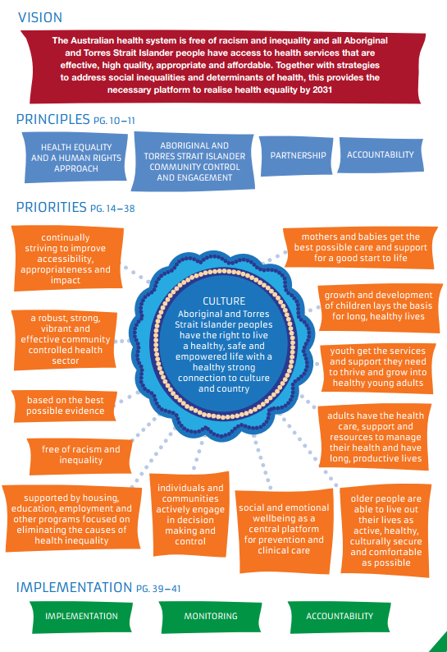
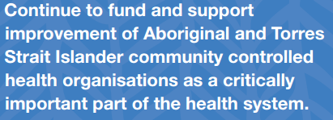
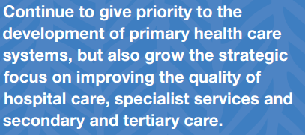
Image source: National Aboriginal and Torres Strait Islander Health Plan 2013–2023, Commonwealth of Australia.
Notes:
2. What are the priorities for health nablers? – the priorities for Health Enablers are the orange boxes. So what does this have to do with CQI? The priority circled in green is underpinned by the following strategies (blue boxes to the right). As shown, quality improvement is central to improving health outcomes. This is an example how external mechanisms like policy help to embed quality activities into Aboriginal and Torres Strait Islander primary health care.

Slide 45
So how does CQI link to other quality activities?
Clinical Governance
CQI
Organisational Governance
Image source: http://www.dreamstime.com/royalty-free-stock-images-eggs-nest-image4596439 (adapted)
Notes:
As shown on this slide - CQI is a process nested within clinical governance that is in turn nested within organisational governance (The Lowitja Institute 2014).
Organisational governance involves the mechanisms, processes and relations by which organisations are controlled and directed.
Clinical governance involves formal structures and processes that attend to corporate (Board) and organisational governance and leadership, workforce capacity and competence, clinical leadership, clinical integration and coordination, clinical monitoring and evaluation including CQI, and client and community participation (Institute for Urban Indigenous Health 2012).
Clinical governance is the mechanism that links organisational governance and management with clinical care, and accreditation with CQI.

Slide 46
Clinical governance is defined as, ‘system by which the governing body, managers and clinicians share responsibility and are held accountable for client care, for minimising risks to [clients], and for continuously monitoring and improving the quality of clinical care’ (Australian Council on Health Care Standards 2004)
Clinical Governance
CQI
Organisational Governance
Image source: http://www.dreamstime.com/royalty-free-stock-images-eggs-nest-image4596439 (adapted)
Notes:
Clinical governance is defined as, ‘system by which the governing body, managers and clinicians share responsibility and are held accountable for client care, for minimising risks to [clients], and for continuously monitoring and improving the quality of clinical care’ (Australian Council on Health Care Standards 2004).
Through clinical governance, Boards and senior managers and clinicians can act as champions and opinion leaders to drive a whole of organisation approach to quality including CQI.

Slide 47
Elements of clinical governance:
Education
Clinical audit
Clinical effectiveness (evidence-based practice)
Risk management
Research and development, and
Openness. (RACGP 2010)
Clinical Governance
CQI
Organisational Governance
Image source: http://www.dreamstime.com/royalty-free-stock-images-eggs-nest-image4596439 (adapted)
Notes:
Clinical governance is defined as, ‘system by which the governing body, managers and clinicians share responsibility and are held accountable for client care, for minimising risks to [clients], and for continuously monitoring and improving the quality of clinical care’ (Australian Council on Health Care Standards 2004).
Through clinical governance, Boards and senior managers and clinicians can act as champions and opinion leaders to drive a whole of organisation approach to quality including CQI.

Slide 48
CQI is not accreditation
CQI | Accreditation
Focuses on improving client care and outcomes | Focuses on improving organisational and clinical administration
Determined by local needs and priorities | Determined by national and international consensus
Internally assessed | Externally assessed
Prospective and ongoing review | Retrospective review
Data for dialogue | Data for certification
Measures, including quality indicators, with changeable targets | Sets of standards
Results vary over time | Yes/no result
Short cycles | Long cycles
(Sibthorpe, Gardner et al. 2015)
Notes:
Accreditation is the formal process in which certification of competency or credibility is achieved. In practice the accreditation of ACCHSs provides formal recognition and credit that quality standards, processes and systems are being maintained (AMSANT 2016).
While both are concerned with quality, as shown on this slide, there are several differences between CQI and accreditation.
Go through and point out the differences .
Check in with your participants:
Be alert to changes in individual and/or group attention, body language and emotion
Respond to changes in emotions or group dynamics such as loss of attention, group chatter and so on by introducing a short break or asking for feedback about the topic – are participants familiar with these topics would they like you to move on? Are the topics difficult to understand – do they require further explanation or discussion?

Slide 49
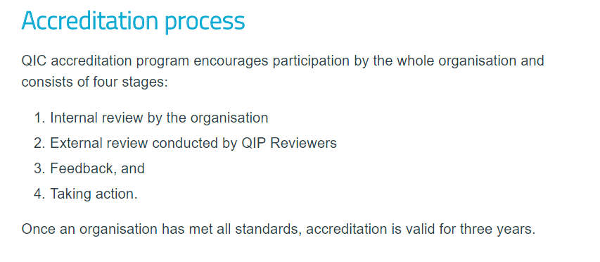
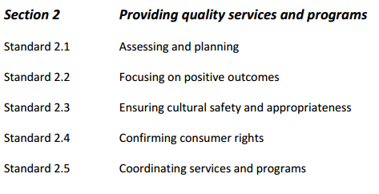
CQI is not accreditation
Source: http://www.qip.com.au/standards/quality-improvement-council-qic-health-and-community-services-standards/
Notes:
Accreditation is the formal process in which certification of competency or credibility is achieved.
In practice the accreditation of ACCHSs provides formal recognition and credit that quality standards, processes and systems are being maintained (AMSANT 2016).
Refer to slide – areas circled in red – accreditation is externally assessed; use of a set of standards (example of standards from QIP); accreditation is valid for three years – long cycle.

Slide 50
CQI is not nKPI reporting
CQI | Performance Reporting
Quality internally assessed | Performance externally assessed
Data for dialogue and action | Data for external accountability (+/- ranking and league tables)
Data published internally, shared among networks | Data published by external agencies
Quality indicators +/- informal, changeable targets and benchmarks | Performance indicators +/- official, fixed targets and benchmarks
Addresses any health issue | Addresses only priority health issues
Incentives: Quality of care and outcomes Clinical and client satisfaction Collegial competition between clinicians and services Service reputation | Incentives: Earned autonomy Access to competitive funds Pay for performance
(Sibthorpe, Gardner et al. 2015)
Notes:
A key performance indicator is a type of measure to understand how a service or program is doing in regard to a set of defined goals and objectives. Both performance reporting and CQI play an important role in improving quality in health service delivery. However, there are several differences between the two systems as highlighted on this slide (Sibthorpe, Gardner et al. 2015).
While both are concerned with quality, as shown on this slide, there are several differences between CQI and nKPIs for performance reporting.
Go through and point out the differences.
Check in with your participants:
Be alert to changes in individual and/or group attention, body language and emotion
Respond to changes in emotions or group dynamics such as loss of attention, group chatter and so on by introducing a short break or asking for feedback about the topic – are participants familiar with these topics would they like you to move on? Are the topics difficult to understand – do they require further explanation or discussion?

Slide 51
Learning activity
1. Is your service accredited? If yes, please describe the type of accreditation and standards
What are the National Key Performance Indicators for Aboriginal and Torres Strait Islander primary health care?
Does your ACCHS participate in any CQI activities?
Notes:
Is your Service accredited? If yes, please describe the type of accreditation and standards
Clinical accreditation:
Royal Australian College of General Practitioners (RACGP) Standards for General Practice.
Organisational Accreditation/Certification:
Quality Improvement Council (QIC) Health and Community Standards
International Organization for Standardization (ISO) Health: Quality Management Systems
Evaluation and Quality Improvement Program (EQuIP) - Australian Council on Healthcare Standards
What are the National Key Performance Indicators for Aboriginal and Torres Strait Islander primary health care?
Go to the following link at AIHW: http://www.aihw.gov.au/indigenous-primary-health-care-nkpi/
Does your ACCHS participate in any CQI activities? Ask participants to share their experiences with the group.
Describe the problem
Describe who was involved
Describe what they did
Describe the outcome
Describe the ACCHS approach to a no-blame or blame free CQI activity.
Check in with your participants:
Be alert to changes in individual and/or group attention, body language and emotion
Respond to changes in emotions or group dynamics such as loss of attention, group chatter and so on by introducing a short break or asking for feedback about the topic – are participants familiar with these topics would they like you to move on? Are the topics difficult to understand – do they require further explanation or discussion?

Slide 52
Summarise and reflect
Notes:
For this session you may:
Go back to the learning outcome slides and review each one with participants,
Select key topics and discuss them,
Do a Q and A, or
Group discussion about CQI and quality management.

Slide 53
Closing
Complete:
Record of participation
Evaluation form.
Notes:
In closing:
Thank participants
Spend time completing relevant forms
Remind participants of your contact details.

