Slide 1
1606_Version 2.0
PowerPoint Presentation – For the Trainer
Orientation and Induction to CQI Learning Program
Module 2
Instructions for trainers
The learning module was developed by the ThinkThrough team led by Dr Sanchia Shibasaki and Dr Beverly Sibthorpe, with contributions from Dr Jacki Mein, Ms Kerry Copley, Ms Carolyn Renehan, Professor Ross Bailie, and Mr Alistair Harvey.
Notes:
Notes for the person delivering the Modules
This PowerPoint presentation is designed to support the person delivering the learning program to the learner(s). The presentations identify and describe the key points for each topic area. The presentations also support the trainer by incorporating information on adult learning principles, learning activities, and so on.

Slide 2
The following presentation is consists of two parts. Please ensure you read the content on the slide and in the notes section.
Part 1: Instructions for those delivering the modules – slides 2 to 12
Part 2: Presentation for learning participants – slides 13 onwards
Instructions for the trainer are written in the notes section
When delivering the module, we recommend you print the presentation in notes pages format.
It is highly recommended that those delivering the Orientation and Induction Modules are familiar with the Professional Development Course Outline for CQI and the Learning Manuals.

Slide 3
The learning manuals and PowerPoint presentations are designed to be tailored or customised to your workplace. As such, you may replace videos, images, words and so on. You may add examples that are reflective of your organisation, situation, and process.

Slide 4
When tailoring the modules, it is recommended that you ensure the quality of content and the intended outcome of the tool is maintained and, where relevant, consistent with the National CQI Framework for Aboriginal and Torres Strait Islander Primary Health Care.

Slide 5
Learning programs for CQI
The Orientation and Induction Learning Program:
One of six learning programs in the Professional Development Course Outline for CQI (refer to the Professional Development Course Outline)
Maps to nine CQI competencies, includes a set of learning outcomes, and provides information such as key references to support the development of learning tools
Learning programs are designed to build on each other.

Slide 6
Orientation and Induction Learning Program
Provides foundational knowledge and skills to prepare learners for work in continuous quality improvement in primary health care and as such, the content focusses on broad CQI topics
Consists of three modules. The delivery of the modules for example all modules delivered in one whole day session or modules delivered separately is left to the discretion of the workplace.

Slide 7
Orientation and Induction Learning Program
It is recommended this learning program is delivered at your workplace as part of the overall orientation and induction to the workplace. The program may be delivered to a group or on a one to one basis.

Slide 8
Criteria for delivering the modules
Those involved in the delivery of learning programs should ideally have:
A thorough working knowledge of the relevant learning programs and be able to interpret and apply the learning programs to different contexts and audiences
Thorough knowledge and skills in adult learning principles
Ability to ‘unpack’ learning outcomes – read notes below
Notes:
Criteria for the Development and Delivery of Learning Programs
Those involved in the development and delivery of learning programs should ideally have:
Thorough working knowledge of the relevant learning programs and be able to interpret and apply the learning programs to different contexts and audiences
Thorough knowledge and skills in adult learning principles;
Ability to ‘unpack’ learning outcomes
to reflect basic building blocks of topics and concepts. For example, the unpacking of what is a performance indicator should cover the basic building blocks such as what is measurement, what is an indicator, and so on;
to reflect requirements of the AQF levels. For example, the learning module content for a learning outcome at AQF Level 1 should reflect the requirements of this level and so on
to reflect the different levels of learning such as knowledge, comprehension, application, analysis, synthesis, and evaluation. At the foundational level (knowledge) learning participants should be able to recall or recognise information, ideas, and principles. As such, learning outcome terms such as describe, define, list and so on are used (e.g. Describe a PDSA cycle). As participants progress through learning levels, the learning outcome terms should reflect this progression for example, give examples of implementing a PDSA cycle (comprehension) or facilitate the uptake of PDSA cycles in primary health care services (application) and so on.

Slide 9
Criteria for delivering the modules
Consultation with individuals with relevant expertise in the learning program content and with representatives from the adult learning sector and industry sector to identify training and learning needs and knowledge gaps
Capacity and capability to customise learning content and delivery to meet the work environment and learning styles of the target audience (i.e. contextualise). In all cases of customising content, the integrity of the outcome of the learning program must be maintained.
Notes:
Criteria for the Development and Delivery of Learning Programs
Those involved in the development and delivery of learning programs should reflect the following criteria (continued):
Consultation with individuals with relevant expertise in the learning program content and with representatives from the adult learning sector and industry sector to identify training and learning needs and knowledge gaps
Capacity and capability to customise learning content and delivery to meet the work environment and learning styles of the target audience (i.e. contextualise). In all cases of customising content, the integrity of the outcome of the learning program must be maintained. The authors of the learning manuals and power point presentations acknowledge there is significant variation and diversity between Aboriginal and Torres Strait Islander peoples, communities and community controlled primary health care services. This variation and diversity has implications on the type of terms used and the differing interpretations of terms. For the purposes of this learning module, several terms are used to be consistent with terms used in the Vocational Education and Training sector and to be adaptable to individual and group contexts. For example, the term ‘client’ is used in lieu of ‘patient’ to describe individuals who may be interested in using the service; individuals that live in the service catchment area and/or patients. The term ‘learning’ is used where possible to describe training. As mentioned above, your organisation may customise learning content and delivery to meet the work environment and learning styles of the target audience (i.e. contextualise). In all cases of customising content, the integrity of the outcome of the learning program must be maintained.

Slide 10
Criteria for delivering the modules
Adopt a reflective and narrative based approach to CQI (e.g. opportunities to describe experiences in applying CQI and to discuss what works, what didn’t work, and contribute personal opinions)
Assess and monitor the quality of learning and training using processes such as a CQI training group that includes experts with relevant knowledge of the learning topic; adult learning; and the industry sector.
Notes:
Criteria for the Development and Delivery of Learning Programs
Those involved in the development and delivery of learning programs should reflect the following criteria (continued):
Adopt a reflective and narrative based approach to CQI (e.g. opportunities to describe experiences in applying CQI and to discuss what works, what didn’t work, and contribute personal opinions)
Assess and monitor the quality of learning and training using processes such as a CQI training group that includes experts with relevant knowledge of the learning topic; adult learning; and the industry sector.

Slide 11
In preparation for the delivery of this module
Identify language, literacy, and numeracy needs for learners and adjust learning approach and tools as needed
Familiarise yourself with the learning manual, power point presentation and notes, and any associated materials
Tailor group discussions and tasks to the learners’ workplace and role
Review the timing of sessions and base the length and number of sessions on the requirements of the learner’s workplace and the learner
Check the organisation setting – available space, layout, access to computers, internet, YouTube
Review the PowerPoint presentation and associated resources such as YouTube links (check if links are still current)
Decide what tasks you want learners to complete (based on their knowledge, skills and relevance to their job and tasks)
Find relevant information learners may need (e.g., blank forms, policies, instruction manuals)
Discuss any changes to the learning and training resources with the registered owner.

Slide 12
On the day …
Confirm front desk / reception are aware of the training and the location – organise appropriate signage if required
Check room layout
Assess OH&S
Check room temperature – adjust ventilation and/or air conditioning
Check water, cups, refreshments
Open PowerPoint presentation
Write name and contact details on the whiteboard
Organise forms – record of attendance, evaluation forms
If required, complete OH&S hazard identification and risk assessment form
Check availability of markers, butchers paper, stationary (pens, notepaper, sticky notes)
Check access to computer, internet, YouTube.

Slide 13
End of Notes

Slide 14
Orientation and Induction to CQI Learning Program
Module 2
The learning module was developed by the ThinkThrough team led by Dr Sanchia Shibasaki and Dr Beverly Sibthorpe, with contributions from Dr Jacki Mein, Ms Kerry Copley, Ms Carolyn Renehan, Professor Ross Bailie and Mr Alistair Harvey.
Notes:
Acknowledgements – refer to the section in the learning manual titled ‘Acknowledgements’.

Slide 15
Welcome
Welcome to the learning journey for CQI
Acknowledgement of Country and Traditional Owners
Introduction of trainer.
Notes:
Welcome
Introduce yourself – refer to the whiteboard or PowerPoint presentation where you have written your name and contact details
Acknowledgement Country, Traditional Owners and Elders
If applicable – provide information about your service or organisation.

Slide 16
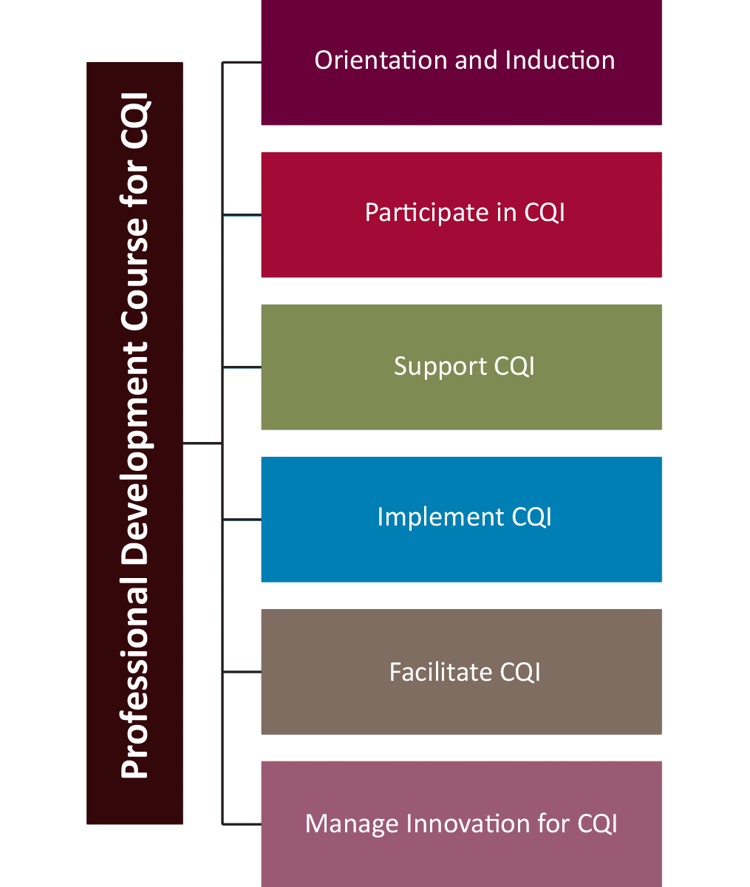
About the CQI Learning Programs
Based on a Professional Development Course Outline for CQI that aligns to the Australian Qualifications Framework (AQF)
Six learning programs – build on each other.
Notes:
Ask participants the following questions and encourage a group discussion – there are no right or wrong answers
What is the purpose of orientation and induction?
What is involved in an orientation and induction?
What do participants expect from this orientation and induction?
The key messages to highlight to participants are the following:
The Orientation and Induction to CQI is a professional development learning program for all staff, Board members and others working in Aboriginal and Torres Strait Islander primary health care services.
The Orientation and Induction learning program provides the foundational knowledge and skills to prepare you for work in continuous quality improvement in primary health care and as such, the content focusses on broad CQI topics.
The Orientation and Induction learning program was developed based on a professional development course outline for CQI that aligns to the Australian Qualifications Framework. A benefit aligning this program to the AQF is it allows those who complete the program to be considered for recognised prior learning.
The Orientation and Induction to CQI Learning Program is one of six learning programs in the professional development of CQI package.
The learning programs build on each other so as you progress through the Professional Development Course Outline for CQI, each learning programs will provide further exploration and detailed discussions of concepts and topics.

Slide 17
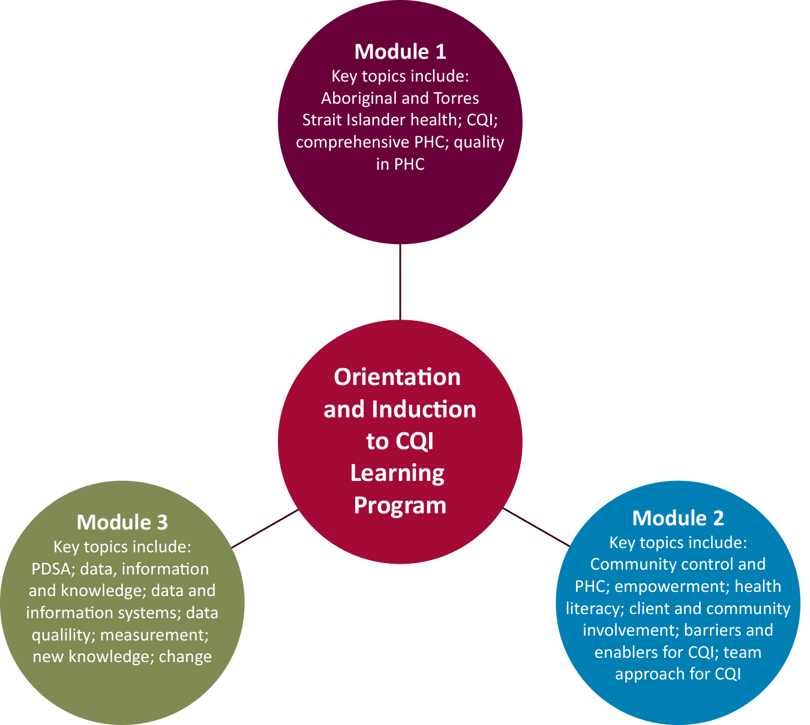
About Orientation and Induction to CQI
Is a professional development learning program for all staff, Board members and others working in Aboriginal and Torres Strait Islander primary health care services
Made up of three modules.
Notes:
Provide information about the Orientation and Induction to CQI Learning Program:
The program is a professional development learning program
The program is for all staff, board members and others working in Aboriginal and Torres Strait Islander primary health care services
Made up of 3 modules – refer to the diagram and highlight that this training session covers Module 2.

Slide 18
Orientation and Induction to CQI Modules
Provide foundational knowledge and skills to prepare you for work in continuous quality improvement (CQI) in primary health care.
Notes:
Provide information about the Orientation and Induction to CQI Learning Program:
It is recommended the Orientation and Induction to CQI Learning Program is delivered as part of the organisation’s orientation and induction process as it provides foundational knowledge and skills to prepare you for work in continuous quality improvement (CQI) in primary health care.

Slide 19
Icebreaker
Notes:
If applicable – insert an icebreaker here or ask participants to introduce themselves to each other and then to the group.
The purpose of this icebreaker is for participants to introduce themselves to the group and to each other.

Slide 20
Learning outcomes
Define community control
Define primary health care as system and process
Identify the main primary health care service structures and processes
Define empowerment
Define health literacy
Describe the roles of the client and community in CQI
Identify organisational policies and procedures that apply to client and community engagement in primary health care
Notes:
Highlight – support for language, literacy, and numeracy: advise participants if they require support or assistance with language, reading, writing and/or using numbers, to let you know so that you can identify ways to support their learning and training needs.
Learning outcomes – On completion of Module 2, participants should be able to (read through learning outcomes – continued to next slide).

Slide 21
Learning outcomes
Identify the main organisational barriers and enablers for CQI
Define team and teamwork
Identify and describe organisational roles and responsibilities for CQI
Describe own role and responsibility as it applies to CQI within an organisation
Describe the key enablers and barriers to teamwork in CQI
Describe the key principles of working with people of different ages, gender, race, religion or political persuasion.
Notes:
Continue to read through learning outcomes.
Repeat support for language, literacy, and numeracy: advise participants if they require support or assistance with language, reading, writing and/or using numbers, to let you know so that you can identify ways to support their learning and training needs.
Ask group if anyone has any learning needs
Ask candidates about their knowledge of the topics or subjects
Ask if participants have any questions, queries or concerns?

Slide 22
Session outline
Learning program tools
Learning manual
PowerPoint presentation
Other handouts
Include group and individual tasks, individual self-reflection, videos.
Notes:
Provide information to participants about the session outline:
Learning program tools and other handouts (if relevant),
Description of learning activities: individual and group tasks, times for self reflection, videos and so on
If you have an agenda – refer to the agenda
Describe how long the session will go for and break times.

Slide 23
Review of Module 1
Notes:
Briefly reflect on topics discussed in Module 1
Be useful to have a copy of Module 1: Learning Manual and PowerPoint presentation. Based on your participant’s learning needs you may:
Provide an overview of the topics,
Ask participants to identify topics from Module 1 that they want to discuss before moving onto Module 2, or
Identify topics relating to Module 1 and briefly discuss each with the group.

Slide 24
Where am I?
Primary Health Care
Source: Bean man -
https://cdn2.vox-cdn.com/thumbor/93Yaxs7y3Tb8tzFfppyRsSn_yN8=/1020x0/cdn0.voxcdn.com/uploads/chorus_asset/file/2509782/confused_man.0.jpg (adapted)
Notes:
Begin with a discussion or task to capture and hook the participants attention.
Your hook might be a set of questions or you might start with a YouTube video, icebreaker or some other activity that is relevant and appropriate for your group
Example of questions:
Tell me about the organisation you work in – what is its core business, what does it do, who does it service, who else works there and what are their roles
Describe the industry you work in – what other services are in this industry, what do these services do…

Slide 25
Aboriginal Community Controlled Health Services (ACCHSs)
ACCHSs are one type of primary health care model
An incorporated Aboriginal organisation
Initiated by a local Aboriginal community
Based in a local Aboriginal community
Governed by an Aboriginal body which is elected by the local Aboriginal community
Delivering a holistic and culturally appropriate health service to the community which controls it. (NACCHO 2014)
Notes:
ACCHSs are a type of primary health care model.
An Aboriginal Community Controlled Health Service is:
An incorporated Aboriginal organisation
Initiated by a local Aboriginal community
Based in a local Aboriginal community
Governed by an Aboriginal body which is elected by the local Aboriginal community
Delivering a holistic and culturally appropriate health service to the community which controls it. (NACCHO 2014)

Slide 26
Aboriginal Community Controlled Health Services
In 2015, there were over 150 ACCHSs across the country.
The ACCHS sector comprises local, and in some areas regional, organisations and is supported by state/territory peak bodies and NACCHO, which are very active in sector and service development and advocacy.
ACCHSs provide services to an estimated 51% (2011–12) of the Aboriginal and Torres Strait Islander population.
(NACCHO 2014)
Notes:
ACCHSs are a type of primary health care model.
An Aboriginal Community Controlled Health Service is:
An incorporated Aboriginal organisation
Initiated by a local Aboriginal community
Based in a local Aboriginal community
Governed by an Aboriginal body which is elected by the local Aboriginal community
Delivering a holistic and culturally appropriate health service to the community which controls it. (NACCHO 2014)

Slide 27
Learning activity
Source: https://youtu.be/P1tiYB5EWE8
Notes:
The YouTube video is embedded into the slide – click on the play button. If the video fails to load, enter the following URL into your web browser: https://youtu.be/P1tiYB5EWE8. Note – although the screen is blank the video will load once the slide presentation is up and running.
Refer to the learning activity in the manual:
Identify and describe three ‘meanings’ from the video Answer: Here are some of the ‘meanings’ shown on people’s palms: empowerment, customs, education, healthy futures, people. Ask the group to identify others that you have not listed.

Slide 28
PHC as system and processes
The first level of contact individuals, families and communities have with the health care system
A type of model or sector that has different governance, funding, administrative and workforce arrangements such the ACCHS sector, general practices and state and territory government funded clinics
The type of services and programs offered and delivered, for example, comprehensive primary health care.
Notes:
There are several ways to describe primary health care such as:
The first level of contact individuals, families and communities have with the health care system;
A type of model or sector that has different governance, funding, administrative and workforce arrangements such the ACCHS sector, general practices and state and territory government funded clinics
The type of services and programs offered and delivered, for example, comprehensive primary health care.

Slide 29
Primary health care (PHC)
Services, clinics or practices can also be described as
system and processes
Notes:
Primary health care services, clinics or practices can also be described as a system and processes.
A system may range from very simple to very complex. Generally speaking, there are numerous types of system. For example, there are biological systems, ecological systems, and social systems. Systems have inputs, processes, outputs and outcomes, with ongoing feedback among these various parts. If one part of the system is removed or changed, the nature of the whole system is changed.

Slide 30
Systems
Source: https://youtu.be/auSo1MyWf8g
Notes:
The YouTube video is embedded into the slide – click on the play button. If the video fails to load, enter the following URL into your web browser: https://youtu.be/auSo1MyWf8g
Describe the system in this video
Describe some factors that may effect the balance of this system
Is it possible to have systems within a system? If so, give an example based on this video.

Slide 31
PHC service as a system
Components include:
People (e.g. human resources)
Money (e.g. financial systems)
Buildings and equipment (e.g. infrastructure)
Computers and software (e.g. technology systems) and so on.
Changes in one part or parts of the system will affect the system as a whole.
Image source: Clock Gears http://comps.canstockphoto.com/can-stock-photo_csp16241535.jpg
Notes:
As a system, the primary health care service, practice or clinic, consists of components or parts that interact with each other to achieve an overarching goal. These components include people (e.g. human resources), money (e.g. financial systems), buildings and equipment (e.g. infrastructure), computers and software (e.g. technology systems) and so on. Changes in one part or parts of the system will affect the system as a whole.

Slide 32
CQI and system
CQI views the service, practice or clinic, as a system made up of interconnecting parts
A change to one part of the organisation will affect the organisation as a whole.
Image source: http://cdn.grid.fotosearch.com/CSP/CSP991/k12244274.jpg
Notes:
CQI requires us to move beyond thinking about what we have in front of us. CQI requires us to ‘zoom out’ and to view the service, practice or clinic, as a system made up of interconnecting parts. A manager and team that makes a change to one part of the organisation will affect the organisation as a whole.
Highlight to participants that CQI also requires a ‘no blame’ or blame-free approach – ‘No blame’ is where individuals are able to identify and report problems without fear of reprimand or punishment.

Slide 33
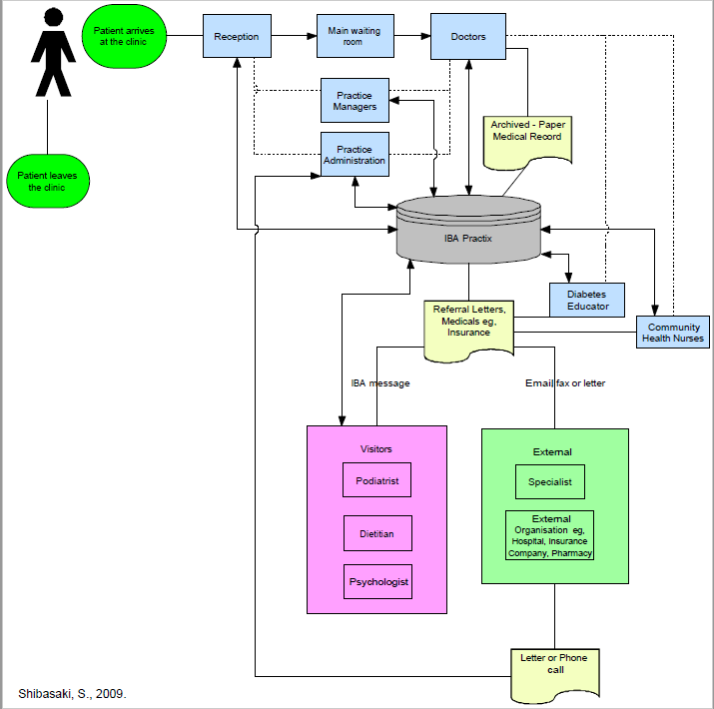
PHC service as processes
Notes:
In terms of processes, there are many processes involved in primary health care. For example, there are processes for making appointments, doing health assessments, making diagnoses, and so on. There are many activities that make up these processes. CQI requires us to look at activities and to chunk them up into steps. A change in one process or step will create a ripple effect to other parts of the process.
Learning Activity:
What are the components in your primary health care service? Answer: Components may include people (e.g. human resources), money (e.g. financial systems), buildings and equipment (e.g. infrastructure), computers and software (e.g. technology systems) and so on.
Reflect on your role. Describe the processes you may be involved in. Answer: the processes identified should relate to the role e.g. receptionist – appointment making or answering the phone; health worker – screening or health assessments and so on
Imagine you arrive to work one day and find that the whole appointment making processes has changed. What other parts of the system may be effected by this change? Answer: Other parts of the system that may effected by this change includes human resources (e.g. new responsibilities for existing roles or new roles to support new tasks); finance (e.g. change to appointment process may change processes for billing and Medicare) and so on.
Check in with your participants:
Be alert to changes in individual and/or group attention, body language and emotion
Respond to changes in emotions or group dynamics such as loss of attention, group chatter and so on by introducing a short break or asking for feedback about the topic – are participants familiar with these topics would they like you to move on? Are the topics difficult to understand – do they require further explanation or discussion?

Slide 34
PHC
Source: https://youtu.be/Oqnmg2qKhDo
Notes:
The YouTube video is embedded into the slide – click on the play button. If the video fails to load, enter the following URL into your web browser: https://youtu.be/Oqnmg2qKhDo
The aim of this video is to highlight the following:
The complexity of the Australian healthcare system
The systems within the Australian health care system – primary health care is one system
The processes within the Australian health care system.

Slide 35
Client and community involvement in CQI
Are at the centre of the health system
There decisions and actions are a vital component for ensuring that society achieves good health outcomes and safe and high-quality health care (National Health and Hospitals Reform Commission 2009)
Influence by the individuals’ ability to make decisions and have control over their personal life (empowerment)
Their own skills, capacities and knowledge; and by the environments in which these actions are taken (health literacy).
Notes:
Clients and communities are at the centre of the health system, and the decisions that they make and the actions that they take are a vital component for ensuring that society achieves good health outcomes and safe and high-quality health care (National Health and Hospitals Reform Commission 2009).
The way in which clients and communities make decisions and take action about health and health care is influenced by the individuals’ ability to make decisions and have control over their personal life (empowerment) and their own skills, capacities and knowledge; and by the environments in which these actions are taken (health literacy).

Slide 36
Client and community involvement in CQI
What is good care?
Notes:
Clients, carers and the community play an important role in CQI because they are the only people who really experience the patient pathway from start to finish and can, if effectively tapped into as a knowledge base provide key insights into: ‘What is good care?’

Slide 37
Client and community involvement in CQI
Associated with improved health outcomes (Bath & Wakerman 2013)
Where there was a lot of client and community participation that is where community members are actively involved in determining priorities and implementing solutions there appears to be an association with improved:
Health outcomes (Sare & Kirby 1999, Hancock et al. 2001, Nikniaz & Alizadeh 2007, Draper et al. 2010 ),
Service quality (Uddin et al. 2001)
Access (Tyrrell et al. 2003).
Notes:
A small but significant body of evidence demonstrates client and community participation in primary health care is associated with improved health outcomes (Bath and Wakerman 2013). In activities where there was a lot of client and community participation (i.e. where community members are actively involved in determining priorities and implementing solutions), there appears to be an association with improved health outcomes (Sare and Kirby 1999, Hancock, Sanson-Fisher et al. 2001, Nikniaz and Alizadeh 2007, Draper, Hewitt et al. 2010 ), service quality (Uddin, Ashraf et al. 2001), and access (Tyrrell, Grundy et al. 2003). Carers and the community play an important role in CQI because they are the only people who really experience the patient pathway from start to finish and can, if effectively tapped into as a knowledge base provide key insights into: ‘What is good care?’

Slide 38
Level of involvement in CQI
Gathering information, for example through community consultation processes
Obtaining advice about service redesign, for example from a client or community advisory committee
Partnering, for example establishing active partnerships with community organisations.
Notes:
Ask participants to give examples of each of the levels.

Slide 39
Source: April Strategy LLP – http://www.aprilstrategy.com
Notes:
Note:
1. This infographic is NOT in the learners manual. It would also be useful to point out that the infographic focusses on hospitals but some of the findings may be applicable to primary health care. In addition – as described in the learners manual:
2. The Professional Development Course Outline for CQI and supporting tools and resources are also based on the understanding there is significant variation and diversity between Aboriginal and Torres Strait Islander primary health care services in terms of models of care, service environments, attributes, capacity, service provision, perspectives and use of terms and titles. For the purposes of this learning module, the term client is used to describe individuals who may be interested in using the service; individuals that live in the service catchment area and/or patients. Please note, terms may be modified to suit your service context however, it is important that such amendments do not change the purpose or meaning of statements.
The purpose of this slide is to pause and reflect on the topic of client and community involvement in CQI using the following questions as prompts:
What does client and community involvement mean to participants?
In terms of the information presented in the infographic on patient experience – what are some examples of:
Good communication
Activities to support client and community involvement.

Slide 40
Client and community involvement in CQI
Are at the centre of the health system
There decisions and actions are a vital component for ensuring that society achieves good health outcomes and safe and high-quality health care (National Health and Hospitals Reform Commission 2009)
Influence by the individuals’ ability to make decisions and have control over their personal life (empowerment)
Their own skills, capacities and knowledge; and by the environments in which these actions are taken (health literacy).
Notes:
Clients and communities are at the centre of the health system, and the decisions that they make and the actions that they take are a vital component for ensuring that society achieves good health outcomes and safe and high-quality health care (National Health and Hospitals Reform Commission 2009).
The way in which clients and communities make decisions and take action about health and health care is influence by the individuals’ ability to make decisions and have control over their personal life (empowerment) and their own skills, capacities and knowledge; and by the environments in which these actions are taken (health literacy).

Slide 41
What is empowerment?
Social, cultural, psychological or political process through which individuals and social groups are able to express their needs, present their concerns, devise strategies for involvement in decision-making, and achieve political, social and cultural action to meet those needs.
Notes:
Empowerment may be a social, cultural, psychological or political process through which individuals and social groups are able to express their needs, present their concerns, devise strategies for involvement in decision-making, and achieve political, social and cultural action to meet those needs.
Through such a process people see a closer connection between their goals in life and a sense of how to achieve them, and a relationship between their efforts and life outcomes.

Slide 42
Types of empowerment
Individual empowerment
Community empowerment
Source: http://images.veer.com/stock-illustrations/Individual-person-stands-out-from-2374289.jpg
Notes:
There are two types of empowerment: individual empowerment and community empowerment.

Slide 43
Types of empowerment
Individual empowerment
An individuals’ ability to make decisions and have control over their personal life.
Includes elements such as self-worth, hope, choice, autonomy, identity and efficacy, improved perceptions of self-worth, empathy and perceived ability to help others, the ability to analyse problems, a belief in one’s ability to exert control over life circumstances, and a sense of coherence about one’s place in the world.
(Zimmerman & Rappaport 1988, Wallerstein 1992).
Community empowerment
Individuals acting collectively to gain greater influence and control over the determinants of health and the quality of life in their community, and is an important goal in community action for health.
(World Health Organization 1998).
Notes:
Individual empowerment refers primarily to the individuals’ ability to make decisions and have control over their personal life. Individual empowerment includes elements such as self-worth, hope, choice, autonomy, identity and efficacy, improved perceptions of self-worth, empathy and perceived ability to help others, the ability to analyse problems, a belief in one’s ability to exert control over life circumstances, and a sense of coherence about one’s place in the world (Zimmerman and Rappaport 1988, Wallerstein 1992).
Community empowerment involves individuals acting collectively to gain greater influence and control over the determinants of health and the quality of life in their community, and is an important goal in community action for health (World Health Organization 1998).
Check in with your participants:
Be alert to changes in individual and/or group attention, body language and emotion
Respond to changes in emotions or group dynamics such as loss of attention, group chatter and so on by introducing a short break or asking for feedback about the topic – are participants familiar with these topics would they like you to move on? Are the topics difficult to understand – do they require further explanation or discussion?

Slide 44
Empowerment
Source: https://youtu.be/82aBw-3_k2A
Notes:
The YouTube video is embedded into the slide – press on the play button. If the video fails to load, enter the following url into your web browser: https://youtu.be/82aBw-3_k2A
Group reflection task (not included in the learning manual). The purpose of this task is to generate group discussion about empowerment and tease out individual stories from participant’s own lives and experiences.
The trainer may ask participants the following questions:
What was the problem?
Answer: being late for school, not bringing books
How did the school support these ladies?
Provided an opportunity to meet with the girls to discuss the concerns e.g. lunch
Asked a key question – what can I do for you to make you want to come to school?
Allowed use of the music room, older girls helping out with homework, play cultural games incorporated into formal class
What elements of empowerment were reflected in the activities such as self-worth, hope, choice, autonomy, identity and efficacy, improved perceptions of self-worth, empathy and perceived ability to help others, the ability to analyse problems, a belief in one’s ability to exert control over life circumstances, and a sense of coherence about one’s place in the world?

Slide 45
Client and community involvement in CQI
Are at the centre of the health system
There decisions and actions are a vital component for ensuring that society achieves good health outcomes and safe and high-quality health care (National Health and Hospitals Reform Commission 2009)
Influence by the individuals’ ability to make decisions and have control over their personal life (empowerment)
Their own skills, capacities and knowledge; and by the environments in which these actions are taken (health literacy).
Notes:
Clients and communities are at the centre of the health system, and the decisions that they make and the actions that they take are a vital component for ensuring that society achieves good health outcomes and safe and high-quality health care (National Health and Hospitals Reform Commission 2009).
The way in which clients and communities make decisions and take action about health and health care is influence by the individuals’ ability to make decisions and have control over their personal life (empowerment) and their own skills, capacities and knowledge; and by the environments in which these actions are taken (health literacy).

Slide 46
Source: http://www.safetyandquality.gov.au/wp-content/uploads/2015/07/Infographic-What-is-health-literacy-two-components.jpg
Notes:
Having consumers who are partners in the processes of health and health care is necessary for safe and high-quality care (Australian Commission on Safety and Quality in Health Care 2014).
Health literacy is the skills, knowledge, motivation and capacity of a person to access, understand, appraise and apply information to make effective decisions about health and health care and take appropriate action (Figure 1).
Health literacy plays an important role in enabling effective partnerships. In order for partnerships to work, everyone involved needs to be able to give and receive, interpret and act on information such as treatment options and plans. When these conditions exist, there is the potential to not only improve the safety and quality of health care, but also to reduce health disparities and increase equity.

Slide 47
Client and community involvement
In Australia, it is unclear at the local level how client and community involvement is enacted and about the role of community, consumer or user representatives in health service processes
Differences in perspectives between staff and health service-users about the purpose and scope of client and community participation (Rutter et al. 2004).
Notes:
While there is policy support for client, public or community participation in health services in Australia, it is unclear at the local level how client and community involvement is enacted and about the role of community, consumer or user representatives in health service processes.
There also appears to be differences in perspectives between staff and health service-users about the purpose and scope of client and community participation (Rutter, Manley et al. 2004).
Check in with your participants:
Be alert to changes in individual and/or group attention, body language and emotion
Respond to changes in emotions or group dynamics such as loss of attention, group chatter and so on by introducing a short break or asking for feedback about the topic – are participants familiar with these topics would they like you to move on? Are the topics difficult to understand – do they require further explanation or discussion?

Slide 48
Let’s Reflect
Source: https://youtu.be/uBCP0CgewHY
Notes:
The YouTube video is embedded into the slide – click on the play button. If the video fails to load, enter the following URL into your web browser: https://youtu.be/uBCP0CgewHY?list=PLsmd5sbzhSch5TpQ_ZnPlWAkLtYuElNEU
The purpose of this video is to demonstrate how clients and communities can get involved in CQI.
How were clients and communities involved in CQI events? Answer: roles as patient advisors, participation in improvements events: 3P changing a process in the health system and RPIW – rapid process improvement workshop
What was involved in the rapid process improvement workshops? Answer: Monday you meet the team and you get some learnings on the different things you’ll be doing during the week like timings and different ways on trying to make improvements; Days 2, 3, and 4 you are on the unit – asking questions, trialling improvements, trialling different ways of doing things, talking to staff
What are some barriers and enablers to client and community involvement in CQI? Here are the key themes from the video. Ask participants to identify other barriers as well Answer: Availability of time, limited organisational support, policies and procedures, resistance to client and community involvement, client fear to be involved and fear of intimidation
What were the benefits of these activities for the clients and communities? Here are the key themes from the video. Ask participants to identify other benefits as well Answer: Rewarding to be a part of, self satisfaction, blessing to be a part of it, opportunity to give own views to help self and others, pride, exciting, empowerment, respect, feeling valued, confidence.

Slide 49
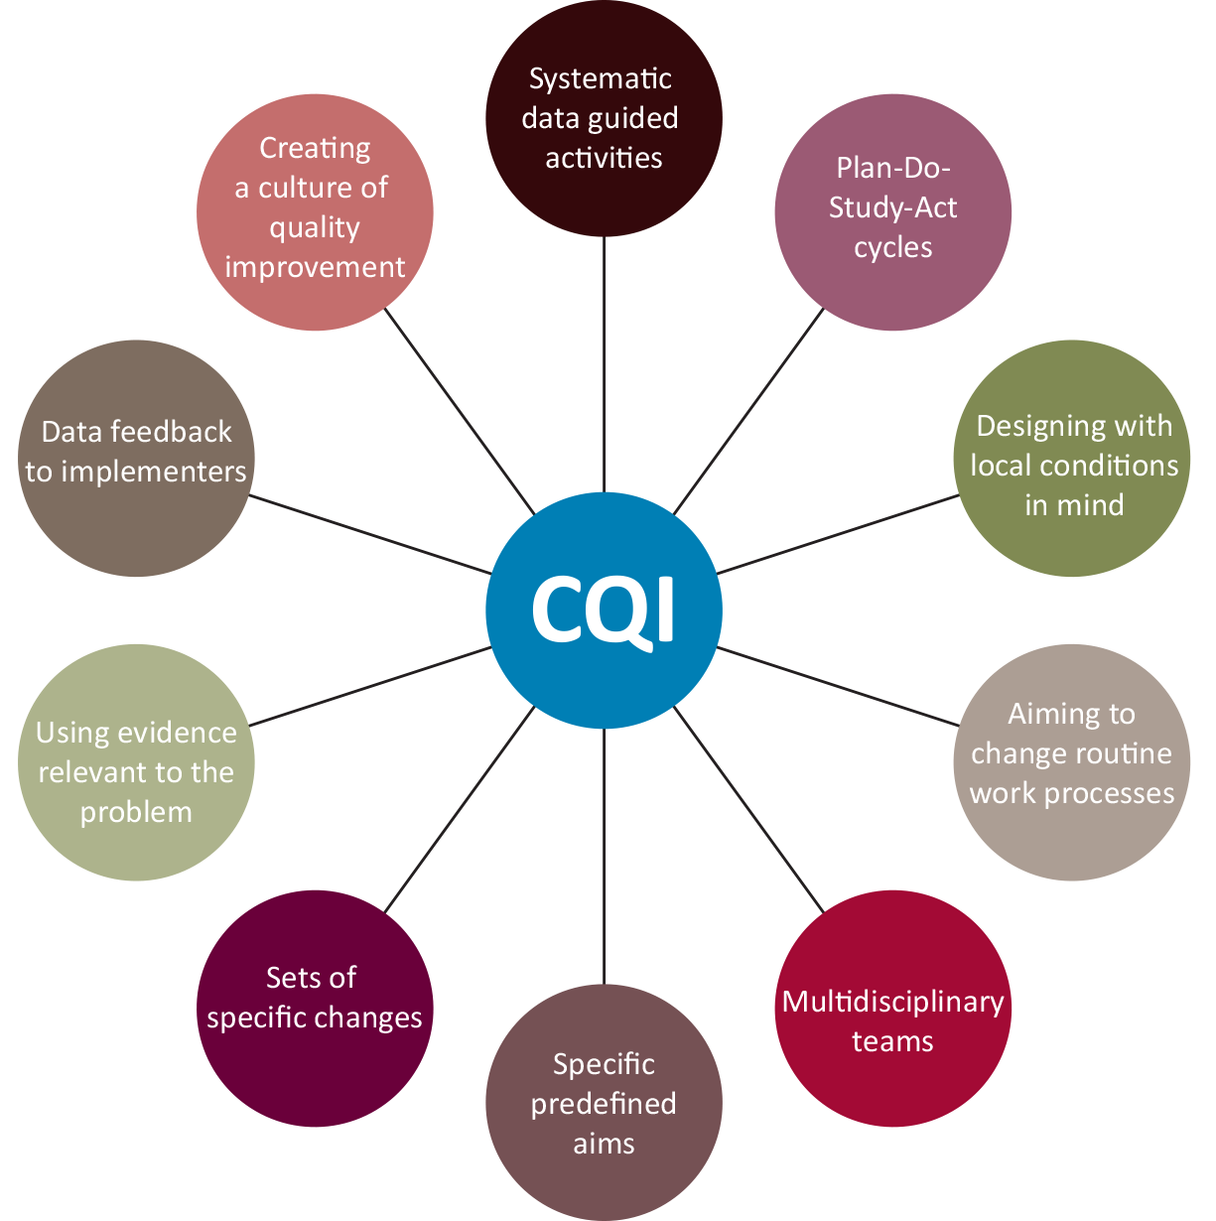
Challenges in implementing CQI
Dixon-Woods, McNicol et al. 2012
Notes:
Healthcare organisations face 10 key challenges in trying to implement CQI programs (Dixon-Woods, McNicol et al. 2012):
Convincing people that there is a problem
Convincing people that the solution chosen is the right one
Getting data collection and monitoring systems right
Over-ambitious goals and giving the impression that the improvement activity is unlikely to survive the time-span of the project
The organisational context, culture and capacities
Tribalism and lack of staff engagement
Leadership
Balancing carrots and sticks – harnessing commitment through incentives and potential sanctions
Securing sustainability
Considering the side effects of change.

Slide 50
Barriers and enablers for CQI
Enablers | Barriers
Commitment and support: From the leadership team and senior management To implement CQI cycle and steps Use CQI for business planning For training and development of information systems and practice-based networks. Approach Systematic, no-blame, systems-oriented, incremental steps Experienced based and learning, Achievable targets Integration of CQI data collection with other reporting requirements. Staff expertise and interest and identified roles to in the service to negotiate implementation of action plans Champions Infrastructure such as established information systems Clear framework and structure for implementation Clearly defined objectives and expectations Clear defined roles/responsibilities for CQ Defined objectives for using clinical performance data in quality reporting structures at local, regional, state and national levels. Quality network for developing and sharing expertise and resources for CQI. | High staff turnover Burden of disease and balancing demands of acute care with those for chronic disease Difficulty in providing/receiving enough training and technical support, Lack of engagement among key staff especially clinic managers, who did not consider CQI to be part of their role, and engagement of GPs who are perceived as being the hardest to engage Multiple patient record systems Lack of a single integrated data reporting system across services delivering care Manual audits and systems assessment that are time consuming, Perceived lack of control to change clinic routines in support of action plans Lack of teamwork.
Lowitja Institute, 2014
Notes:
The barriers and enablers for CQI in Aboriginal and Torres Strait Islander primary health care are summarised in the following table (The Lowitja Institute 2014).

Slide 51
Who is responsible for CQI?
Addressing the barriers to CQI requires organisational commitment and whole team involvement
Source: https://youtu.be/9ll01UNrbR4
Notes:
The YouTube video is embedded into the slide – click on the play button. If the video fails to load, enter the following URL into your web browser: https://youtu.be/9ll01UNrbR4
Addressing the barriers to CQI requires organisational commitment and whole team involvement to improve service processes for delivering care.
Highlight embedding CQI requires a blame free or no-blame culture - No blame is where individuals are able to identify and report problems without fear of reprimand or punishment.

Slide 52
Who is responsible for CQI?
Key organisational roles include:
Board of directors
Leadership teams such as chief executive officer, senior managers, and program managers
Clinical leader such as the senior medical officer
Clinical governance team
CQI lead
External roles such as external CQI facilitators or coordinators, public health medical officers and so on.
Lowitja Institute, 2014
Notes:
The key organisational roles that are responsible for driving and embedding CQI in Aboriginal and Torres Strait Islander primary health care includes:
Board of directors
Leadership team includes chief executive officer, senior managers, and program managers
Clinical leader such as the senior medical officer
Clinical governance team
CQI lead.
There are also roles external to the organisation that drive and support CQI in Aboriginal and Torres Strait Islander primary health care. The roles may be based in partner organisations, regional and state/territory organisations or national organisations. Roles include external CQI facilitators or coordinators, public health medical officers, and so on.
Check in with your participants:
Be alert to changes in individual and/or group attention, body language and emotion
Respond to changes in emotions or group dynamics such as loss of attention, group chatter and so on by introducing a short break or asking for feedback about the topic – are participants familiar with these topics would they like you to move on? Are the topics difficult to understand – do they require further explanation or discussion?

Slide 53
Why a team approach to CQI?
Research suggests the presence of strong CQI teams and collaborative teamwork as crucial factors in successful programs. (Fox et al. 2007, Chin et al. 2008, Gardner et al. 2010, Lob et al. 2011).
Likewise, lack of teamwork is a barrier to CQI. (The Lowitja Institute 2014)
Notes:
CQI is a team function, so embedding CQI in everyday practice requires everyone – health professionals, managers, leaders and administrative and support staff – to learn and apply new knowledge and skills (The Lowitja Institute 2015).

Slide 54
Why a team approach to CQI?
The team is the primary vehicle through which problems are analysed, improvements are generated and change is evaluated.
(Sollecito & Johnson 2013)
Notes:
CQI is a team function, so embedding CQI in everyday practice requires everyone – health professionals, managers, leaders and administrative and support staff – to learn and apply new knowledge and skills (The Lowitja Institute 2015). Teams are necessary to deliver comprehensive primary health care, especially for chronic disease. In the area of quality improvement, the team is the primary vehicle through which problems are analysed, improvements are generated and change is evaluated (Johnson and Sollecito 2013. )

Slide 55
Why a team approach to CQI?
Source: https://youtu.be/jop2I5u2F3U
Notes:
The YouTube video is embedded into the slide – click on the play button. If the video fails to load, enter the following URL into your web browser: https://youtu.be/jop2I5u2F3U

Slide 56
Key roles for CQI
Clinical Leader
CQI Lead
External CQI Facilitators.
Notes:
The key roles in helping to embed CQI in primary health care include: Clinical Leader, CQI Lead, and External CQI Facilitators.

Slide 57
Clinical Leader
Fundamental for driving service redesign and improving patient outcomes at the service level.
(Garrubba et al. 2011, Zachariadis et al. 2013)
Leads a team, that is the formal organisational structure where managers and clinicians share responsibility and are held accountable for patient care, minimising risks to consumers, and for continuously monitoring and improving the quality of clinical care.
(The Lowitja Institute 2015)
Notes:
The clinical leader role is recognised as fundamental for driving service redesign and improving patient outcomes at the service level (Garrubba, Harris et al. 2011, Zachariadis, Oborn et al. 2013 ). The clinical leader leads a team, that is the formal organisational structure where managers and clinicians share responsibility and are held accountable for patient care, minimising risks to consumers, and for continuously monitoring and improving the quality of clinical care(The Lowitja Institute 2015).
Group or individual question – who is the clinical leader in your service? Where could you go to find out who is the clinical leader in your service?

Slide 58
CQI Lead
Designated quality lead at the individual primary health care provider level and/or at the regional level
Aims to ensure that CQI activities have a ‘driver’ and can be embedded into routine practice over time.
Notes:
The CQI lead role is the designated quality lead at the individual primary health care provider level and/or at the regional level. The CQI lead aims to ensure that CQI activities have a ‘driver’ and can be embedded into routine practice over time.
As previously discussed – the team is vital for successful improvement efforts and may vary in size and composition and the context of the primary health care service.
Group or individual question – who is the CQI lead role in your service? Where could you go to find out who is the CQI lead role in your service?

Slide 59
External CQI Facilitators
In the Australian context, CQI has often been the responsibility of external CQI facilitators rather than of the staff managing clinical care within health services
(The Lowitja Institute 2015)
External CQI facilitators provide support of organisations, primary health care providers, teams and individual health professionals that is tailored to meet specific needs and different levels of CQI capacity.
(The Lowitja Institute n.p.)
Notes:
In the Australian context, CQI has often been the responsibility of external CQI facilitators rather than of the staff managing clinical care within health services (The Lowitja Institute 2015). External CQI facilitators provide support of organisations, primary health care providers, teams and individual health professionals that is tailored to meet specific needs and different levels of CQI capacity (The Lowitja Institute 2015).
Group or individual question – who is the CQI lead role in your service? Where could you go to find out who is the CQI lead role in your service?

Slide 60
Other CQI roles
Good leaders
Foster teamwork
Clearly define roles, responsibilities and objectives for team members
Support and provide protected time for CQI
Motivate teams .
Clinician champions
Critical role in motivating staff participation along with dedicated clinic managers or administrative staff
Support CQI teams by ensuring that service priorities are translated into actions, and by holding the team accountable for CQI.
Notes:
Good leaders help to foster teamwork by clearly defining roles, responsibilities and objectives for team members, setting structured time aside for CQI activities and motivating teams to participate in CQI activities (Wang, Wolf et al. 2004, Gardner, Bailie et al. 2011).
Clinician champions can also play a critical role in motivating staff participation as can dedicated clinic managers or administrative staff who help support CQI teams by ensuring that service priorities are translated into actions, and by holding the team accountable for CQI processes(Wang, Wolf et al. 2004, Bray, Cummings et al. 2009, Gardner, Dowden et al. 2010). To work efficiently, CQI teams need diversity: people with different skills, experience, knowledge and viewpoints.

Slide 61
Diversity
To work efficiently, CQI teams need diversity: people with different skills, experience, knowledge and viewpoints
Workplace diversity refers to the variety of differences between people in an organisation. Diversity encompasses race, gender, ethnic group, age, personality, cognitive style, tenure, organizational function, education, background and more.
Notes:
To work efficiently, CQI teams need diversity: people with different skills, experience, knowledge and viewpoints.
Workplace diversity refers to the variety of differences between people in an organisation. That sounds simple, but diversity encompasses race, gender, ethnic group, age, personality, cognitive style, tenure, organizational function, education, background and more. Diversity not only involves how people perceive themselves, but how they perceive others. Those perceptions affect their interactions. For a wide assortment of employees to function effectively as an organisation, they need to deal effectively with issues such as communication, adaptability and change.
In the Australian context, CQI has often been the responsibility of external CQI facilitators rather than of the staff managing clinical care within health services (The Lowitja Institute 2015). External CQI facilitators provide support of organisations, primary health care providers, teams and individual health professionals that is tailored to meet specific needs and different levels of CQI capacity (The Lowitja Institute 2015).

Slide 62
Diversity
Diversity not only involves how people perceive themselves, but how they perceive others. Those perceptions affect their interactions
For a wide assortment of employees to function effectively as an organisation, they need to deal effectively with issues such as communication, adaptability and change.
Notes:
Diversity not only involves how people perceive themselves, but how they perceive others. Those perceptions affect their interactions. For a wide assortment of employees to function effectively as an organisation, they need to deal effectively with issues such as communication, adaptability and change.

Slide 63
Learning activity
Go to your organisation’s website, annual report, policy and procedure manual or to your supervisor.
Who are the key roles responsible for CQI in your organisation?
Who is the leader for clinical governance?
Reflect on your role – describe the responsibility your role has in CQI?
Notes:
Remind participants embedding CQI requires a blame free or no-blame culture - No blame is where individuals are able to identify and report problems without fear of reprimand or punishment.
What does no-blame or blame free mean to participants?
How can an organisation support a no-blame or blame free culture?

Slide 64
Summarise and reflect
Notes:
For this session you may:
Go back to the learning outcome slides and review each on with participants;
Select key topics and discuss them;
Do a Q and A; or
Group discussion about CQI and primary health care; CQI and your service; CQI and roles and responsibility; CQI and client and communities.

Slide 65
Closing
Complete:
Record of participation
Evaluation form
Notes:
In closing:
Thank participants
Spend time completing relevant forms
Remind participants of your contact details.

