Slide 1
CAUSE AND EFFECT
DIAGRAM

Slide 2
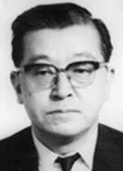

Also known as…..
The Fishbone Diagram
The Ishikawa Diagram
The “Fishykawa” Diagram!

Slide 3
What is a fishbone/cause and effect diagram?
It’s a graphic – a picture
a structured and systematic way of looking at an effect (the problem) and
the causes, conditions or relationships that bring about, or could bring about, the “effect”

Slide 4
It’s purpose is to:
  voice theories about the root cause
  see the relationships among them
  generate as many ideas as possible, concerning the conditions or causes related to the effect

Slide 5
It’s purpose is to:
highlight the main causes, minor causes and sub causes leading to the effect (the problem)
And it’s an important tool in the early stages of problem solving

Slide 6
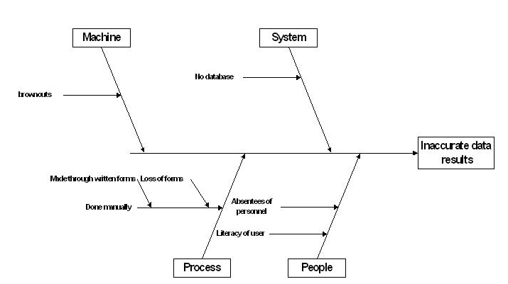
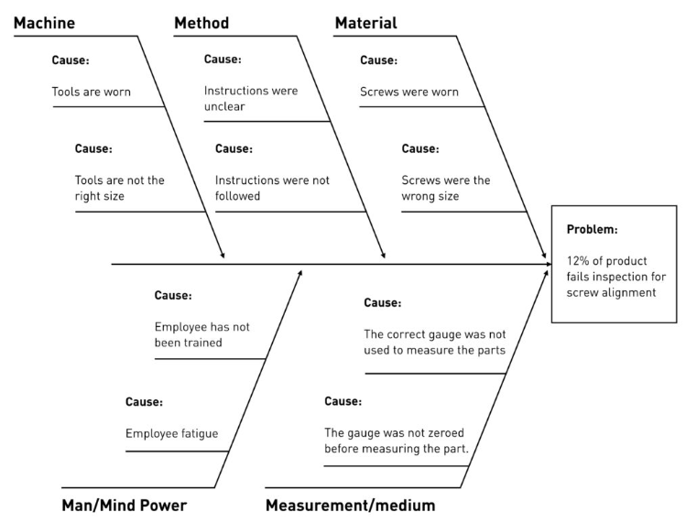
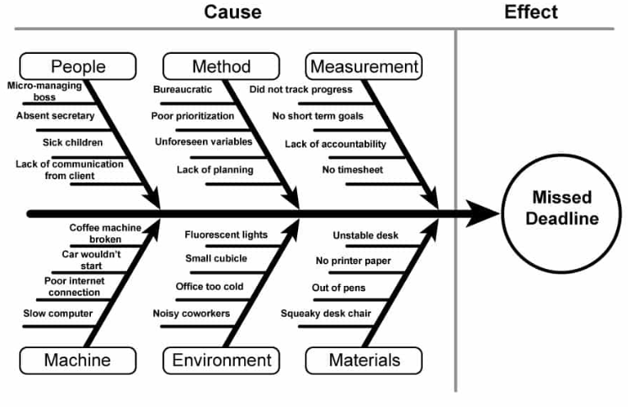
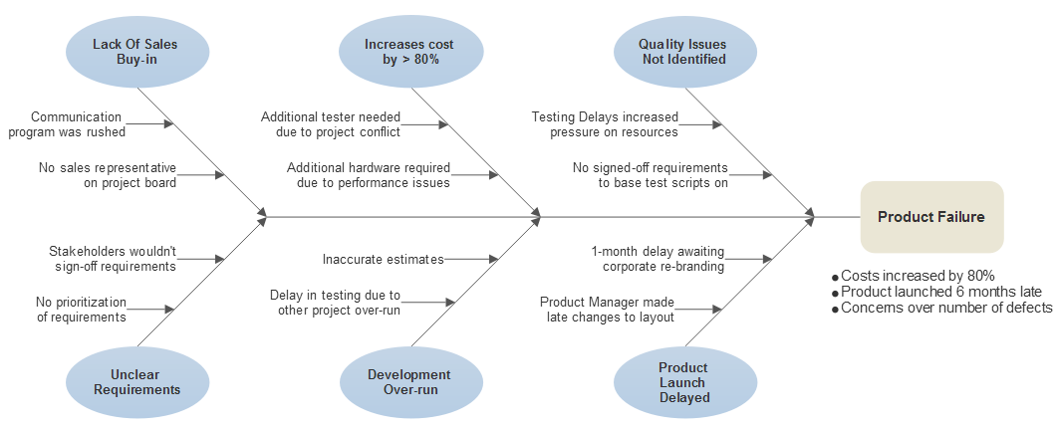
Fishbone /cause and effect diagram
Cause and effect diagrams are multi-leveled:
  Level one – asks what are the causes of the effect?
  Level two – asks what are the causes of the causes?
  Level three – asks what causes these subsidiary causes?

Slide 7
Fishbone /cause and effect diagram
Generating ideas is the same as the brainstorming process
But what is different is that each main bone of the diagram is a category within which the brainstorming ideas are included

Slide 8
How to construct a fishbone diagram…………..
Begin by agreeing on or identifying a single problem (the effect) and placing it in the “head” or the “effect” box of the diagram
Effect
or
the
Problem

Slide 9
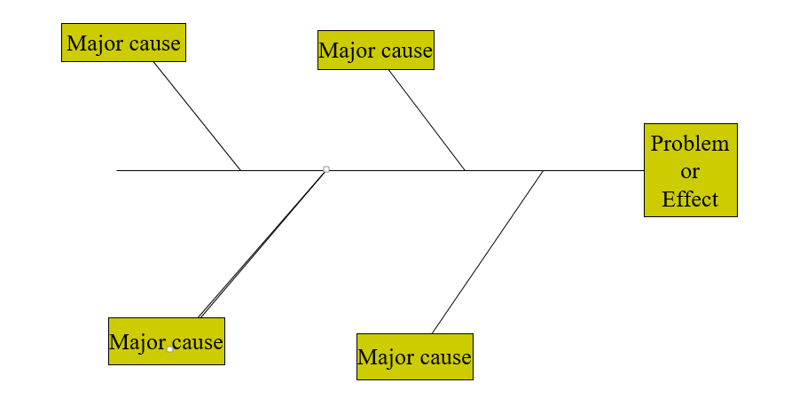
How to construct a fishbone diagram…………..
Draw the main bones on the ‘skeleton’ – and attach a major cause to each
The causes could be material, machines, measurement, man, methods
Or equipment, people, technology, environment, policies.
You can even make up your own!

Slide 10
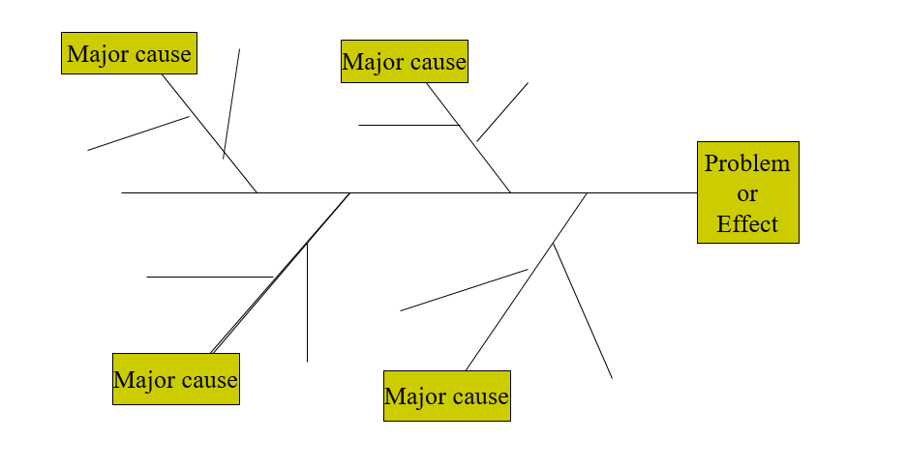
How to construct a fishbone diagram…………..
Brainstorm the sub causes and place them on the smaller “bones”

Slide 11
What’s next?
Display the fishbone for others to see and comment on and contribute to
Sit back and reflect on the fishbone diagram
Interpretation – how are we going to improve?
  Are there repeated or similar causes?
  Prioritise what must be done first – are there patient/staff safety or risk factors that must be addressed?
  Are there dependencies amongst the causes? – does one thing lead to another

Slide 12
What’s next?
Once you have done this you can:
  prioritise and
  come to a consensus to further analyse a particular cause,
  using the PDSA tool, come up with ideas to problem solve or make changes to improve the situation

Slide 13
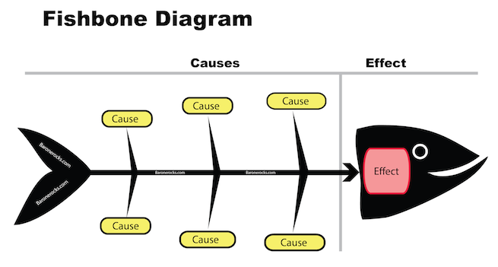
Let’s do it!
Let’s do it!!!

Slide 14
CAUSE AND EFFECT
  Step 1
  Decide on the problem (or the “effect”) and write it in the head of the fish
  Step 2
  Allocate the major causes of the problem to the skeleton of the fish (using pink and red post its)
  Step 3
  Brainstorm the sub causes of each major cause and write them on the skeleton of the fish
  Step 4
  Which sub cause would you use for your PDSA?

