Slide 1
Fit checking P2/N95 respirator
Infection Monitoring and Prevention Service

Slide 2
What is fit checking?
Quick check to ensure that the respirator is fitting each time it is put on
Minimum standard for healthcare workers

Slide 3
When and why should P2/N95 mask be worn?
For airborne precautions
Perform a fit check every time
Properly applied
Good seal is achieved

Slide 4
How to fit check
Placement of the respirator on the face
Placement of the headband or ties over the head and at the base of the neck
Compressing the respirator to ensure a seal across the face, cheeks and the bridge of the nose
Checking the positive pressure seal of the respirator by gently exhaling. If air escapes, the respirator needs to be adjusted
Checking the negative pressure seal of the respirator by gently inhaling. If the respirator is not drawn in towards the face, or air leaks around the face seal, readjust the respirator and repeat process, or check for defects in the respirator.

Slide 5
Considerations
Respirators should not be touched while being worn
Respirators should be changed when they become moist
Respirators should never be reapplied after they have been removed
Respirators should not be left dangling around the neck
Hand hygiene should be performed upon touching or disposing of a used respirator
Respirators should be removed outside the patient-care area and disposed of in a closed receptacle
Beards – difficult to get an adequate seal

Slide 6
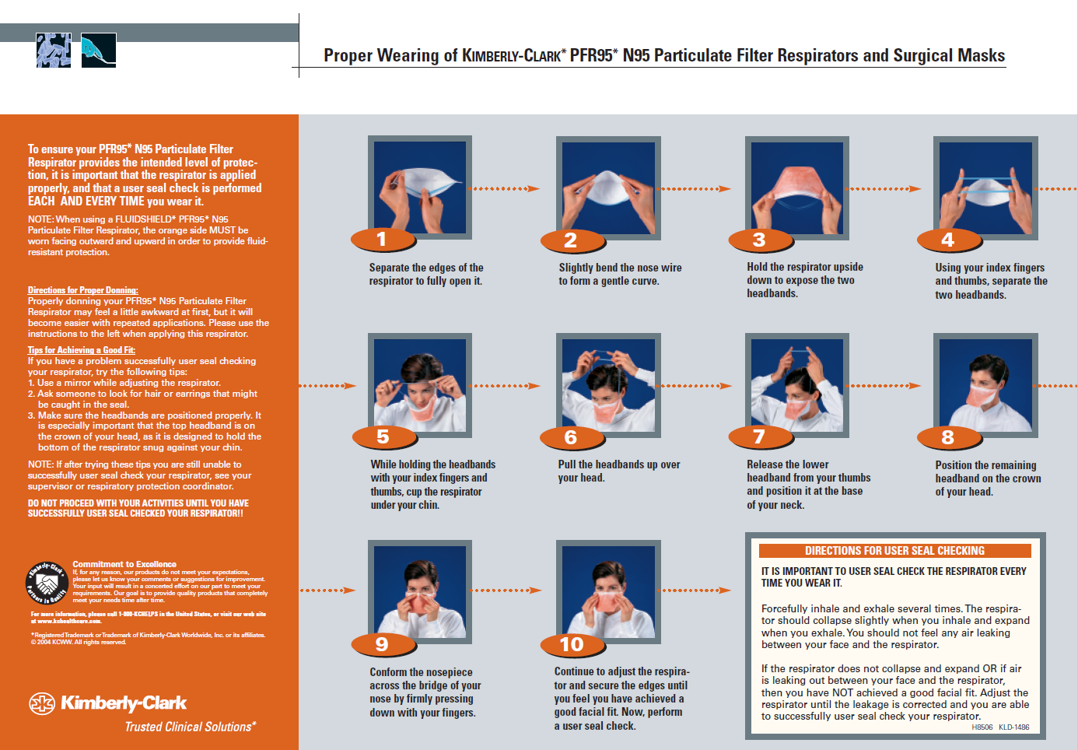

Slide 7
