Slide 1

Remote Food Security Strategy: progress and lessons learned
Ruwani Peiris, Public Health Registrar AMSANT

Slide 2
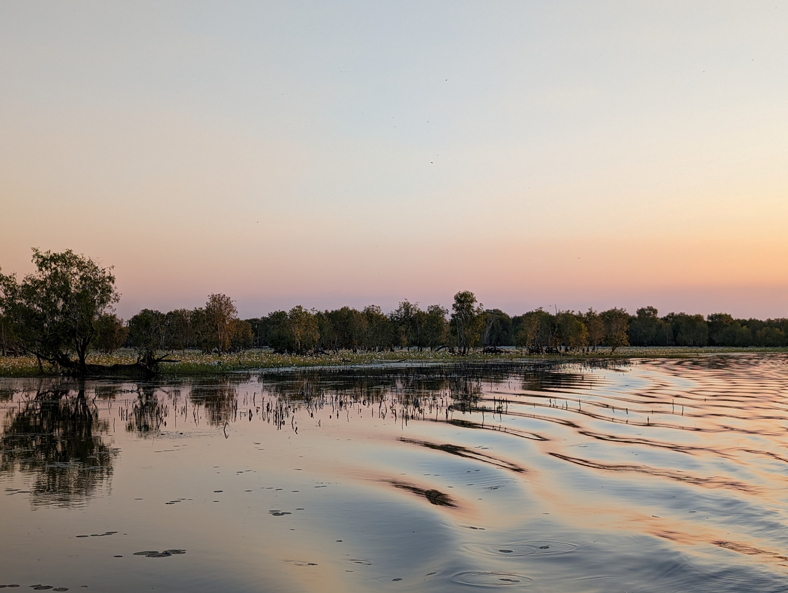
“The land and the sea is our food security. It is our right.
Food security for us has two parts: Food security is when the food from our ancestors is protected and always there for us and our children. It is also when we can easily access and afford the right non-traditional food for a collective healthy and active life.
When we are food secure we can provide, share and fulfil our responsibilities, we can choose good food, knowing how to make choices and how to prepare and use it.”
(Menzies School of Health Research, 2010)

Slide 3
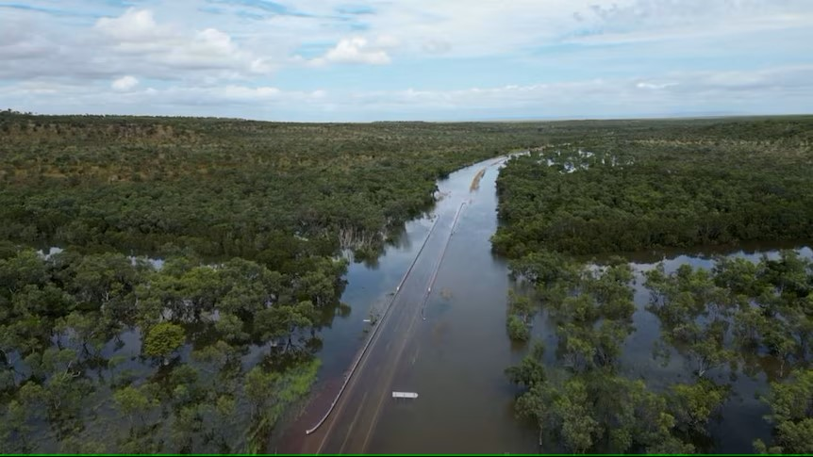
How did we get here?
1788 – Food insecurity was a tool of colonisation
2010 – AMSANT Fresh Food Summit
2021 – AMSANT Food summit
2022 – Parliamentary Inquiry
2023 – National Strategy (co-led by NIAA and AMSANT)
Flooded road in the Kimberley. Source: ABC News

Slide 4
What is the opportunity now?
To get food insecurity funded in the next Federal budget
Interest from the new Indigenous Affairs Minister
Federal election → pressure to show positive results
= money and political will
We could get some (not all) Strategy actions funded to improve food security

Slide 5









What came out of consultation?
More storage capacity
Better power & water supply
Stock good food
Good management
Stores
Food Storage
Nutritionists in ACCHSs, schools, aged care etc
More income
More affordable food
Health
Money
Community led
Houses
Houses that can store, prepare, cook food
Supply chain
Freight costs
Good supply routes
Supply chain monopoly
Culture
Education
Food initiatives should improve connection/Culture
More Traditional foods
School, trades, degrees
Health, food, money literacy

Slide 6
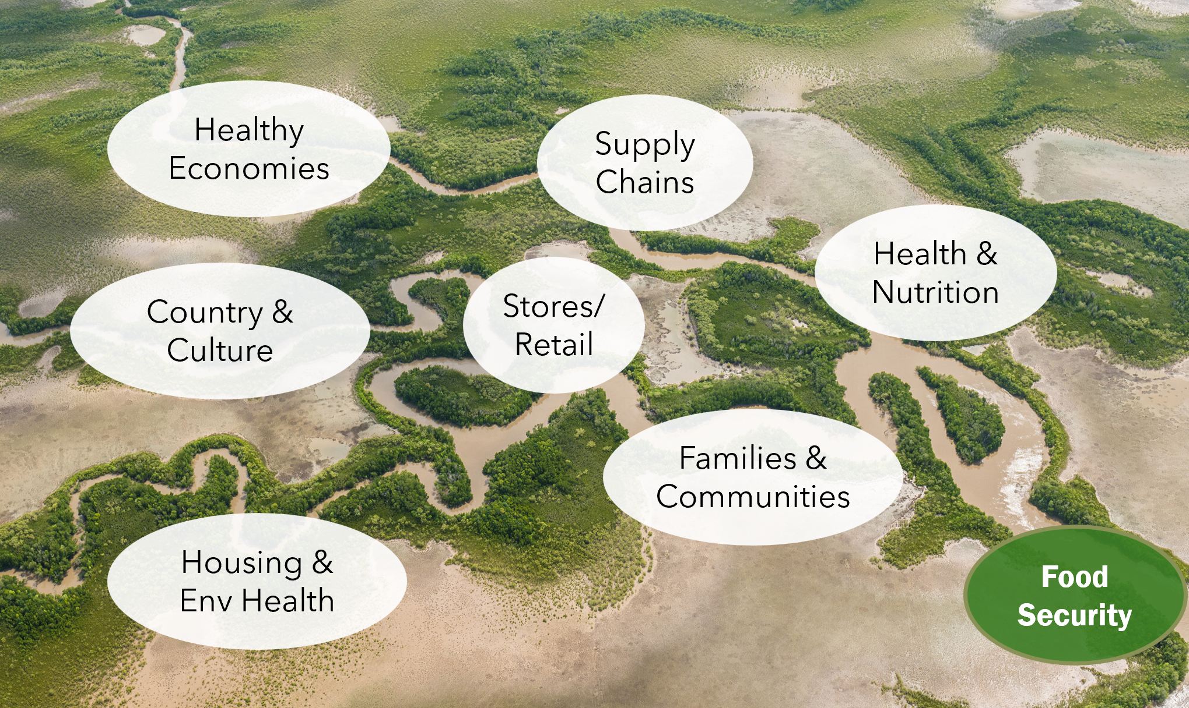
What will be in the Strategy?

Slide 7
What will be in the Strategy?
3 documents:
  Vision, Purpose, Objectives
  National Action Plan
  Governance Plan, includes Monitoring & Evaluation
Aboriginal and Torres Strait Islander led
Immediate vs long term changes
Health
Education
Housing
Infrastructure
Stores
Industry
NGO
etc
National
Jurisdictional
Local

Slide 8
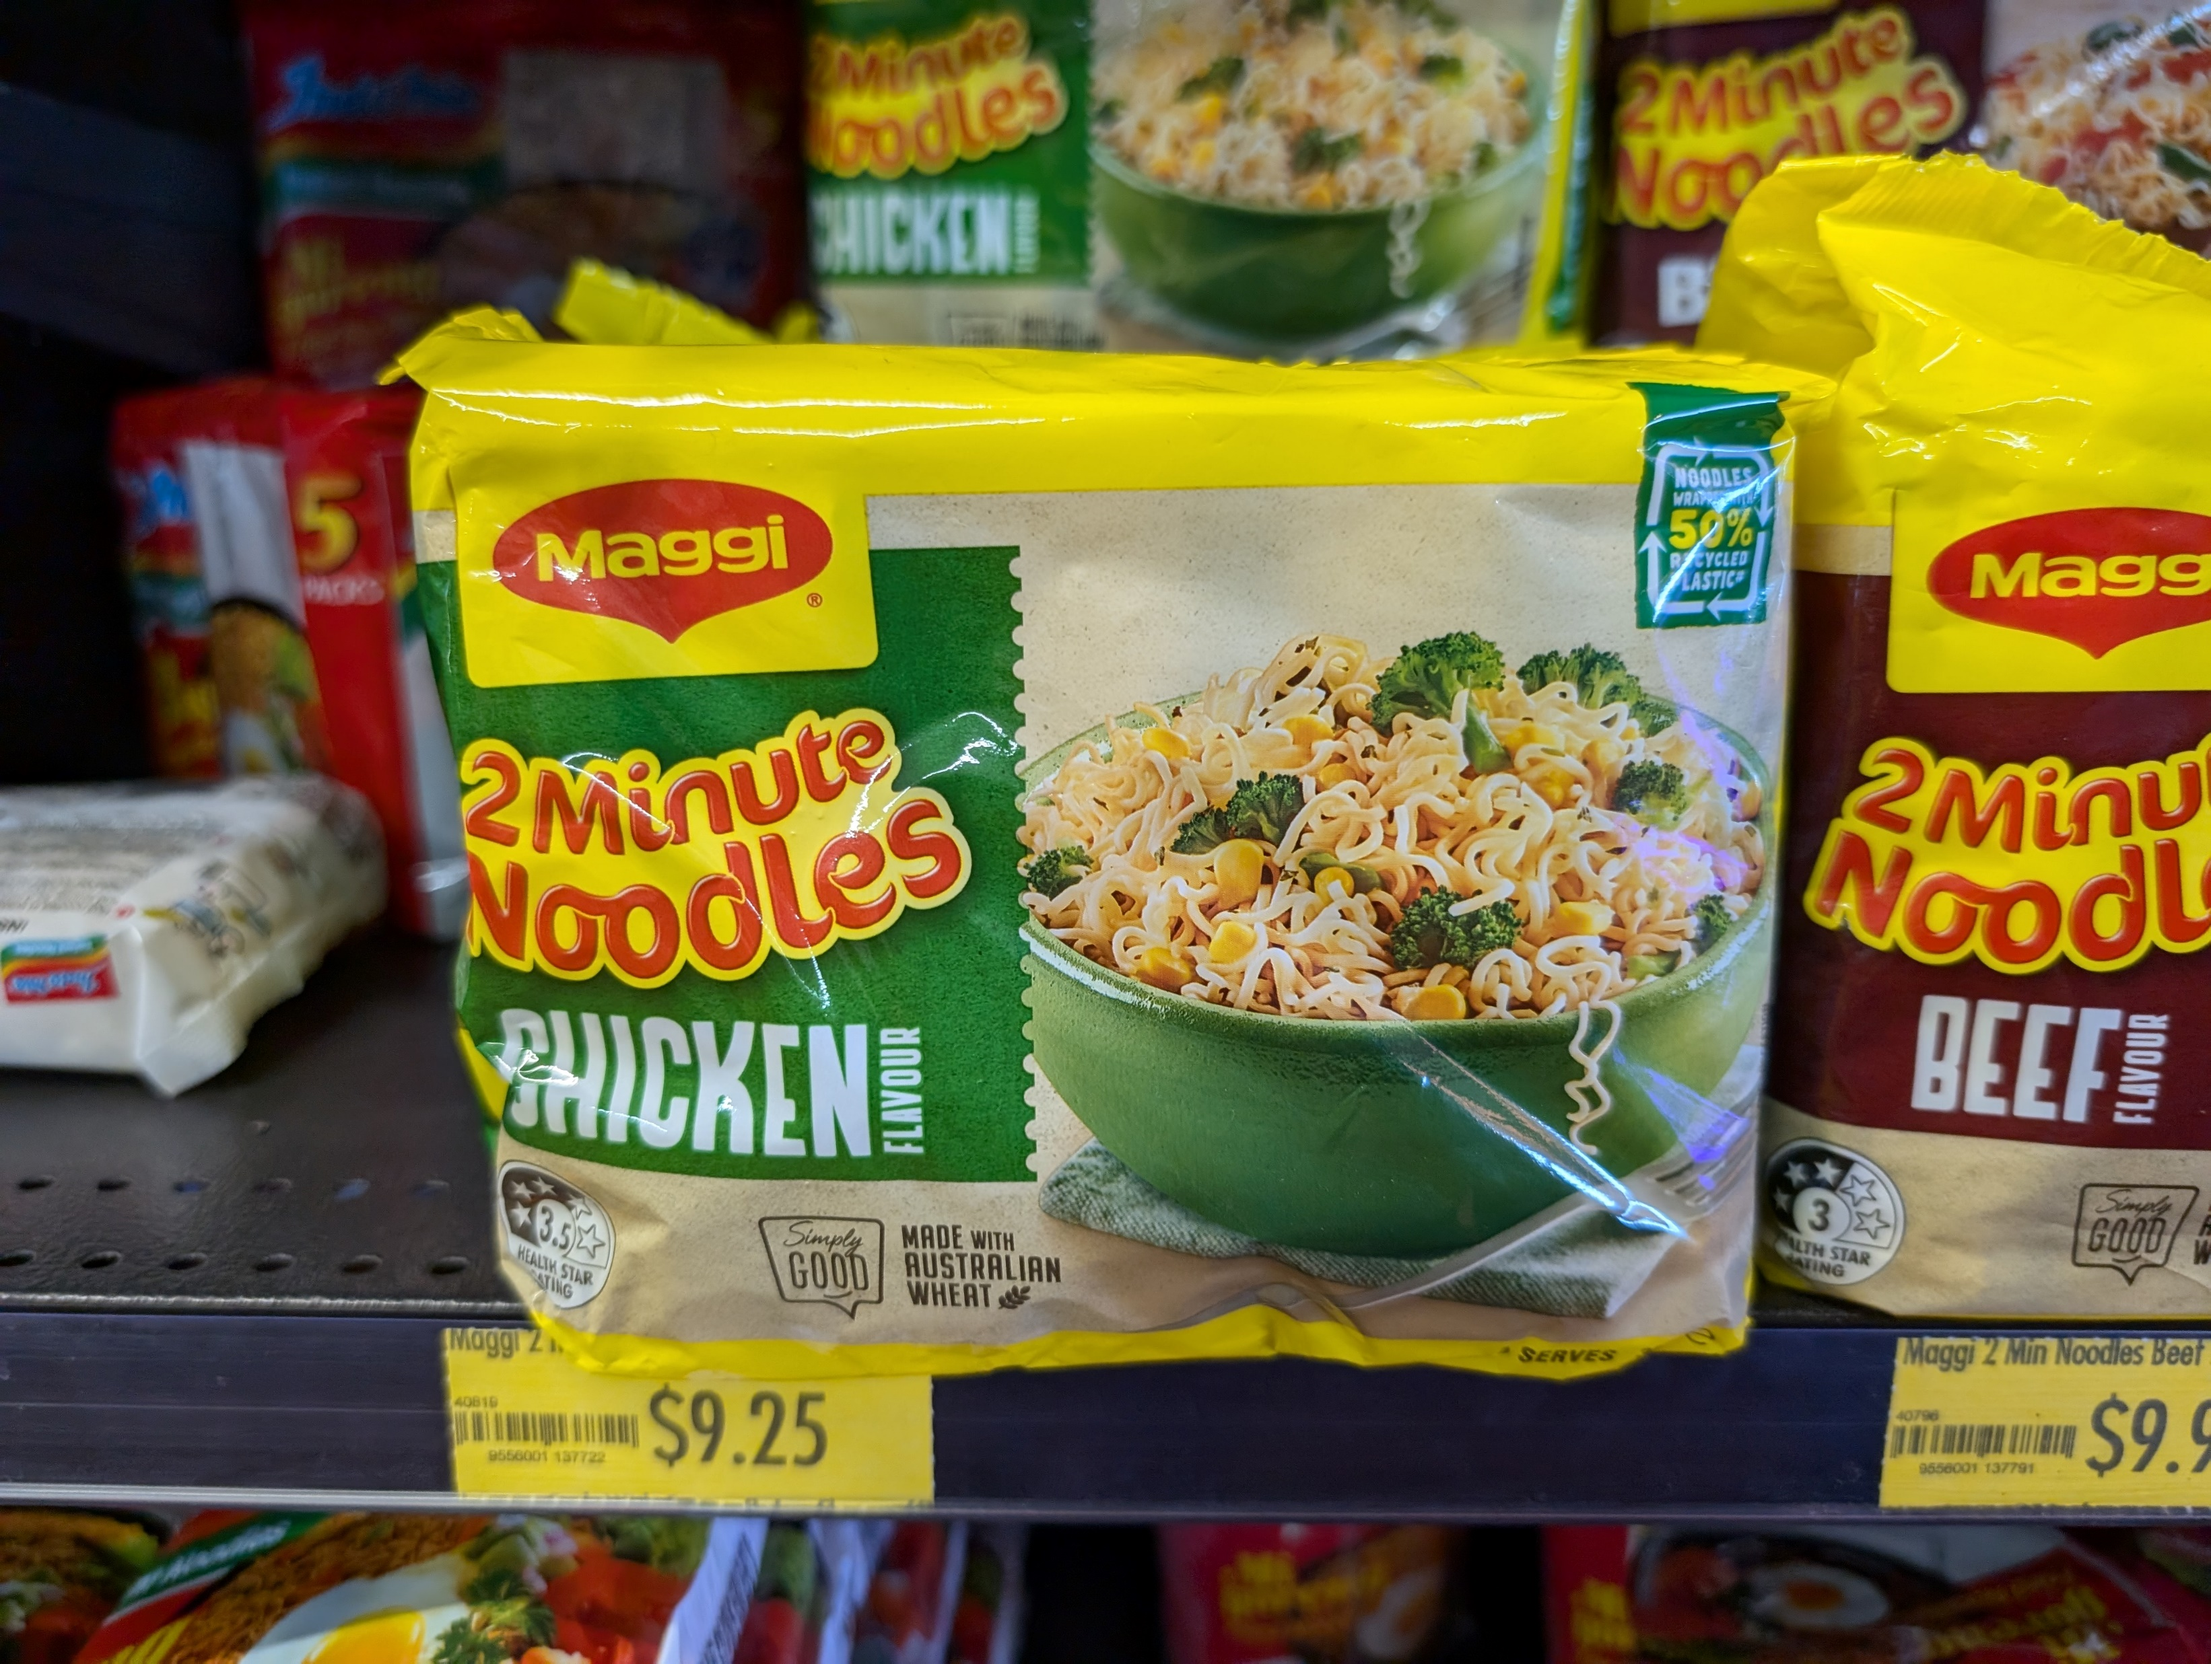
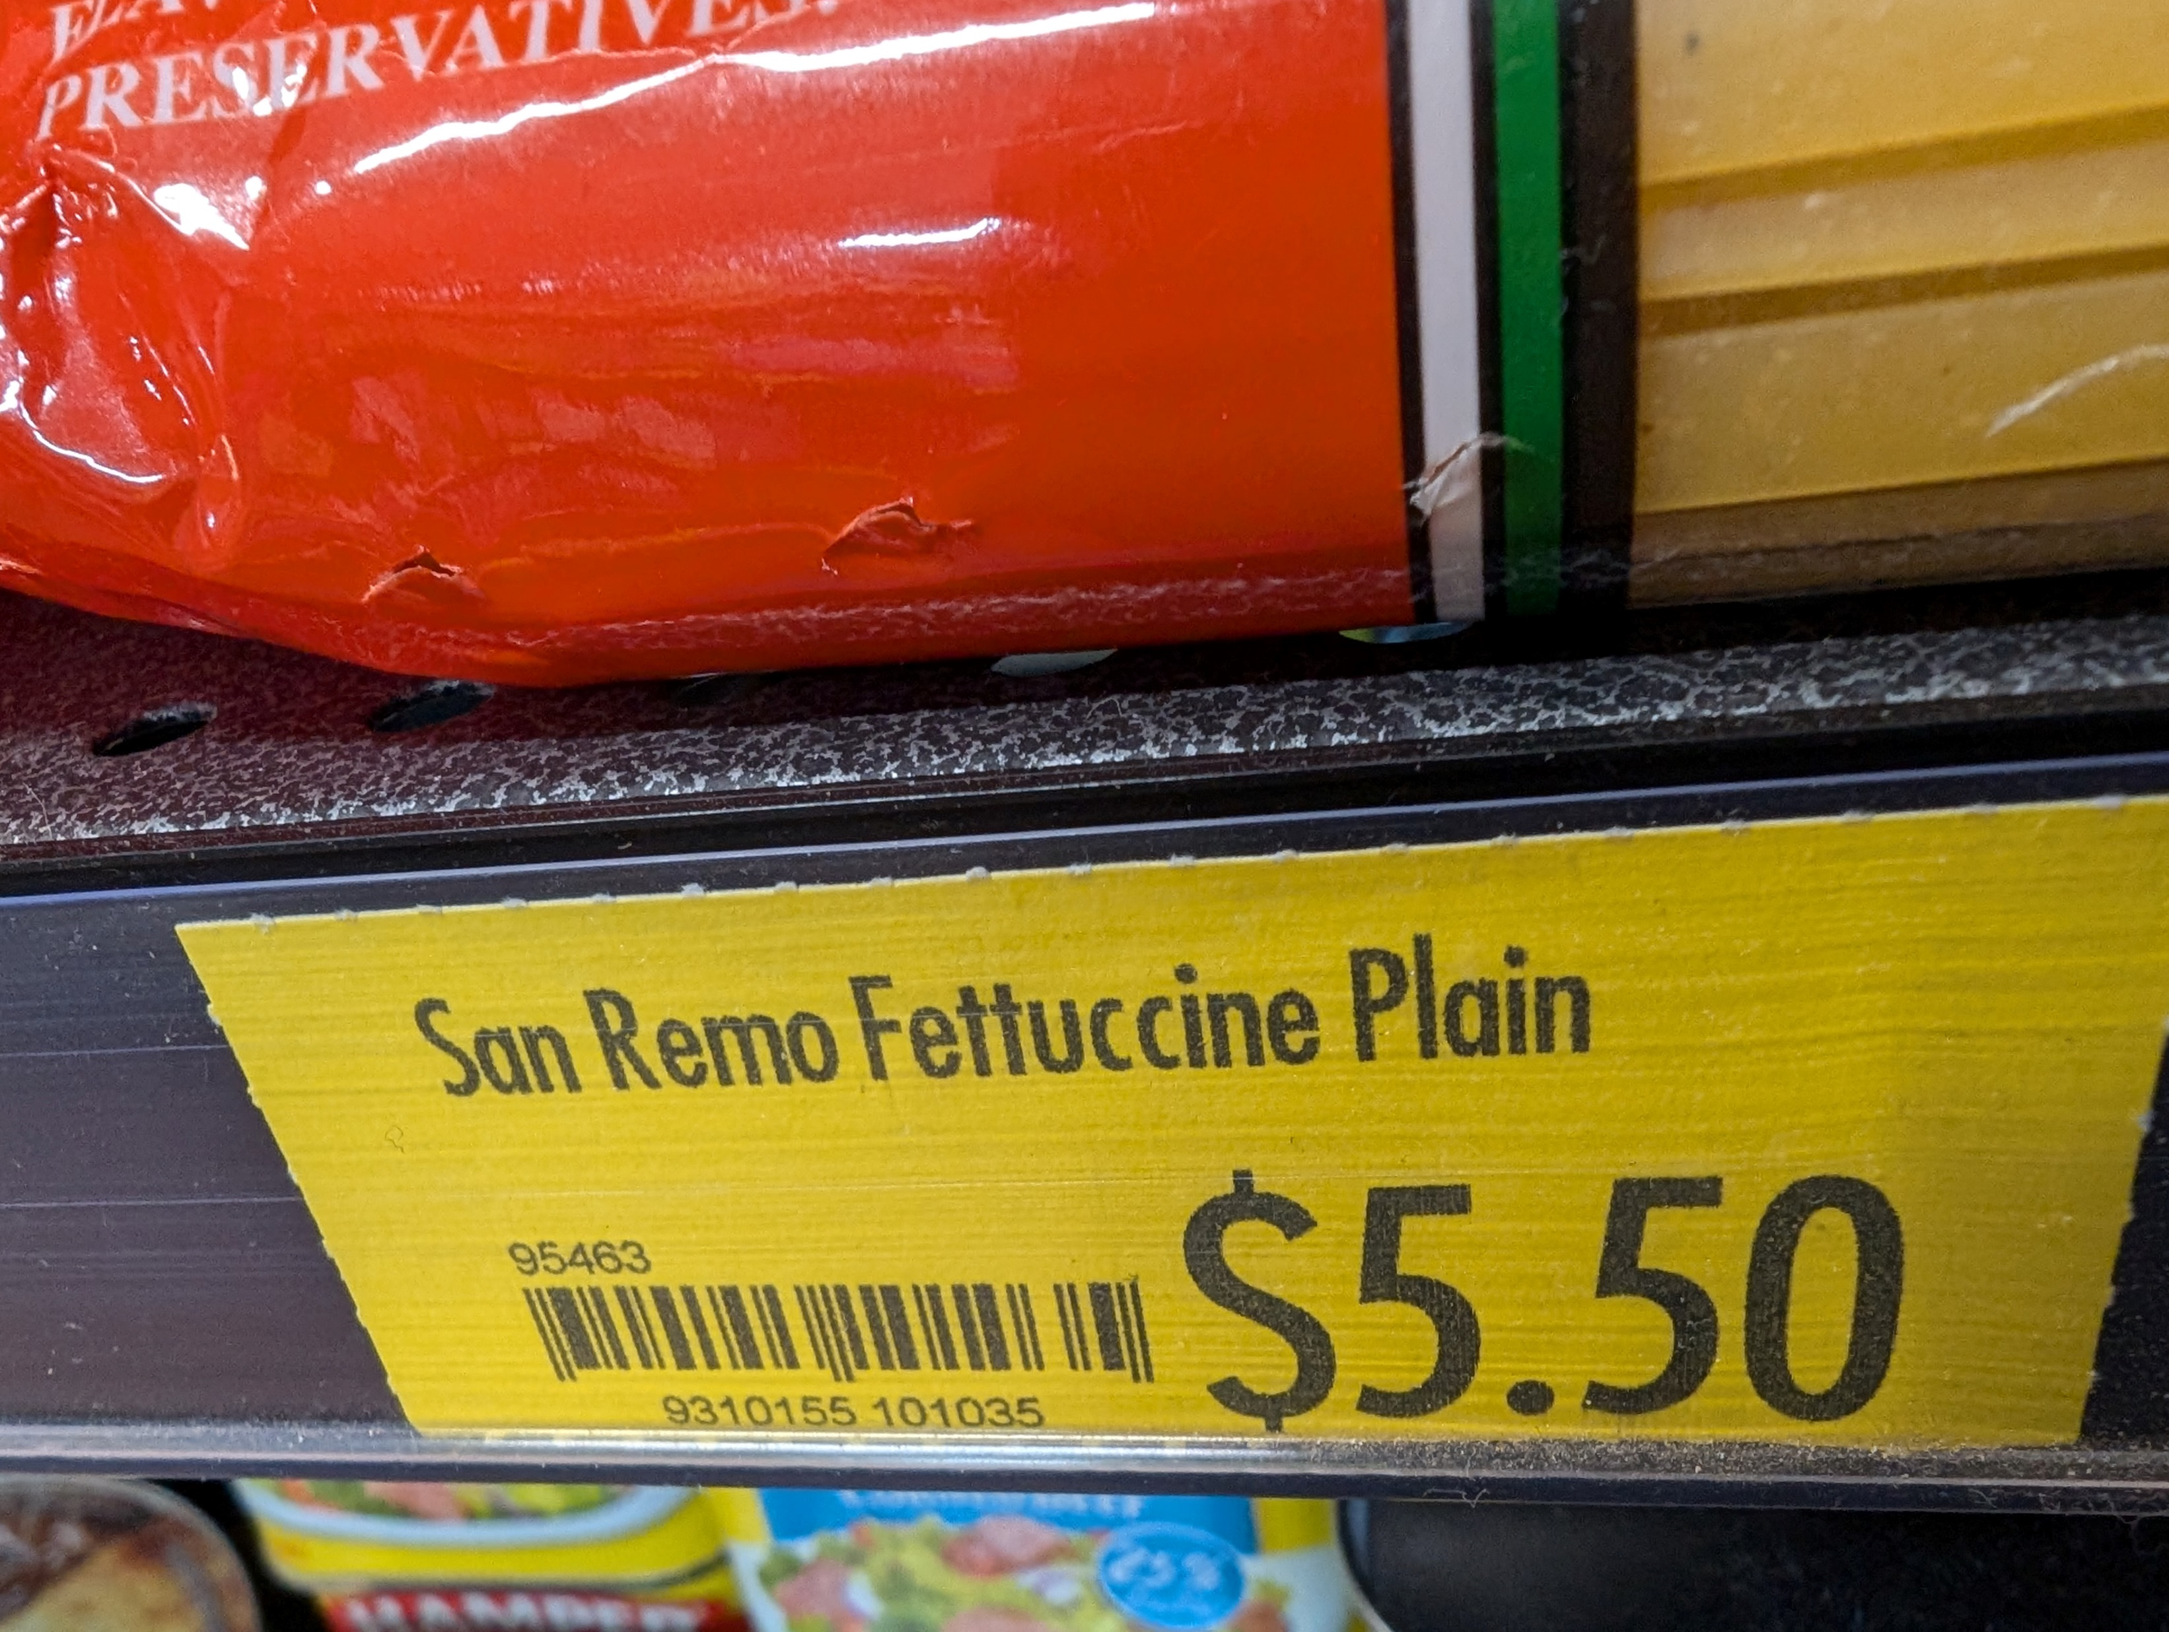
Immediate action example: Poverty
We want:
  Increase to the Remote Area Allowance (up to what it should be)
Closes a Gap
Immediate effect
Food items in a Central Australia petrol station. Source: own images

Slide 9
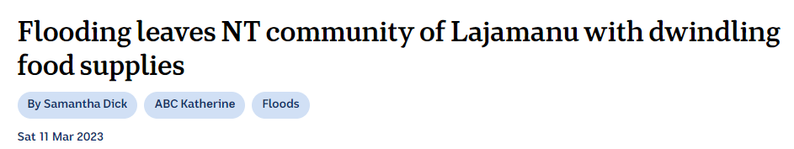
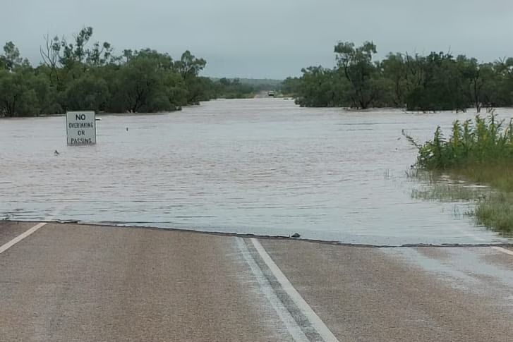
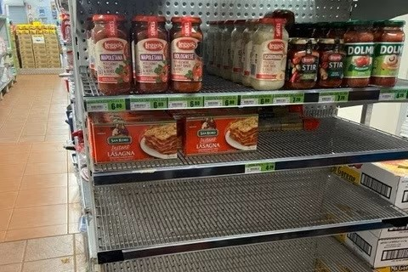
Immediate action example: Severe weather events
We want:
  Upgraded remote stores infrastructure to stock enough food during floods/severe weather
Addresses a predictable food crisis
Probably cost effective (compared to food supply by plane)
Source: ABC News

Slide 10
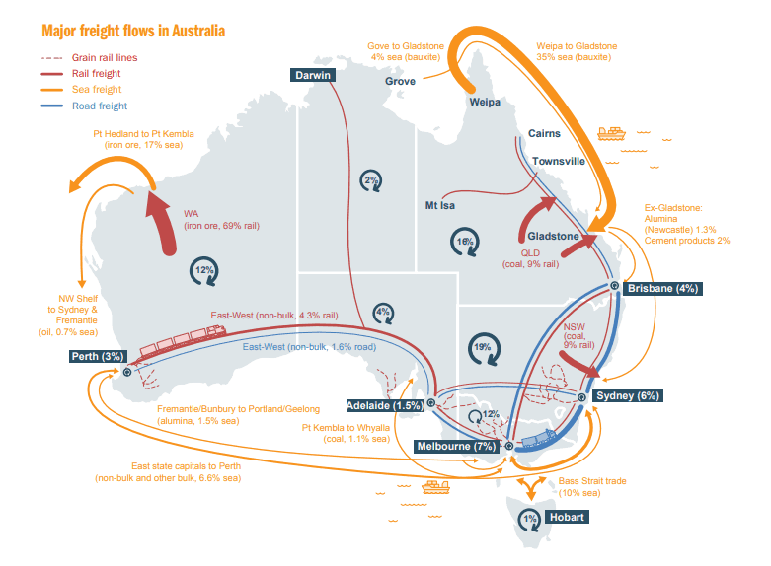
Challenges to implementing the Strategy
Complex issue vs. limited funding
What will the governance look like?
Flexible enough to allow community control
Freight supply routes. Source: Freight Australia

Slide 11

Challenges we had along the way

Slide 12

Challenges: partnership
Challenge
?Solution
Opportunity
CTG Priority Reform 1: Formal Partnerships and Shared Decision Making
CTG Priority Reform 3: Transforming Government Organisations
Time constraints jeopardise ability to work together
Orgs that don’t know how to share power
Save time by working in real time
Orientation to working with community controlled orgs

Slide 13
Challenges: working with consultancies
Challenge
?Solution
Opportunity
CTG Priority Reform 2: Building the Community Controlled Sector
Also transforming private organisations
Consultation fatigue and skepticism
No previous relationship with communities
Have community members involved in developing strategies
Orientation for consultancies

Slide 14
What is happening next?
By the end of the year:
  final draft of the vision/purpose/objectives
  action plan
Decide on what are the best actions to recommend for funding
Get the actions into a Federal Budget stream by December

Slide 15
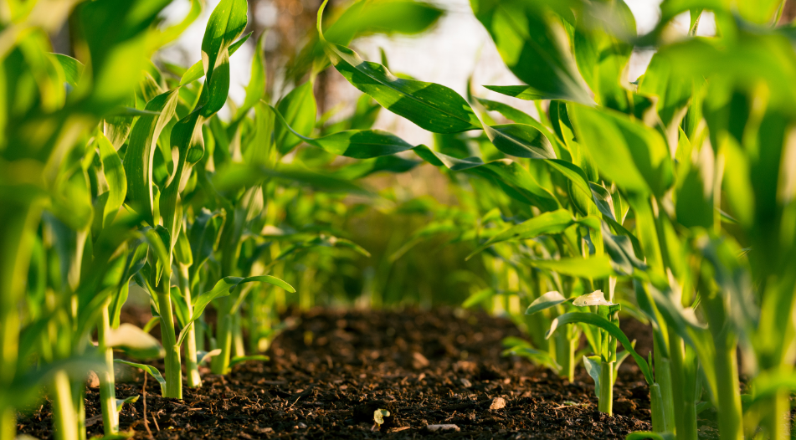
Conclusion
We have a window of opportunity to improve food security in remote communities
Lessons learned to take into future strategy planning

Slide 16


Questions for you
Any aspects of food security you’d like to discuss?
What are your experiences in working with consultancies or national agencies?
What else did this talk make you think about?
Link to AMSANT Food Summit report
Link to Food Security Discussion paper

