Slide 1
The Australian Early Development Census (AEDC) A data sovereignty journey
Department of EDUCATION
Uluru-Kata Tjuta National Park, Central Region
ANANGU COUNTRY

Slide 2
ACKNOWLEDGEMENT OF COUNTRY
We acknowledge Aboriginal and Torres Strait Islander people as the Traditional Custodians of this country throughout Australia, and their connection to land, sea, spirit and community.
We acknowledge and pay our respect to ancestors, elders and Aboriginal communities of the Northern Territory and recognise they are the custodians of the land on which we live, work and learn.
Fogg Dam, Top End Region
LIMILNGAN-WULNA COUNTRY

Slide 3
About this session
What
How
Why
Australian Early Development Census (AEDC)
- Our work nationally and in the NT
Governance of Indigenous Data
- Our Data Sovereignty Journey
Continuous Quality Improvement
- Putting the data to work
Notes:
The Golden Circle.

Slide 4
About this session
What
How
Why
Australian Early Development Census (AEDC)
- Our work nationally and in the NT
Governance of Indigenous Data
- Our Data Sovereignty Journey
Continuous Quality Improvement
- Putting the data to work
To be of service
To find collaborators
To make change together
Notes:
The Golden Circle.
How we are going to make change is through Indigenous Data Sovereignty. Its not just about respect. Its about better information.

Slide 5
About this session
Why
NT CQI Strategy
Improve the health outcomes in the Aboriginal population
AEDC
Closing the Gap Target 4:
Children are developmentally on track at 5 years of age
Notes:
By 2031, the goal is to have 55% of these children assessed as developmentally on track in all five AEDC domains

Slide 6
The Australian Early Development Census (AEDC)
Nightcliff, Darwin Region
LARRAKIA COUNTRY

Slide 7
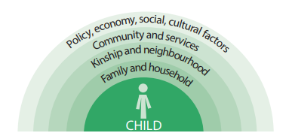
The Australian Early Development Census
A nationwide population census on young children's development in first year of school.
Data shows strengths and areas for improvement to support children and families.
Wholistic indictor of use for everyone in our ecosystem
Used for research, policy and service delivery. (Policy and research placemat.)
LAG
LEAD
Notes:
A child’s early development affects not just their childhood years but also lays a foundation for their adulthood lives. Therefore, investing time, effort and resources in children’s early years – when their brains are developing rapidly – brings lifelong benefits to them and to the whole community.
The Australian Early Development Census (AEDC) is a nationwide data collection that shows how young Australian children have developed as they start their first year of full-time school.
The data highlights what is working well and what needs to be improved or developed to support children and their families.
In the NT, AEDC data provides insights into early childhood development and helps validate solutions funded by the Child and Family Community Fund (CFCF) and supported by Child and Family Centres (CFCs).
The AEDC is a valuable lead and lag indicator of child development that can guide decisions of communities, service providers and governments about the holistic needs of children.

Slide 8
Who are the children in the AEDC data today?
AEDC collection year
AEDC collection year
The first AEDC collection year
2009
2021
2024
2027
2030
Children in utero
Children of the first collection are now 20 years old
Children are now 8 years old and doing NAPLAN this year
Children who are 2 years old
Children in Transition year level
Children who will ‘close the gap’ in 2030 are being born 2024 financial year.

Slide 9
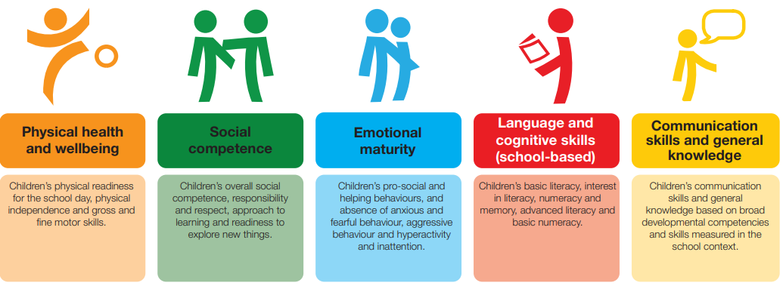
AEDC Domains
Notes:
The five AEDC domains provide a holistic picture of how children are developing and are predictors of children’s later health, wellbeing and academic development. The AEDC data measures five important areas of early childhood development:
physical health and wellbeing
social competence
emotional maturity
language and cognitive skills
communication skills and general knowledge (AEDC 2022).

Slide 10
Examples of the AEDC Questions
 | How many days absent were due to illness/injury? Is the child well-coordinated (i.e. moves without running into or tripping over things)?
 | Does the child know how to handle a book (e.g. turn a page)? Can the child draw or paint with crayons, paint brushes or pencils?
 | Is the child able to play with other children? Is able to adjust to changes in routine?
 | When the child speaks in their language, can adults understand? When adults speak to the child, can the child understand?
 | Does the child kick, bite or hit other children or adults? Will the child try to help someone who is hurt?
https://www.aedc.gov.au/researchers/early-development-instrument/2024-early-development-instrument

Slide 11
AEDC Overall Indicators
Three summary indicators
Three headline indicators
Children who are developmentally on Track on all five domains
Children who are developmentally vulnerable on one or more domains
Children who are developmentally vulnerable on two or more domains
Notes:
The AEDC uses three main summary indicators that reveal children's developmental strengths and vulnerabilities.
These reveal children’s developmental strengths (what is on track) and vulnerabilities (where there is the greatest need)
Developmentally at risk and vulnerable measurements can identify where additional support may be needed
Developmentally on track measurements can help identify where things are working well to support children’s development.
OT5 reflects children’s developmental strengths and recognises the importance of holistic development. It can help to identify where things are working well to support children’s development. DV1 and DV2 can be used to identify schools and communities experiencing the greatest developmental vulnerability.

Slide 12
Other measures
Transition indicators
children are settling in well to school
parents are engaged
children are read to at home
Early childhood education and care participation
Special needs diagnosis and requiring further assessment
Background
information
Special skills
or talents
Notes:
Transition indicators
children are settling in well to school
parents are engaged
children are read to at home
Non-parental early childhood education and care participation
Special needs diagnosis and requiring further assessment
Background information
Special skills or talents (AEDC 2022)

Slide 13
Facts about AEDC Data Collection
AEDC data collected every 3 years.
Survey by transition teachers & they must know the child for 4+ weeks.
Not a test; child presence not required.
Children’s identity kept private and secure.
Parents can exclude or withdraw their child’s data.
Cultural experts might be consulted for Aboriginal and Torres Strait Islander children.
Notes:
AEDC data is collected every 3 years.
Transition teachers observe children and fill out a survey for each child – it takes about 20 minutes to gather this information.
The transition teacher should have known the child for at least 4 weeks.
For Aboriginal and Torres Strait Islander children, teachers might talk to cultural experts.
It’s not a test and children do not need to be present.
Children’s identity is private and the data is kept secure and protected.
Parents can choose to not include their child and can withdraw their child's data at any time by contacting the school.
Children do not receive an individual assessment or results. The data is used for understanding all children in a community, leading to broader improvements such as services and support for kids and resource planning like new playgrounds and literacy programs.

Slide 14
The Framework for Governance of Indigenous Data
Iytwelepenty / Davenport Ranges National Park, Barkly Region
ALYAWARR, WAKAYA, KAYTETE AND WARUMUNGU COUNTRY

Slide 15
- Priority reforms
Formal partnerships and shared decision-making
Building the community-controlled sector
Transforming government organisations
Shared access to data and information at a regional level.
The principles of respect
for cultural heritage, informed consent,
privacy, and trust.
Notes:
Through the National Agreement on Closing the Gap, all agencies must work toward this goal. There are four priority reforms of the National Agreement focus on changing the way governments work with Aboriginal peoples.
Priority reforms are:
1. Formal partnerships and shared decision-making
2. Building the community-controlled sector
3. Transforming government organisations
4. Shared access to data and information at a regional level.
The Framework is based on the principles of respect for cultural heritage, informed consent, privacy, and trust.
It is informed by FAIR (Findable, Accessible, Interoperable, and Reusable) guiding principles on data management and CARE (Collective Benefit, Authority to Control, Responsibility, Ethics) principles which reflect the important role of data in self-determination.

Slide 16
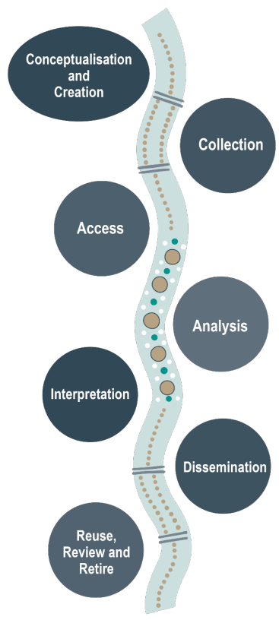
Framework for Governance of Indigenous Data
Indigenous Data Sovereignty (IDS): The right of Indigenous people to exercise ownership over Indigenous Data.
Developed to support Indigenous data governance across the Australian Public Service.
The framework is a data lifecycle
Notes:
Indigenous Data Sovereignty (IDS) refers to the right of Indigenous people to exercise ownership over Indigenous Data.
Ownership of data can be expressed through the creation, collection, access, analysis, interpretation, management, dissemination and reuse of Indigenous Data.

Slide 17
The guidelines
Partner with Aboriginal and Torres Strait Islander people
Build an inclusive data system
Provide knowledge of data assets
Build data-related capabilities
Notes:
The Framework for Governance of Indigenous Data has set guidelines that seek to influence behaviour, change current practices, and enable the APS and other agencies to work in partnership with Aboriginal peoples at all levels. Guidelines align with priority reforms of the National Agreement.
Guidelines are:
Partner with Aboriginal and Torres Strait Islander People
Build data-related capabilities
Provide knowledge of data assets
Build an inclusive data system
You need to be doing all of these things at each stage of the cycle.
These guidelines are informing the AEDC implementation plan and we will discuss each in the later slides.

Slide 18
Conceptualization and creation
AEDC started in 2009
AEDC Indigenous Adaptation Study (2007-9)
New national Aboriginal governance and partnerships
In NT: looking to formalise the great relationships?
Place-based child and family services across NT
Explore Two Way perspectives on child development as a starting point for understanding.

Slide 19
Conceptualization and creation
AEDC started in 2009
AEDC Indigenous Adaptation Study (2007-9)
New national Aboriginal governance and partnerships
In NT: looking to formalise the great relationships?
Place-based child and family services across NT
Explore Two Way perspectives on child development as a starting point for understanding.

Slide 20
Collection (2024)
Value the process!
Valuing the process as opportunity to strengthen practices:
Family and community engagement – knowing children, decision-making
Transitions from Preschool to Transition
Team teaching and leadership of Aboriginal staff and community members
Language learning –LBOTE and EAL/D
Teaching Planning cycle prepares for collection and use of the AEDC data
Additional learning needs and process for further assessment
Place-based child and family services - case study/relationship

Slide 21
Access
Redrawing geographic boundaries - so data is useful/available
Promoting data platforms - fit for purpose
Promoting access to other data and research
Who can help us?

Slide 22
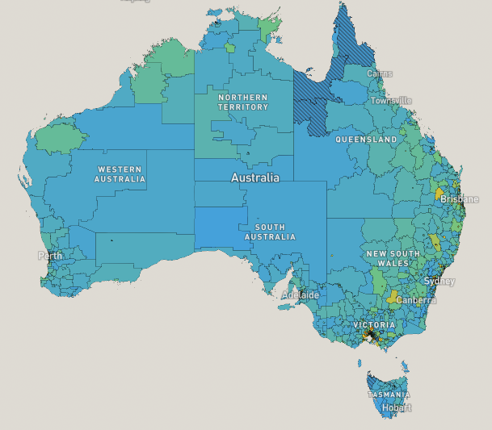
Access the AEDC and other data
There are a few ways to access AEDC data:
Free and publicly available data can be accessed from Data (aedc.gov.au), including the AEDC Data Explorer the AEDC National Reports and Community Profiles.
School Profile (through collaboration with Principal)
Australian Child Atlas
Story of our Children
Do these meet our needs?
Join a working group!
Notes:
There are a few ways to access AEDC data:
Free and publicly available data can be accessed from the AEDC Data Explorer the AEDC National Reports and Community Profiles.
Schools have their own reports based on their enrolments (School Profile). This data is not publicly available.
Australian Child Atlas (Australian Child and Youth Wellbeing Atlas n.d.).

Slide 23
Analysis and Interpretation
Community conversations - Place-based child and family services
Party with friends - Access and make sense of the data together
What sense does community make of the data?
What questions does community want to ask?
What stories does community want to tell?
What other data do we need? Who can help us?
Prepare the analysis - before the data is released April 2025
Take action - How do we know that to do in response to the stories?
Who can help us?
Never let a person or a number
stand alone!

Slide 24
Equipping front line practioners across Australia with the information they need to improve outcomes for children and families
Notes:
We are partnering with RSTO who had a role in creating the AEDC. They are providing the stepping stones between Population target’s and people’s daily work.
Working in social sector for over 20 years. First with SVA then FYA and now at MCRI.
MT asked me to share a little about the work we are doing here at MCRI, CCCH to better equip communities and service providers across the country with key information they need to improve outcomes for children and family
Program is known as RSTO

Slide 25
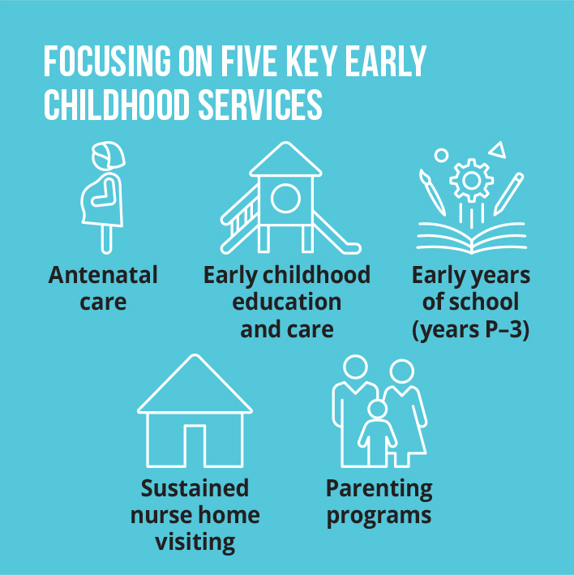
Early intervention and prevention: we can address intergenerational disadvantage by more equitable delivery of a ‘stack’ of 5 high quality, evidence-based services
Context
Moving from ad hoc delivery to a ‘stack’ of core services:
Continuous care: antenatal care, ECEC, early years of school
Complementary programs: parenting programs, sustained nurse home visiting
Not just one of these things, all of them
Delivered with the right quality, quantity and participation
Empowering service and community led decisions and action
Standardised evidence-based lead indicators
Supporting partners across community (service providers, government) to build their capability to collect, understand and use data to support shared decision and develop local solutions
Notes:
- RSTO aims to address this through more equitable service delivery across the early years by supporting the delivery of a ‘stack’ of 5 high quality, evidence-based services
- We focus on 5 key services – that are continuous pre birth – 8 as well as those that complementary – supporting families/ children with additional needs.
- Our research has demonstrated that by providing all of these services to children and families at the right quality, quant and dose there is increased benefit – currently reading and numeracy outcomes
- Unfortunately though not all services providers; policy makers; communities know what good looks like in all of these – they don’t have the right information (data) to know whether there is enough of these services available for the given population; they are delivered at the right quality or whether families and children are participating in them to get the right dose to be on track to achieve better outcomes.
- So RSTO’s focus in on empowering service providers and communities to understand how they are tracking by using a standard set of lead indicators – across quality, quant and part - and supporting them to use data to develop local solutions

Slide 26
Dissemination
Consulting to prepare the reports people need
- being prepared for release in April 2025
Presenting information in meaningful ways
- visualizations, stories, metaphors
Build in data-related capabilities
- AEDC great entry-level dataset for growing data literacy.
Promoting relationships with schools
- AEDC data is available via schools

Slide 27
Reuse, Review and Retire
Aboriginal perspectives on child development
Congruence?
AEDC has unmet potential for supporting Aboriginal people
– Professor Tony Dreise Pro Vice-Chancellor First Nations Engagement, Charles Sturt University
Understanding our data needs and AEDC
- strengths, limitations and need for improvement/alternatives.

Slide 28
Continuous Quality Improvement Strategy
Uluru-Kata Tjuta National Park, Central Region
ANANGU COUNTRY

Slide 29
The NT CQI Model
AEDC in the NT
is using this framework to articulate our work
Notes:
The figure shows the components of the NT CQI Strategy, with our guiding principles of cultural safety, cultural respect and culturally appropriate care encircling them. At the centre is the client, reflecting the central importance of the client, their family and community in CQI.

Slide 30
How can AEDC help you in these areas?











Notes:
SUPPORT - My role is to support people to use the AEDC data. What could support look like for you and your organisation for each of these things?
CULTURALLY APPROPRIATE / RESROUCES - What are culturally appropriate resources for communicating the data? What are culturally appropriate and community-led questions to ask and stories to tell about child development in particular places?
TEAM – can we use AEDC data as an opportunity to bring people together to talk about what matters, to strengthen relationships?
How can we be on each other’s teams? (All our jobs are too hairy to do on our own!)
SYSTEMIC USE OF DATA – How can we embed the use of AEDC data but also support everyone’s CQI to Close the Gap? – See Restacking the Odds
Many of the CTG and Generational Strategy actions in the NT are about growing data capability. Could AEDC because its holistic, publicly available and easy to understand be a useful introduction to data?
LEADERSHIP ACCOUNTABILTY – with RSTO and accountability of leaders, government, policy, decision-makers and services. What is the analysis we need to do, and the systemic use of data that will support that?
CULTURALLY RESPECTFUL – In how the data is collected, used and talked about. How the stories the data can tell can promote respect for Aboriginal perspectives on what is required of policy and services in the NT.
CQI EVERYBODYS BUSINESS – we have an ecosystem perspective. Using the promotion of the AEDC to reach out to everyone about the role they play in children’s development.
INFORMATION SHARING – we want this data to be put to work. The AEDC has much unmet potential for communities.
Can accessing AEDC help us access other public data for community use?
ABORGINAL ENGAGEMENT – I will segue into talking about how we are engaging with Aboriginal people on our data sovereignty journey.
And GOVERNANCE – We have made many friends, but we want to formalise a group that can guide our AEDC work in the NT and influence the national conversation.

Slide 31
Keep in touch
Please scan the QR code to connect or share your thoughts.
Karen Cieri
Assistant Director
Australian Early Development Census
NT Department of Education and Training
karen.cieri@education.nt.gov.au or 0428 718 981
Thank you!

