Slide 1


Learning from history for a brighter future for our mob
Presentation to AMSANT CQI Collaborative, Garamilla/Darwin, Larrakia Country
October 2024
Donna Ah Chee, Chief Executive Officer

Slide 2
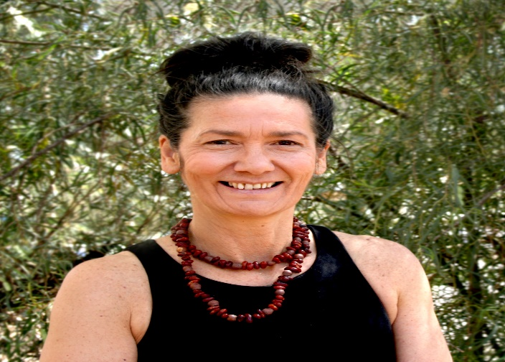
Introduction and acknowledgment of Country
Ms Donna Ah Chee
Chief Executive Officer
Central Australian Aboriginal Congress

Slide 3
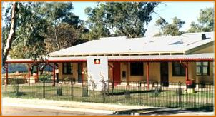
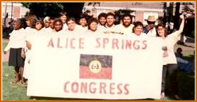
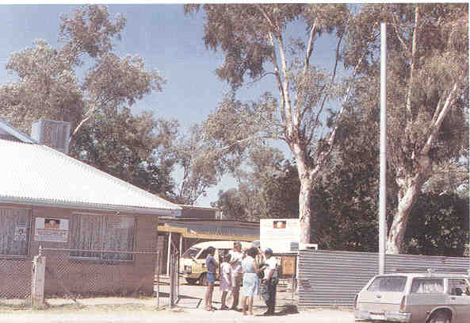
Overview
Learning from history
Establishing the Alukura Midwifery Group Practice
Strengthening Child Health

Slide 4
1. LEARNING FROM HISTORY

Slide 5
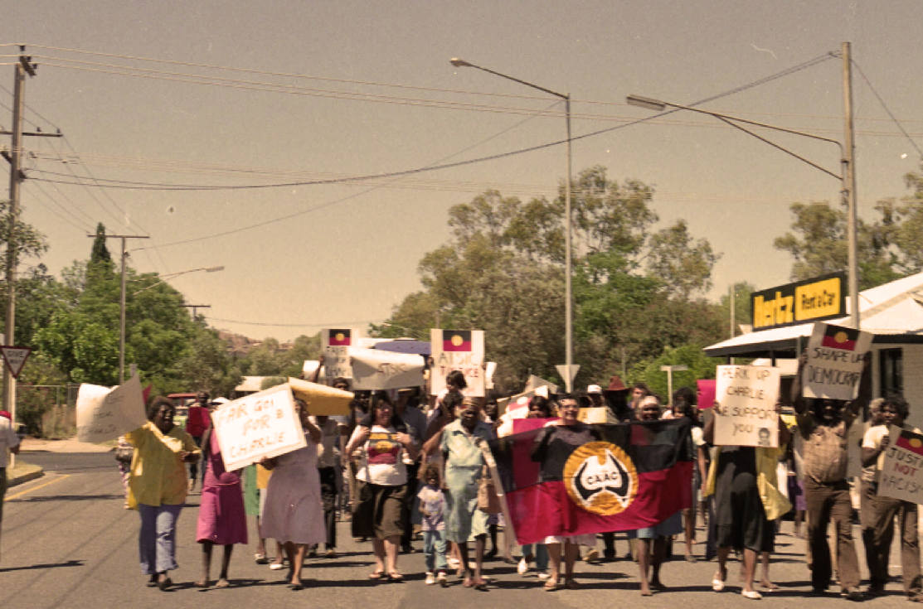

50 years of Aboriginal Community Controlled Health Services in Central Australia
What have we achieved, and what have we learnt?

Slide 6
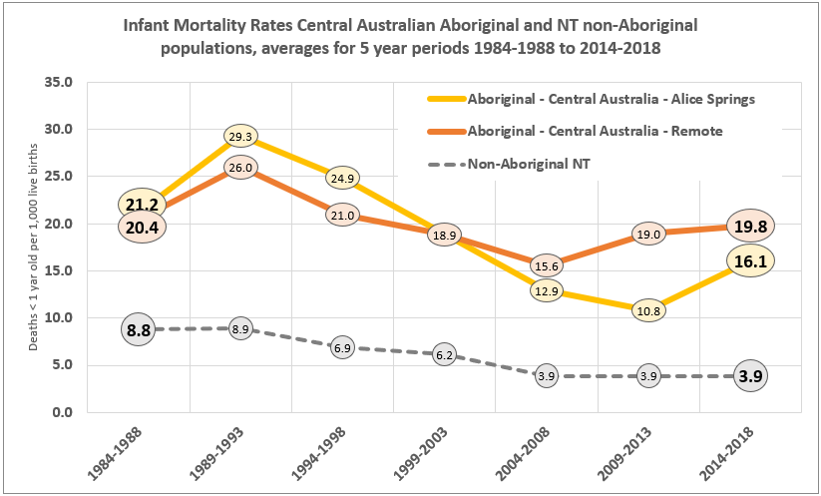
Infant Mortality – Central Australia
1964-1971: Aboriginal IMR in Central Australia = 172 deaths per 1,000 live births

Slide 7
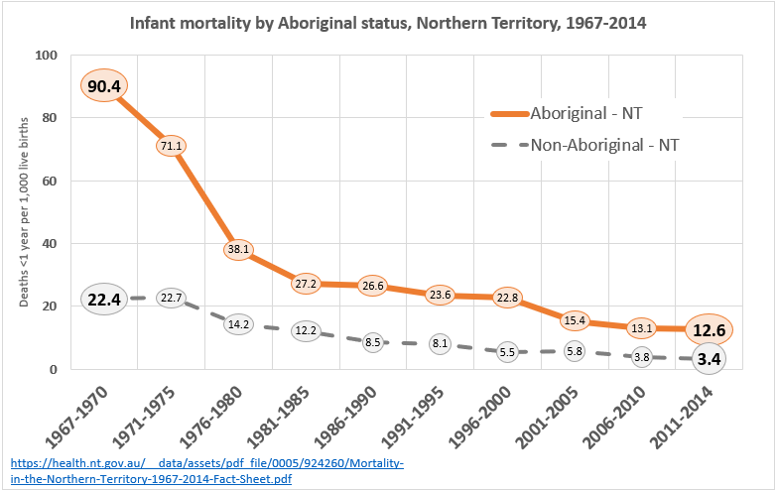
Infant Mortality – all Northern Territory

Slide 8
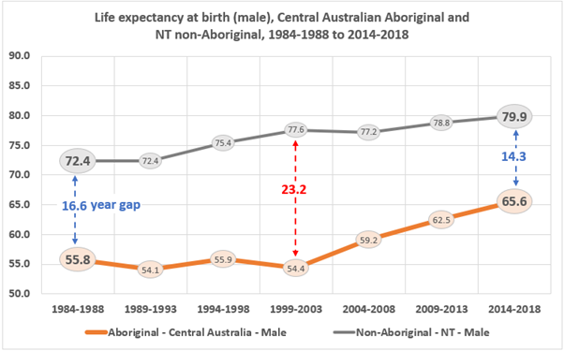
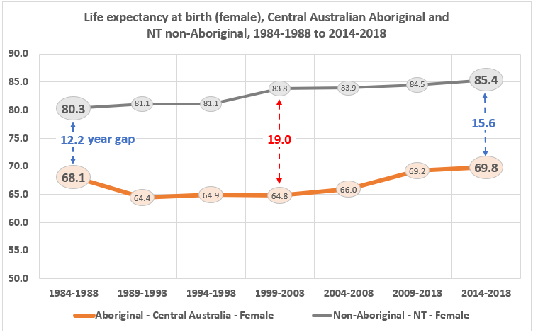
Changes in health: Life expectancy

Slide 9
Why culturally safe birthing is preventive heath care
Key maternal outcomes data over decades shows the need for a culturally responsive model providing midwifery continuity of care.
Birthweight
Pre-term labour
Tobacco and Alcohol consumption in pregnancy
Births in hospital
Teen pregnancies
Overall life expectancy

Slide 10
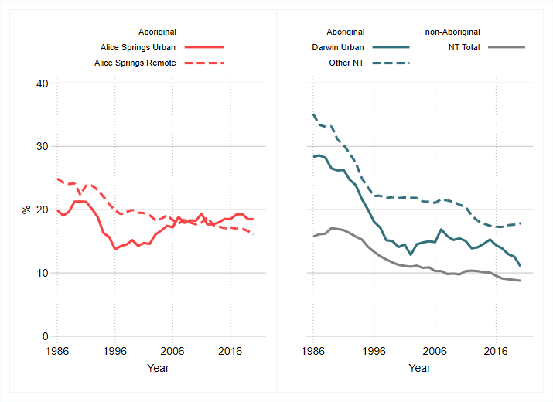
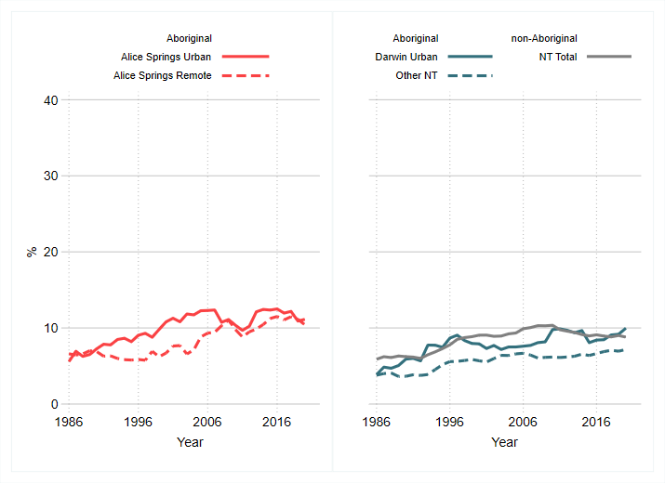
Birthweight
Low birthweight
High birthweight

Slide 11
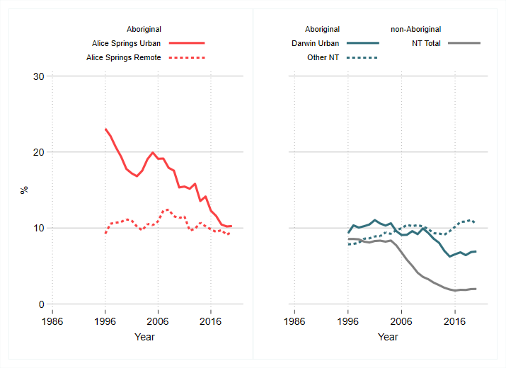
Alcohol consumption in pregnancy

Slide 12
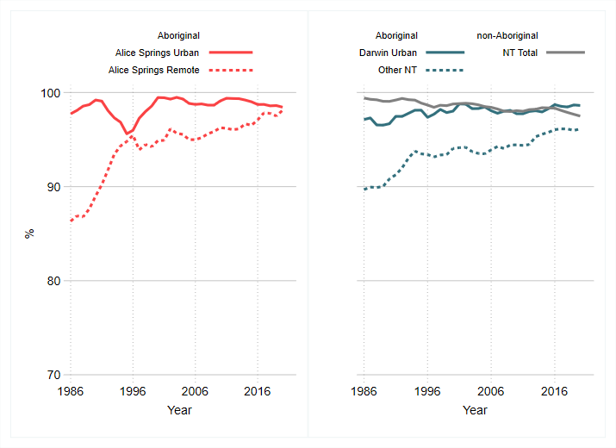
Births in hospitals

Slide 13
2. ESTABLISHING ALUKURA MGP

Slide 14
Alukura: By the Grandmothers’ Law
For Aboriginal mothers and babies in Central Australia, colonisation continues to be reflected in poorer outcomes and inequities in health, pregnancy and childbirth.
Alukura was established by the Central Australian Aboriginal Congress following extensive consultation with Aboriginal women from all areas of Central Australia
Women from across the region expressed strongly that the cultural issues they experienced accounted for poor maternal outcomes, and that their business – Women’s Business – must be sustained as it was traditionally, before colonisation
First Birthrights conference held in Alice Springs in 1984; following this, a report and funding submission presented to the Commonwealth Department of Health and the Department of Aboriginal Affairs
Planning and lobbying through the late 1980s to form Congress Alukura; Alukura Council formed in 1986-87
Alukura is an Arrernte word meaning ‘women’s camp’
Purpose of Alukura:
  Provide culturally responsive antenatal, postnatal and women’s health care
  Seek funding for birthing service.

Slide 15
A strong message was provided to government following the Birthrights conference:
We the Aboriginal women of Central Australia have all said the same things.
We have all said that the Aboriginal beliefs and practices of childbirth are radically different to Western methods.
Childbirth has its beginnings in the dreamtime and as a result we have different meanings and language for childbirth. For us, childbirth as a whole is a part of our Dreamtime and traditional Law.
We have said how we feel shame in the hospital without our grandmother’s Law, male doctors, the strange surroundings in hospital, not knowing what is happening, being left alone with no grandmothers' or aunties which would be the case in Aboriginal tradition to help us, with a lack of interpreters to explain the actions taken by medical staff while in hospital. We feel sad and sorry by not being able to use our traditional birthing ways, which have been developed over thousands of years and still used today.
We Aboriginal women want control over our own birth business as a whole, and we strongly ask for our Aboriginal Law and traditions to be used alongside the western way.
We want the government to fund a Congress Alukura.

Slide 16
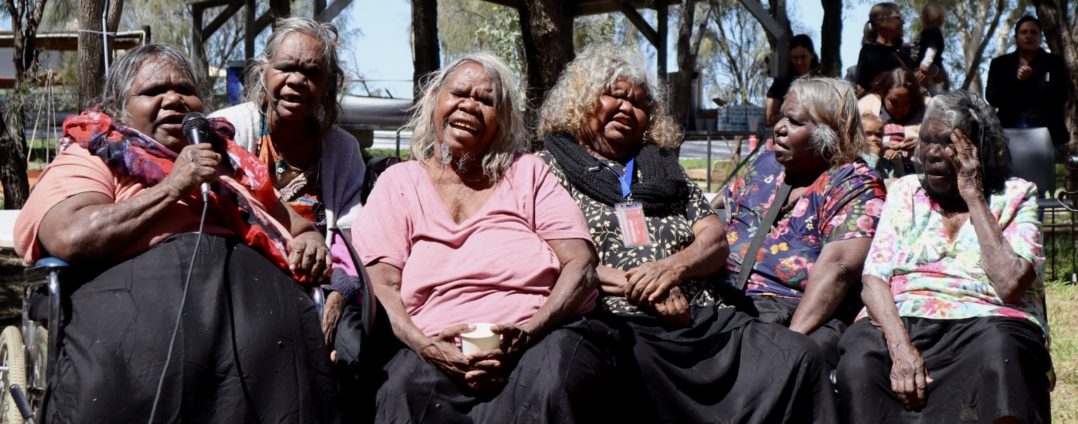
Alukura: By the Grandmothers’ Law
The underlying philosophy of Alukura since this time is that:
Aboriginal people are a distinct and viable cultural group with their own cultural beliefs and practices, Law and social needs
Every woman has the right to participate fully in her pregnancy and childbirth care, and determine the environment and nature of such care
Every Aboriginal woman has the right in pregnancy and childbirth to maintain and use her own heritage, customs, language and institutions

Slide 17
Birthing at Alukura: Past attempts to establish a midwifery group practice
Recommendation by DAA in Alukura Review 1, 1989 that:
Alukura expand its organisation and functions to fully implement women’s preference for their own alternate health and birthing service that fostered cultural support by providing a service run by women: Women’s health is strictly women’s business.
Alukura maternity service, 1993 to 1997
  17 births at Alukura
  Births attended by midwives, traditional grandmothers, support person, GP
  Provision of antenatal and postnatal care
Birthing ceased in 1997 due to an inability to recruit doctors and midwives with sufficient skills and experience for birthing in such setting
Alukura continued to provide antenatal and postnatal care

Slide 18
Birthing at Alukura: Past attempts to establish a midwifery group practice
Alukura Review 2, 1998; Maternity Service 2002-2005
Second review of Alukura found:
  Alukura was recognised as playing a key role for Aboriginal women
  Quality of care considered to be technically high, culturally appropriate and sensitive
  Many young Aboriginal women’s preferred place for birthing was Alice Springs Hospital
Maternity service (MGP) 2002 – 2005
  Birthing service recommenced with agreement with Alice Springs Hospital (ASH) that would enable Alukura midwives to maintain accreditation for small number of Alukura births
  Visiting privileges for Alukura midwives to ASH as Independent Midwives to birth with low risk women
  Manage births of eligible Alukura clients at ASH (improved continuity of care)
  88 births from 2002-2005; critical incident in 2005 led to temporary cessation of birthing service and review of ASH birthing agreement
  Key issue: clinical governance

Slide 19
Birthing at Alukura: Past attempts to establish a midwifery group practice
Alukura MGP 2010-2011
Maternity group practice re-established in 2010
  Updated birthing agreement with Alukura midwives under direct clinical supervision of ASH obstetricians
  Alukura midwives part of ASH orientation, induction and professional development
  Birthing for high and low risk women to ensure skills maintenance for all births
  Provision of higher level of continuity of care
Ceased in 2011 due to shortage of midwives eligible for Medicare billing and capable of birthing at both Alukura and Alice Springs Hospital
Whilst we had done well in providing quality antenatal and postnatal care, we had not been able to consistently integrate this with birthing in a sustainable way.

Slide 20
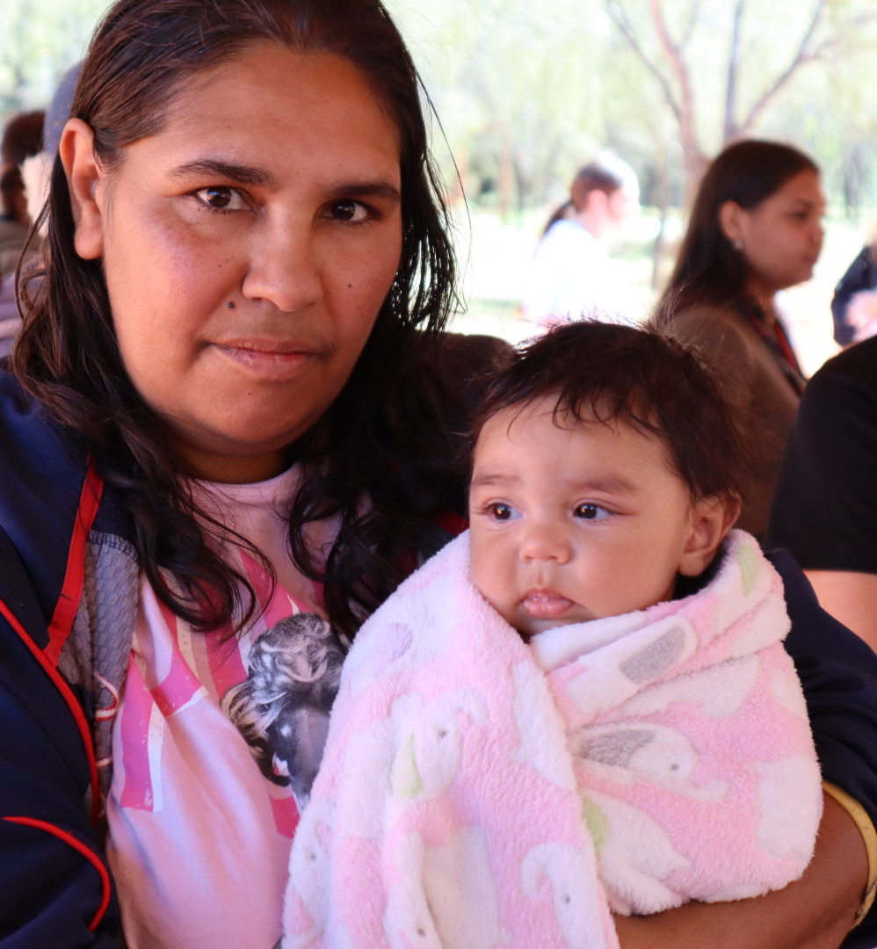
Establishment of Alukura Midwifery Group Practice
In late 2023, the long-held vision of the Alukura Grandmothers came to fruition with the commencement of the Alukura MGP
Working in partnership with MyMidwives and NT Health
Funded by the First Nations Health Division, Commonwealth Department of Health and Aged Care
Since establishment in September 2023, 94 births have been supported
Close to 110 women enrolled in Alukura MGP to September 2024
There are already 28 antenatal bookings so far for 2025, with a further 26 bookings left for the end of this year (2024).

Slide 21
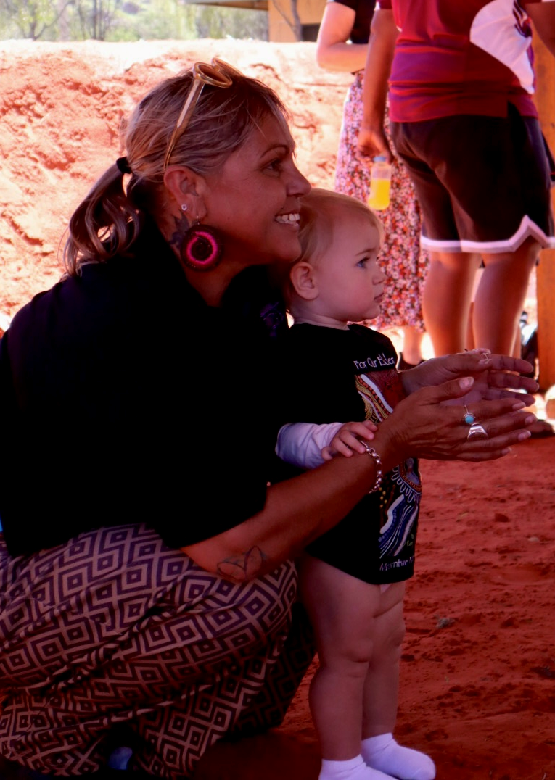
The Alukura MGP Model
Six credentialed Endorsed Midwives provided by MyMidwives
Aboriginal Maternity Care Workers
Social Worker
Diabetes Nurse Educator
Psychologist
Resources to reinvigorate the Alukura Grandmothers
Regular drop-in Cultural Days as part of the model:
  On-site at Alukura with Grandmothers and Aunties
  Diabetes Nurse Educator, Psychologist, AMCWs, Midwives, Social Worker and other programs/services
  Opportunity for peer support

Slide 22
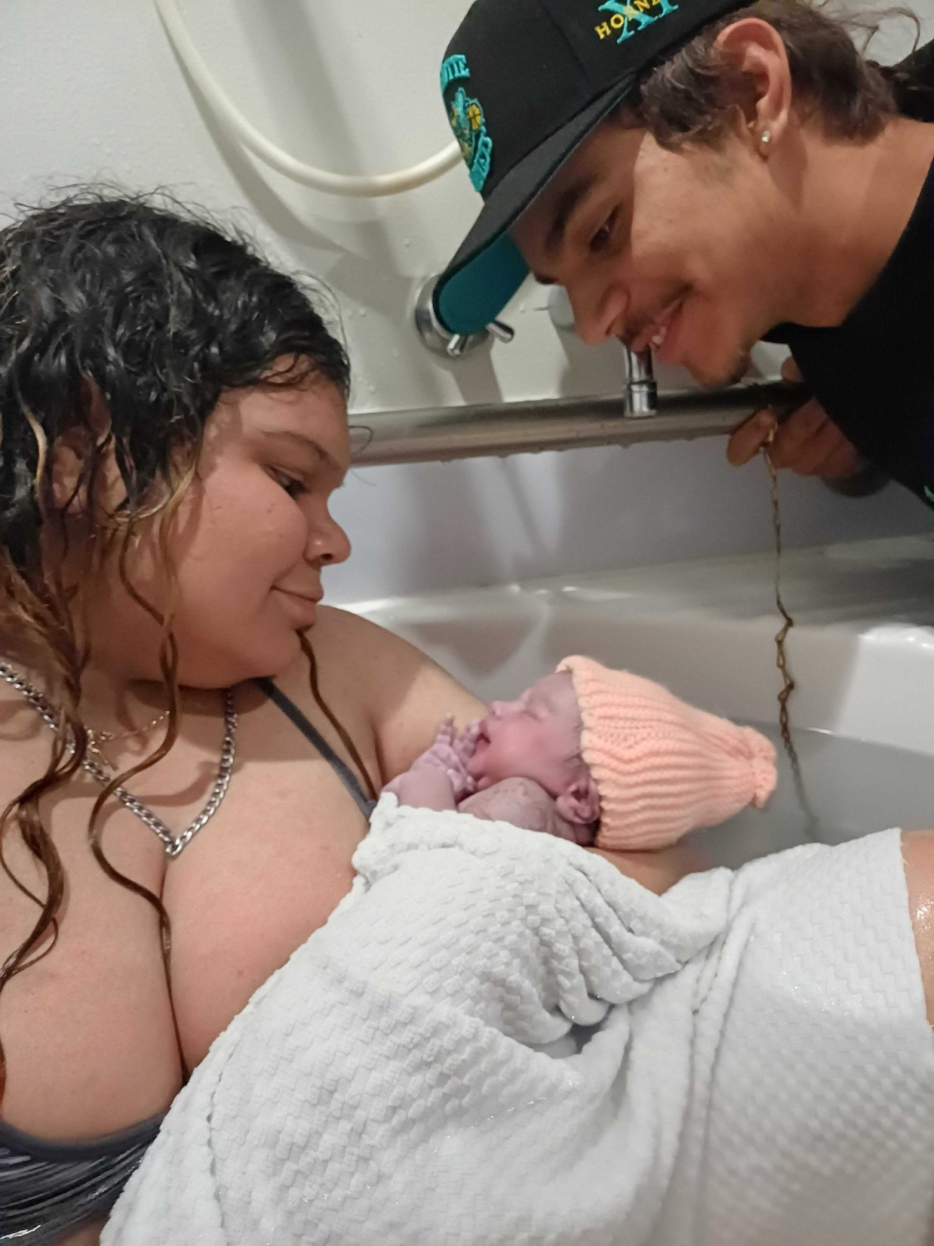
Why the Alukura MGP Model is best for Aboriginal Women
Midwives are on-call to provide care and respond to the needs of women 24/7
Midwives are fully endorsed and experienced working independently and have a wider scope of practice which ensures they are the women's main antenatal care provider, in consultation with Obstetric colleagues
Pre-term births are reduced because the Midwives can respond quickly to matters at all hours that may trigger pre-term births rather than women having to wait for their next appointment
The women and Midwives build a strong relationship which leads to continuity of care for vulnerable women and their families which makes a significant impact on the health outcome for the mother and baby
Medicare rebate for Midwifery Services helps support this model with additional funding

Slide 23
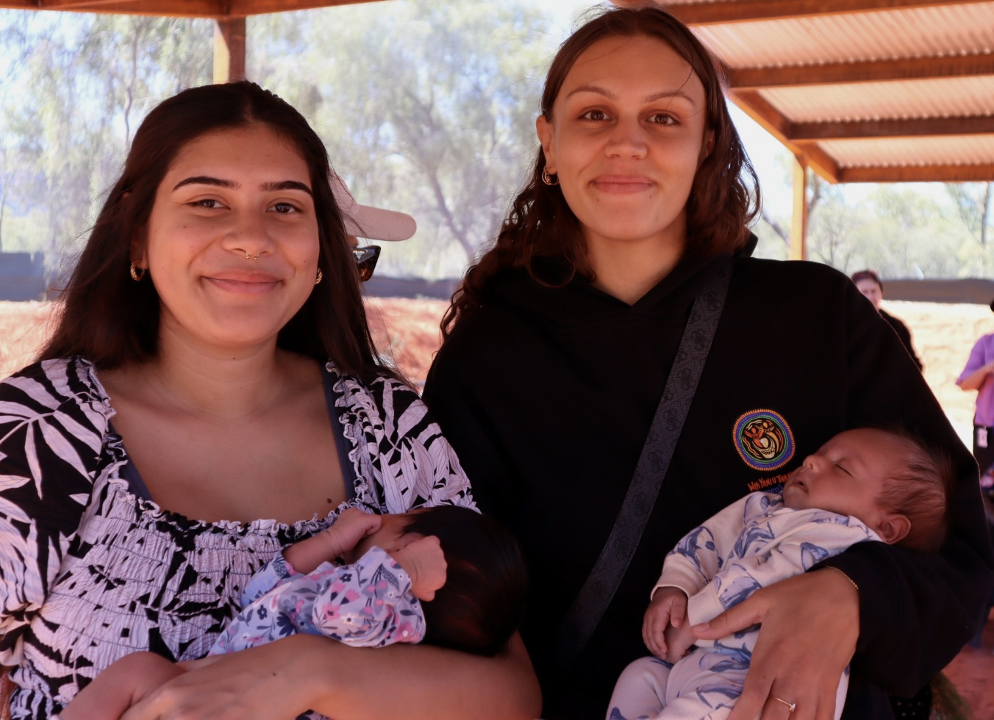
Evaluating outcomes
It’s early days, but we are confident of the impact of this culturally responsive model in providing continuity of care for improved outcomes for mothers and babies.
Congress and the Molly Wardaguga Research Centre will use data linkage and qualitative methods to evaluate outcomes
This evaluation will take a Participatory Action Research approach
It is expected we will see outcomes in:
  Reduced preterm labour
  Improved birthweights
  Reduced interventions in childbirth
  Reduced perinatal/infant mortality
All past reviews showed that Aboriginal women in Central Australia want this model.

Slide 24
3. STRENGTHENING CHILD HEALTH

Slide 25
Strengthening child health
Improving outcomes for our little ones has taken a coordinated focus and a CQI approach to the way we do child health at Congress.
Restructuring child health
The role of Community Connectors in supporting Aboriginal families
Focusing on data
Driving improvements to child immunisation rates, ASQ-Traks and child health checks

Slide 26
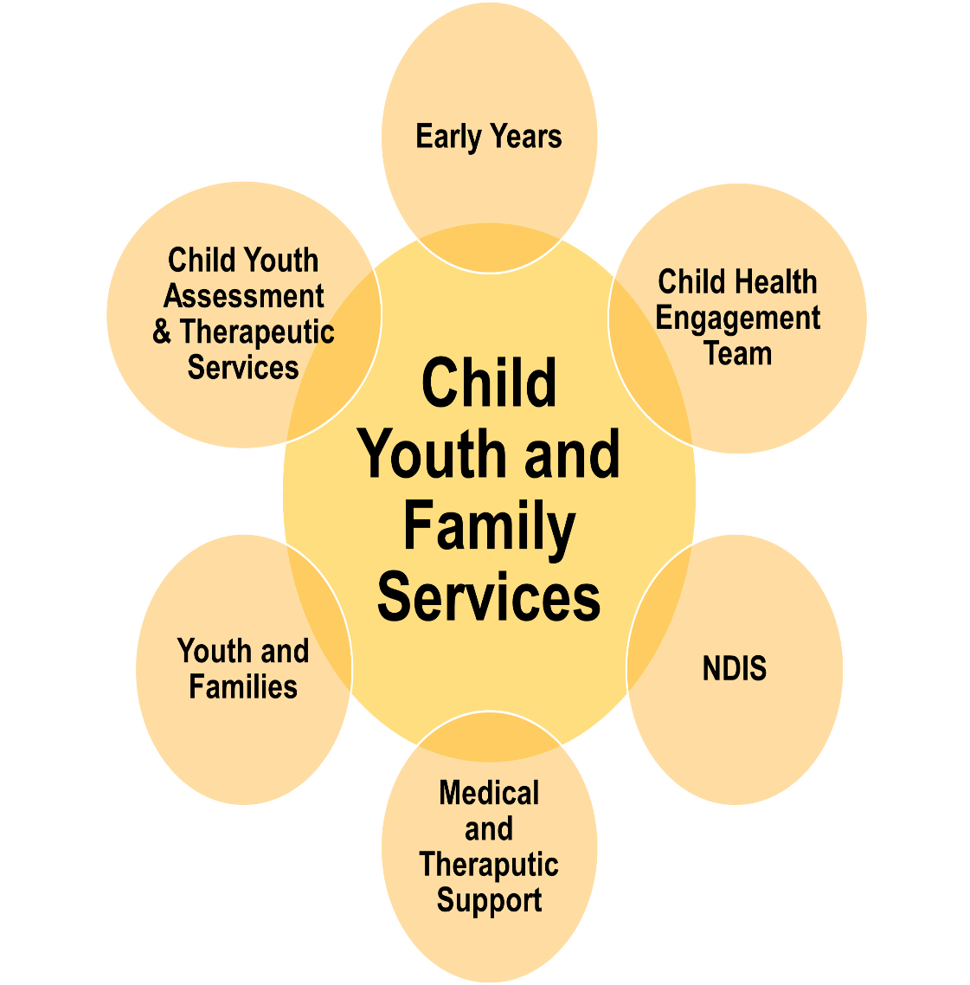
Establishing the Child Health Engagement Team
The Child Health Engagement Team was established in April 2023, as a new section within our Child, Youth & Family Services Division.
CHET integrates a range of child health functions and positions, including:
Child Health Nurses (x3)
Preschool Transport and Engagement Officer (x1)
Early Years/Preschool Engagement Officers (x2)
Connected Beginnings Community Connectors (x2)
These positions report to the Child Health Engagement Manager.

Slide 27
Making the right connections
Supporting Aboriginal families: the role of Community Connectors
Children attending appointments with our Child Health Nurses will be booked in for immunisations, ASQ-Trak and/or a child health check
Child Health Nurses provide appointment list to Community Connectors
Community Connectors lead engagement with families, providing outreach and transport where required to support families to attend appointments
Child Health Nurses and Community Connectors are continuously collaborating to increase the number of child health checks, ASQ-Traks and immunisations.

Slide 28
Focusing on the data
Merging of all Congress Communicare databases into one database, Congress Communicare
Data cleaning by our Immunisation Nurse
Uploading data to the Australian Immunisation Register (AIR)
Staff education and support by our CQI team
Using generic recalls

Slide 29
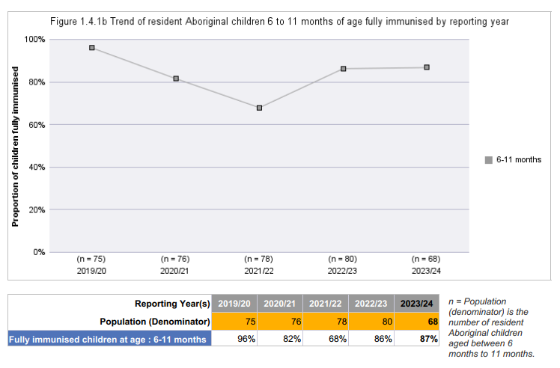
Improvements to child immunisation rates
Alice Springs, 6-11 months

Slide 30
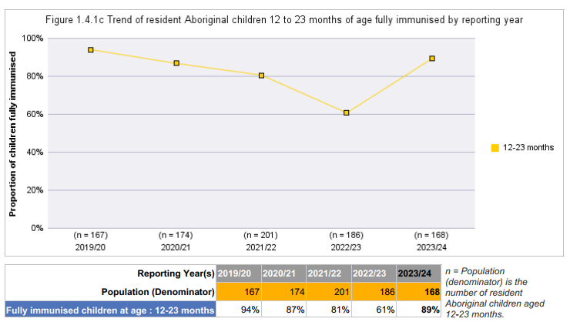
Improvements to child immunisation rates
Alice Springs, 12-23 months

Slide 31
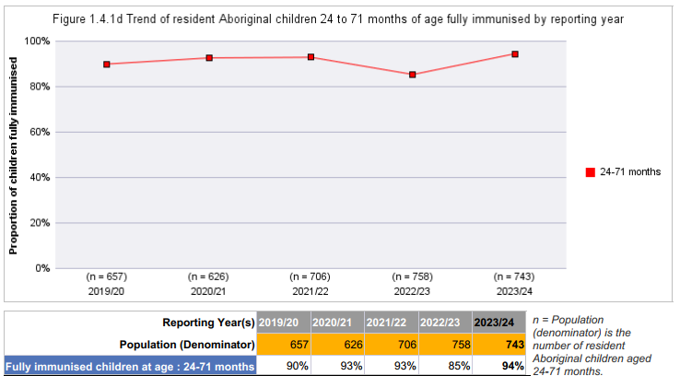
Improvements to child immunisation rates
Alice Springs, 24-71 months

Slide 32
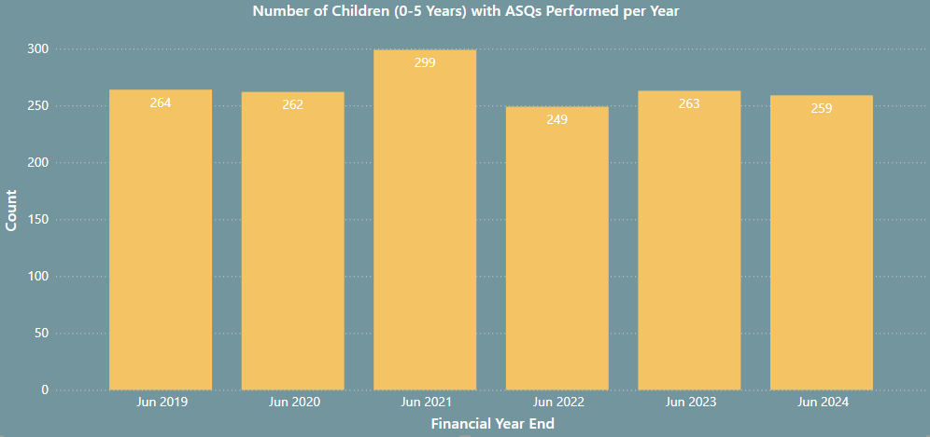
Sustained focus on ASQ-Traks

Slide 33
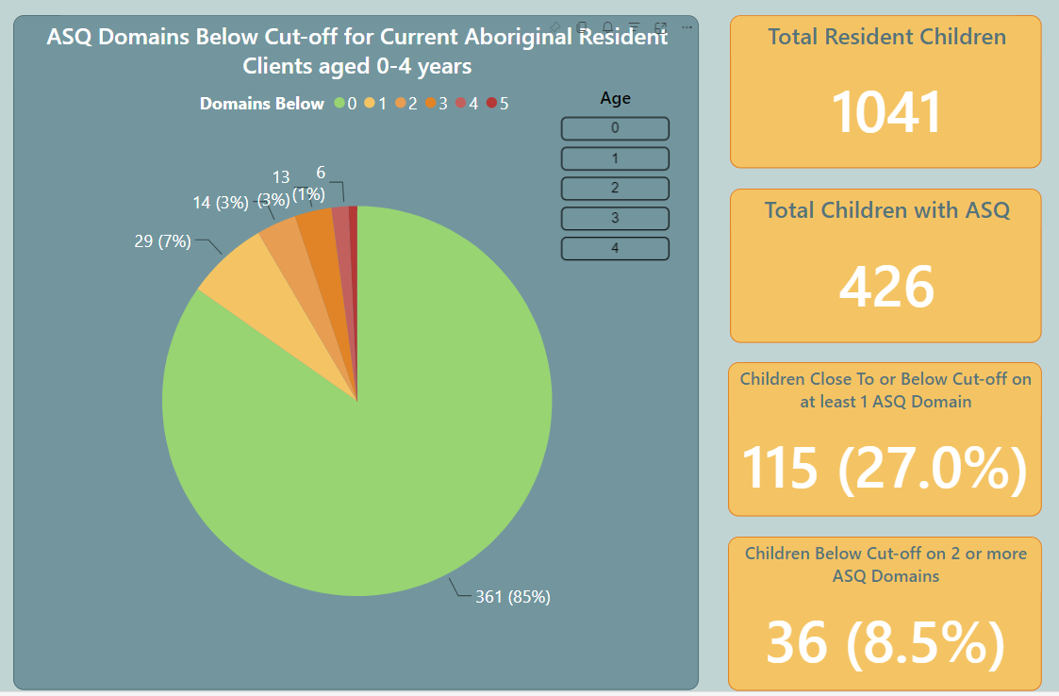
Sustained focus on ASQ-Traks

Slide 34
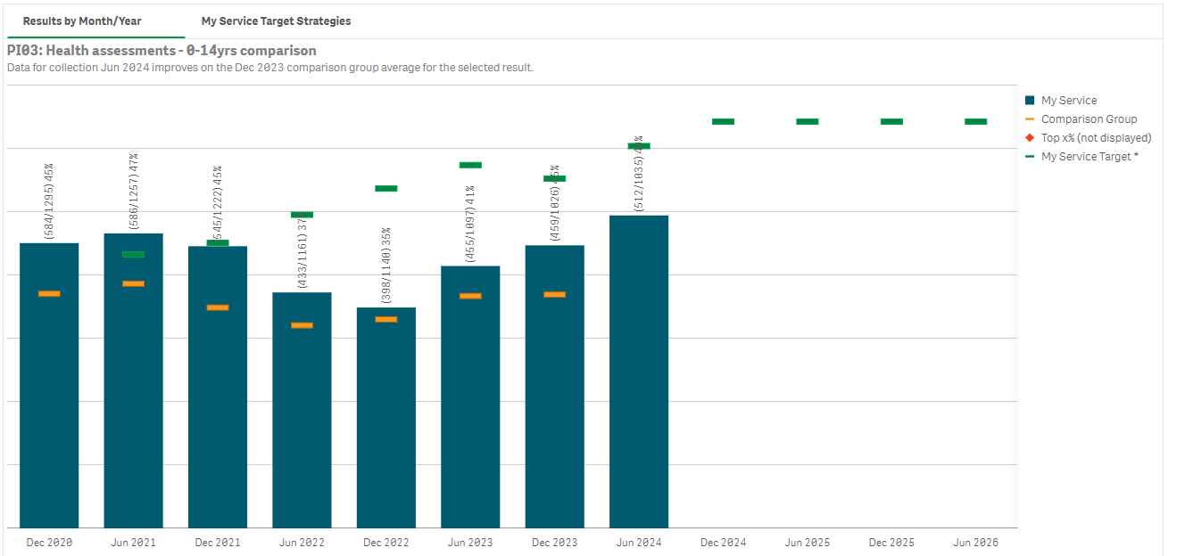
Child Health Checks

Slide 35
Questions?

